Slide 1
WIOA Adult Eligibility
June 1st, 2023

Slide 2
Objective
The primary objective of this presentation is to inform the audience about the details around Workforce Innovation and Opportunity Act (WIOA) Adult Eligibility.

Slide 3
Federal Guidance
Workforce Innovation and Opportunity Act (WIOA) of 2014.
Training and Employment Guidance Letter (TEGL) 19-16 – Guidance on Services Provided through Adult and Dislocated Worker under WIOA – dated March 1st, 2017.
TEGL 07-20 – Implementation of Priority of Service in WIOA Adults – dated November 24th, 2020.

Slide 4
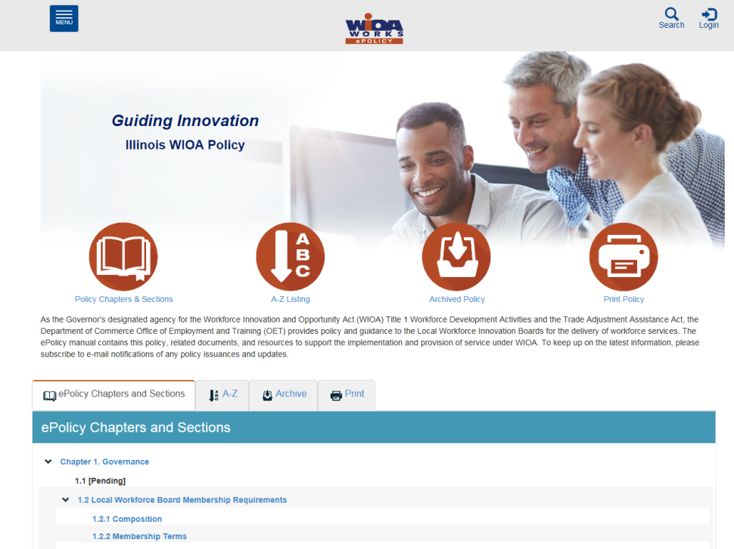
Understanding the ePolicy Manual
The Illinois Department of Commerce and Economic Opportunity, Office of Employment and Training (OET) utilizes a WIOA ePolicy portal where all current and new guidance issued by the Illinois Workforce Innovation Board (IWIB) and OET will be maintained.
Homepage: www.illinoisworknet.com/DCEOPolicies

Slide 5
State Policy Guidance
Office of Employment and Training (OET) WIOA ePolicy Chapter 5.1 – WIOA General Eligibility
OET WIOA ePolicy Chapter 5.1.1 – Compliance with Selective Service
OET WIOA ePolicy Chapter 5.2 – Adult Eligibility
OET WIOA ePolicy Chapter 5.5 – Low Income Eligibility
OET WIOA ePolicy Chapter 5.9 – Basic Skills Deficiency Assessment Requirements

Slide 6
WIOA Adult Eligibility
WIOA ePolicy Chapter 5.2 – Adult Eligibility
WIOA Legislation requires that an Adult be 18 years of age or older.
Be a citizen or noncitizen authorized to work in the US; and
Meet Military Selective Service registration requirements (individuals born male only).

Slide 7
WIOA Adult Priorities
WIOA Adult clients who meet WIOA Low-Income criteria are a priority under WIOA Legislation.
WIOA Adult clients who are determined “Basic Skills Deficient” (BSD) or are considered “English Language Learners” (ELL) are a priority under WIOA Legislation.
It is important to understand that Low-Income, BSD & ELL are equal priorities under the Adult title.

Slide 8
Veterans Priority of Service
As was addressed in the WIOA General Eligibility presentation, based on guidance in the Jobs for Veterans Act, a Veteran or Qualified Spouse of a Veteran must receive priority of service over other qualified individuals who are not a Veteran or Qualified Spouse of a Veteran.

Slide 9
Adult Priorities Must Be Followed at all Times
Veterans and eligible spouses who meet WIOA low-income criteria or are BSD or ELL.
Individuals who are not veterans, who meet WIOA low-income criteria, or are BSD or ELL.
Veterans or eligible spouses who do not meet WIOA low-income criteria and are not BSD or ELL.
Non-veterans who do not meet WIOA low-income criteria or BSD/ELL criteria

Slide 10
DOL TEGL 7-20
Department of Labor issued TEGL 7-20, Implementation of Priority of Service in WIOA Adults in November 2020:
This guidance issues a threshold for each state (which in turn will be monitored down to each LWIA,) to serve at least 75% of their Adult population in one or more of the priority groups of Low-Income, Basic Skills Deficient (including English Language Learners), as well as Veterans or Qualified Spouse of a Veteran.

Slide 11
DOL TEGL 7-20 – Tracked by Exiters
Department of Labor issued TEGL 7-20, Implementation of Priority of Service in WIOA Adults in November 2020:
Closer examination of TEGL 7-20, it was noted that DOL will be tracking this Adult Priority based on Adult Exiters in PY20 (7-1-20 – 6-30-21) to capture a baseline on how each state (and each LWIA) has been doing regarding serving Adult clients who have met the WIOA Adult Priorities outlined in the WIOA legislation.

Slide 12
PY20 Adult Exiters
Below were how the PY20 exiters numbers were reported (exited on or after 7-1-2020 through 6-30-21) - number of Adult exited clients who had met one or more of the Adult Priorities:
State-wide: 3,424 total – 3,137 who met priority = 91.6%
LWIA 24: 110 total – 94 met priority = 85.5%
LWIA 25: 51 total – 51 met priority = 100%
LWIA 26: 99 total – 92 met priority = 92.9%

Slide 13
PY21 Adult Exiters
Below were how the PY21 exiters numbers were reported (exited on or after 7-1-2021 through 6-30-22) - number of Adult exited clients who had met one or more of the Adult Priorities:
State-wide: 4,292 total – 3,925 who met priority = 91.4%
LWIA 24: 120 total – 114 met priority = 95%
LWIA 25: 69 total – 69 met priority = 100%
LWIA 26: 83 total – 78 met priority = 94%
Note: These reported FY21 Adult exiter counts were as of 11-29-2022

Slide 14
DOL TEGL 7-20 – Tracked by Exiters
Department of Labor issued TEGL 7-20, Implementation of Priority of Service in WIOA Adults in November 2020:
For those working with the Adult title, you must be aware of these priorities and ensure you are following the priorities.
From reviewing the results in PY20 and PY21, you folks are doing an excellent job with the implementation of priority of service for WIOA Adult clients.

Slide 15
Report for Tracking Adult Priorities
A report under the Reporting Menu (Participant Reports), called Non-Priority 1A Adult Report:
This report allows each LWIA the ability to run a report, for a given period that identifies the clients who are currently being served under the Adult Funding stream that had not met any of the WIOA Adult priorities.
See the next slide for a screen print of the report criteria screen.

Slide 16
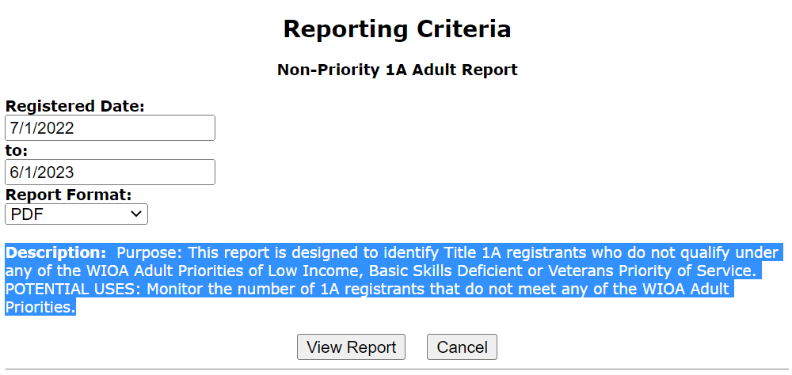
Non-Priority 1A Adult Report
See the report description for indication of report purpose and uses:

Slide 17
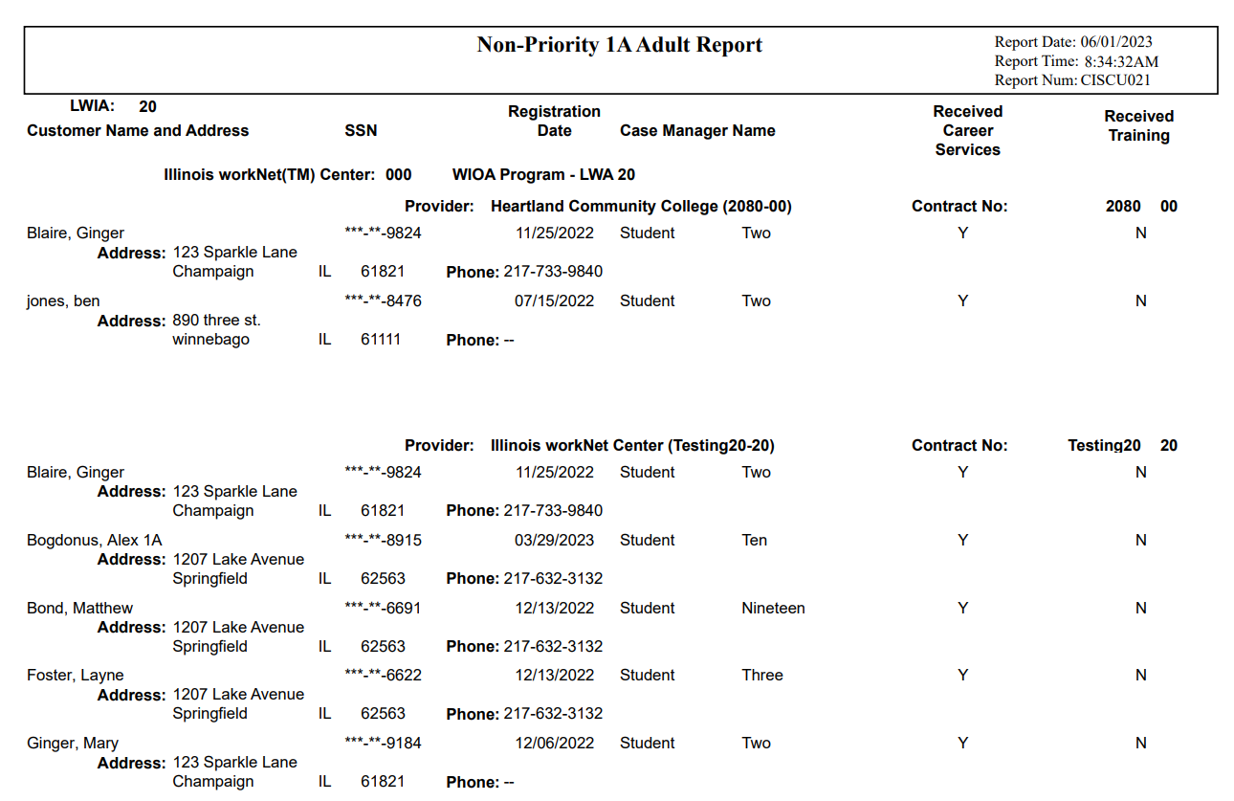
Example of Non-Priority 1A Adult
Due to PII, example report is out of the “Training Platform” of IWDS.
As shown, the report results provide the details about the Adult Clients who had not met any Adult Priority that has been Registered during the selected time frame.

Slide 18
Another Report in Development to Track Adult Client Priorities
There is another new report currently in development that will have an option to be ran by LWIA, program year and either by Registrant or Exiter, showing how the LWIA has done or is doing serving Adult clients who meet one or more of the Adult Priorities.
This report will also provide a detailed numeric breakdown on how the Adult clients have met the different Adult Priorities during the selected reporting period.

Slide 19
WIOA Low Income
As was addressed in the WIOA Low Income presentation, below are the six different ways an Adult client could meet WIOA Low Income criteria:
Cash Welfare
Food Stamps
Homeless
Foster Child
Family Low-Income Determination
Family of One Due to a Disability

Slide 20
Adult Priority Due to Low Income
If a qualified Adult client meets any one or more of the six WIOA Low-Income criteria shown on the previous slide, they should be certified under Adult Low-Income and receive priority under the WIOA Adult title.

Slide 21
Basic Skills Deficient Definition
Basic Skills Deficient (BSD) – respect to an individual—
who is a youth, that the individual has English reading, writing, or computing skills at or below the 8th grade level on a generally accepted standardized test; or
who is a youth or adult, that the individual is unable to compute or solve problems, read, write, or speak English, at a level necessary to function on the job, in the individual’s family, or in society.

Slide 22
Basic Skills Deficient
As was covered in the standalone presentation on Basic Skills Deficient (BSD), there are three different ways an Adult client could meet the WIOA Adult Priority tied to BSD:
Scoring at or below 8th Grade Level Equivalency (GLE) on their pre-assessment math or reading tests.
Being determined BSD due to the Basic Skills Screening Tool.
If an Adult Client is assessed as an English Language Learner (ELL).

Slide 23
Adult Priority due to BSD
If a qualified Adult client meets any one or more of the three WIOA Basic Skills Deficient (BSD) criteria shown on the previous slide, they should be certified under Adult BSD and receive priority under the WIOA Adult title.

Slide 24
Co-Enrolled Adult Client
WIOA Adult clients who meet the priority of services – (Low-Income and/or Basic Skills Deficient) could be co-enrolled with an age appropriate Youth title or a Dislocated Worker title to break up funding of services:
If this is done, the client cannot exit from one title until services from all titles are completed.
If this is done, the client would fall into performance outcomes for each title that the client is registered.
Note, if an Adult client does not meet one of the Adult Priorities, but meets either Youth or Dislocated Worker criteria, they should not be served under the Adult title.

Slide 25
Overview
To recap, for overall WIOA Adult Eligibility a client must be 18 years of age or older, be legally authorized to work in the U.S. and if born a male, who was born on or after 1/1/1960, must be compliant with Selective Service requirements.
However, it is important that the priorities laid out in the OET WIOA Adult Policy are always followed, meaning:
Veterans Priority of Service must be followed.
Any qualified Adult who meets WIOA Low-Income criteria or is Basic Skills Deficient or is considered an English Language Learner must receive priority to eligible Adults who do not meet the priorities laid out.

Slide 26
Questions
This concludes the presentation on WIOA Adult Eligibility.
If you have questions related to this presentation, feel free to contact me at James.potts@Illinois.gov or you can phone me at (217) 416-7097.

