Slide 1
Building a Client in IWDS
June 22nd, 2023

Slide 2
Objective
The primary objective of this PowerPoint is to demonstrate the steps required for completing an application for a Workforce Innovation and Opportunity Act client from start to finish in Illinois Workforce Development System.

Slide 3
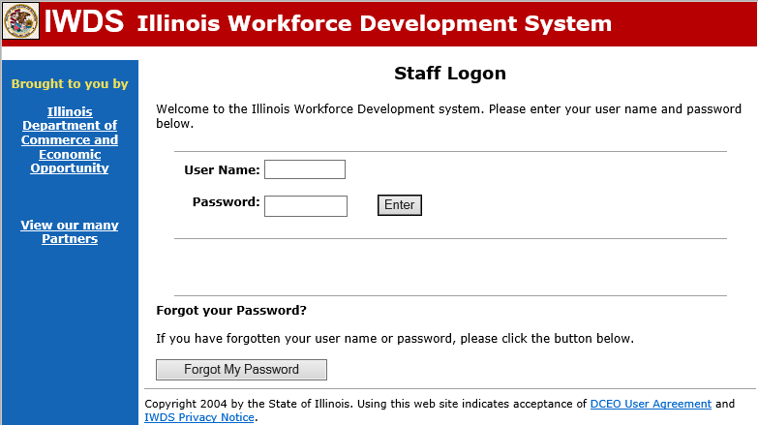
Illinois Workforce Development System
The Illinois Department of Commerce and Economic Opportunity, Office of Employment and Training (OET) utilizes Illinois Workforce Development System (IWDS) as the system of record for all WIOA and Trade records.
Directly below is the URL to IWDS:
https://iwds.dceo.illinois.gov/iwds/staffhome.html

Slide 4
IWDS Access
The Career Planner staff who have responsibility for creating the record in IWDS must have an active IWDS User ID
The individual who has the role of Local Systems Administrator within IWDS at each LWIA will set up the various IWDS accounts for the staff at the LWIA
When the IWDS User ID is created, a user ID name and temporary password are provided

Slide 5
Active/Inactive IWDS Account
When an IWDS User account has been created, the owner of that account must log in to their IWDS account at least once every 35 days or the IWDS account will be automatically disabled due to long-term inactivity
When logging into IWDS, if not successful within five (5) attempts, the system will automatically disable the account
In instances where an IWDS account has been disabled, the local systems administrator is the contact to reset the IWDS account/password

Slide 6
Logging into IWDS

Slide 7
Training Platform of IWDS

Slide 8
Training Platform of IWDS
For this presentation, the example client record will be built in the training platform of IWDS; which acts/reacts the same as production IWDS
After logging in, the “Staff Menu” screen is the starting point when working with client records

Slide 9
IWDS Client Level Records
IWDS has two (2) distinct levels for data entry
“Customer” level records
“Application” level records
The “Customer” level is the entry level where an individual record must begin in IWDS
The “Application” level is where the actual applications are recorded, and then after certification, where the services are attached to the application

Slide 10
Records in IWDS
IWDS has been around since the early 2000s; there are thousands upon thousands of customer level records currently in IWDS; it’s important to always search first to see if the client has a current “Customer” level record
There should only be one (1) customer level record per client in IWDS, so that is why it is important to always thoroughly “Search Customers”

Slide 11
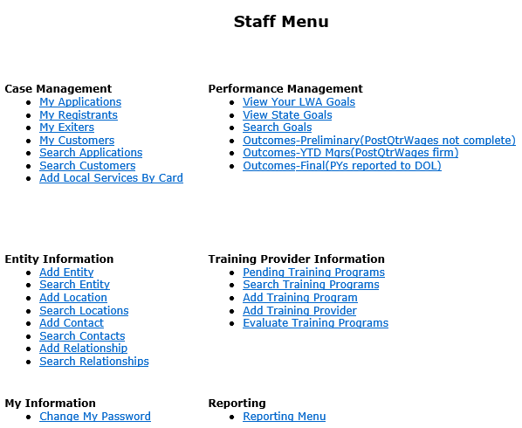
Search Customers
Sometimes when an individual comes into an office, staff may forget to search for an existing IWDS record and attempt to add an individual into IWDS without conducting a thorough search to see if the individual is already in IWDS
This can be how there ends up being multiple customer level records for the same individual

Slide 12
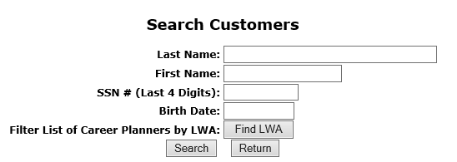
Searching for an Individual in IWDS
Due to the protection of personally identifiable information (PII), the ability to search by complete SSN has been removed
The search within IWDS looks for exact matches, so searching partial spelling of name is encouraged, versus spelling out the complete name for the initial search

Slide 13
Searching for an Individual in IWDS
These four (4) simple searches will find 99% of existing IWDS client records:
Partial Last Name and Last 4 SSN
Partial Last Name and Partial First Name (with or without Last 4 SSN)
Partial First Name and Last 4 SSN
Last 4 SSN and Birth Date
Note: These last two searches are essential if there could be a legal name change (especially if the client is female – more likely to have a legal name change with a marriage or divorce).

Slide 14
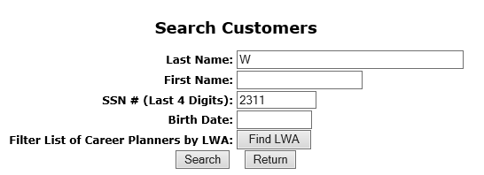
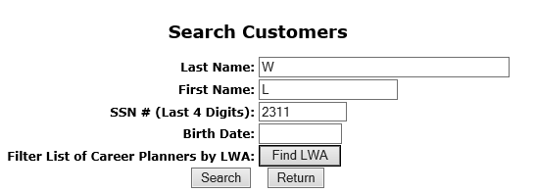
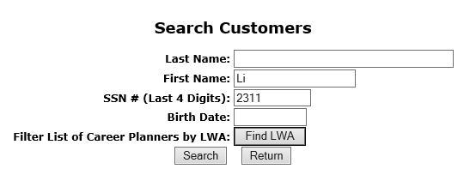
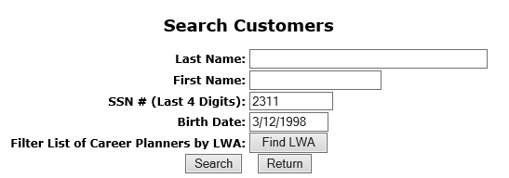
Example Recommended Customer Search in IWDS

Slide 15
Searching for an Individual in IWDS
By using any of the four recommended examples from the previous slide, it would have found the following “Customer” level record that was already in the “Training” platform of IWDS
If we were moving forward with this client to build an application, the next step would be to click on “view” and the customer level record would come up

Slide 16
Searching for an Individual in IWDS
For another example, in situations where another “Search Customer” is completed, and does not find the individual currently in IWDS, a secondary search will then come up to see if the individual has a current record in Illinois workNet (IwN) - see left screen print below as an example when this occurs
Next, for the search in IwN, it requires that the individual’s birth date be provided. Below in the right screen print is an example:

Slide 17
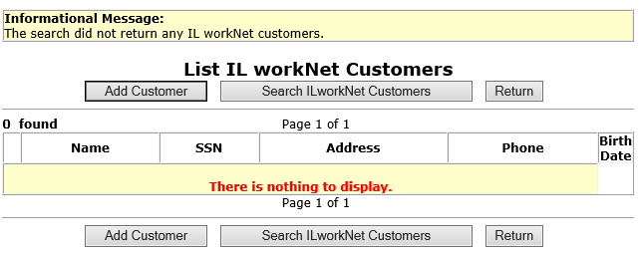
Searching for an Individual in IwN
In situations where the “Search Customer” did not find the individual in IWDS and the secondary search did not find the individual in IwN, then the screen below comes up and the new “Customer” record can be created in IWDS by “Add Customer”.

Slide 18
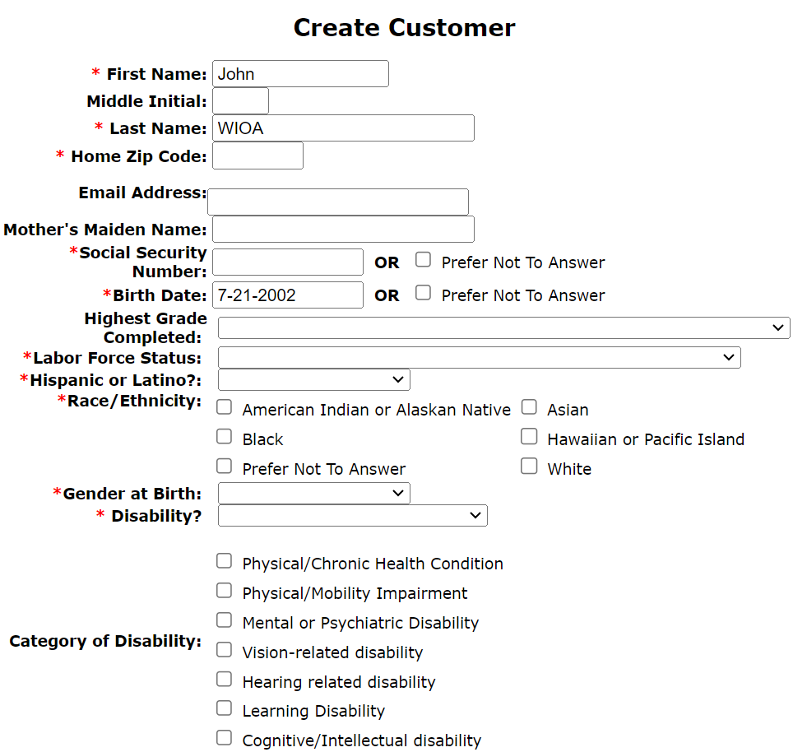
Creating a Customer Record
When the “Create Customer” screen first appears, the red (*) asterisk indicates the field must be populated
Notice that many of the required fields do have an option of “Prefer Not To Answer” as a selection choice when creating the client’s initial “Customer” level record

Slide 19
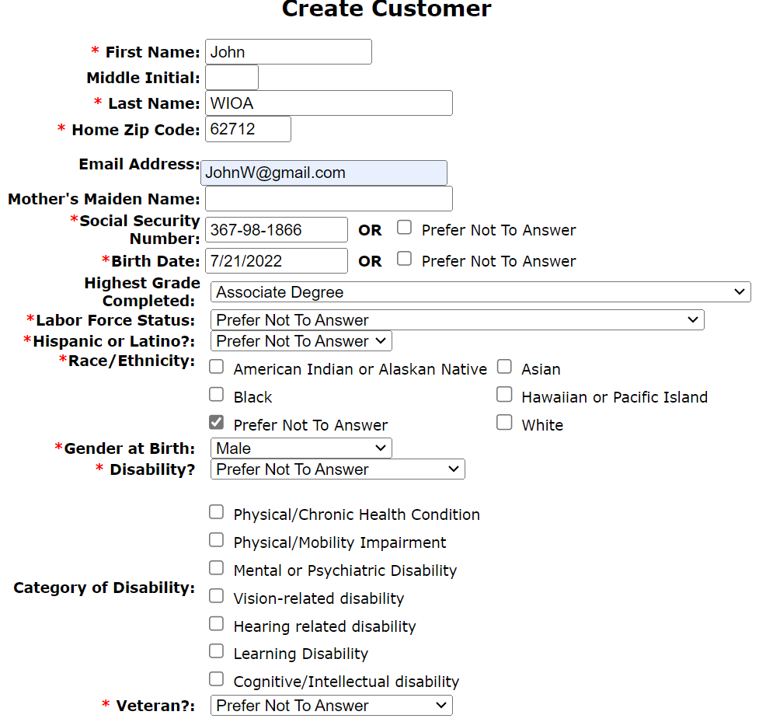
Creating a Customer Record
When creating an initial customer level record in IWDS, if the client does not already have an Illinois workNet (IwN) account, when an email address is provided, an IwN account will be auto-created for the individual
When this is done, the individual will receive a welcome to IwN email with instructions about logging in and updating the temporary password

Slide 20
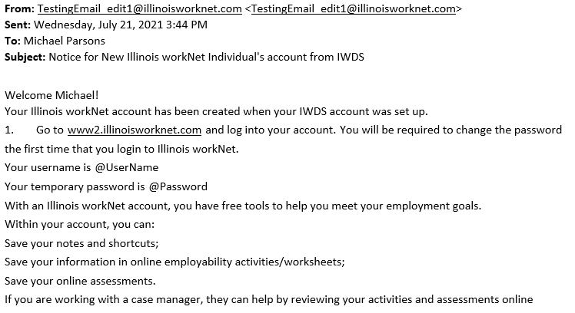
Auto Created IwN Account
The client will receive a welcome to Illinois workNet email with their username and temporary password
They will need to log-on Illinois workNet account and they will be required to change their temporary password

Slide 21
Recording Local (Self) Services
On the left rail, you will see “Add Local Services” – if you click on that, it brings up the various Local Services and then click on “Save”.

Slide 22
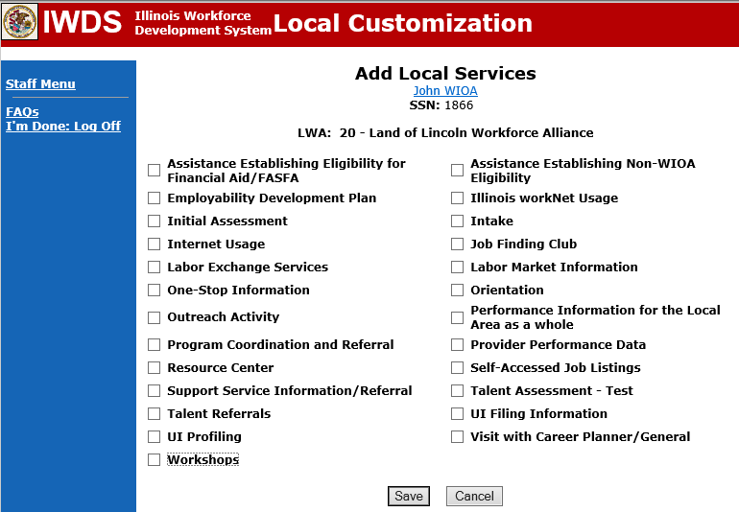
Recording Local (Self) Services
The LWIA staff or the client who has created their own “Customer Level” record would choose which “Local Services” they had received by placing a mark next to the service.

Slide 23
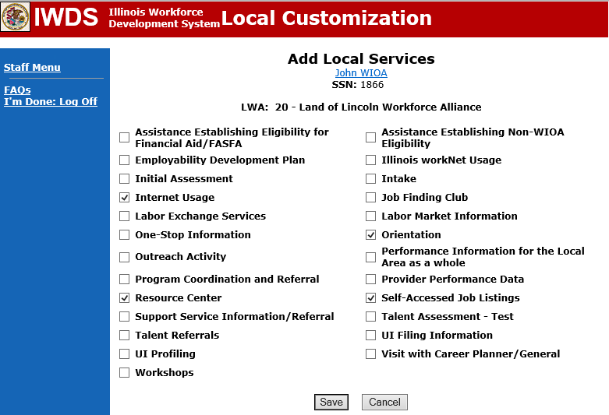
Recording Local (Self) Services
In this case, the client participated in an ‘Initial Orientation’, used the ‘Internet’ in the ‘Resource Center’, and had ‘Self Accessed Job Listings’
When the ‘Save’ button is hit, those local services will be attached to the client's record

Slide 24
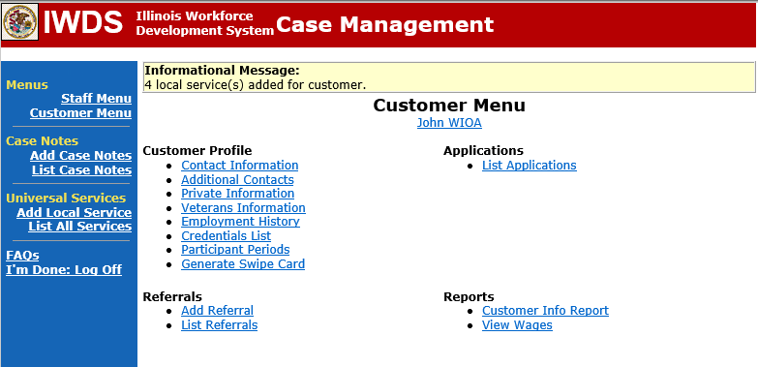
Viewing Local Services
Looking on the left rail, you will see “List All Services”
Click on that to view the local self-services the client received that have been added to the record

Slide 25
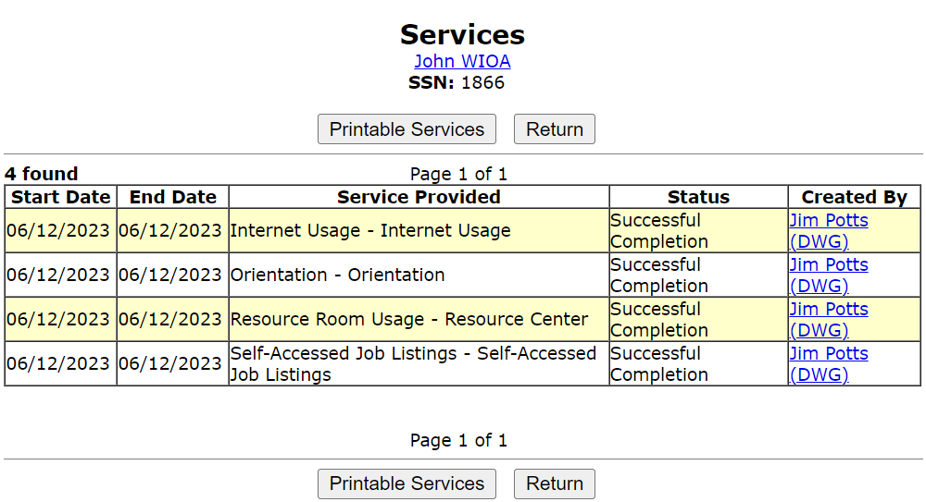
Viewing Local Services
As demonstrated on the adjacent screen print, the various local services that had been recorded are shown.

Slide 26
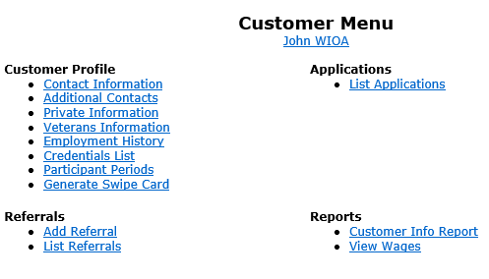
Adding an Application
From the “Customer Menu”, to move forward with creating a new WIOA application, simply “click” on “List Applications”:

Slide 27
Adding an Application

Slide 28
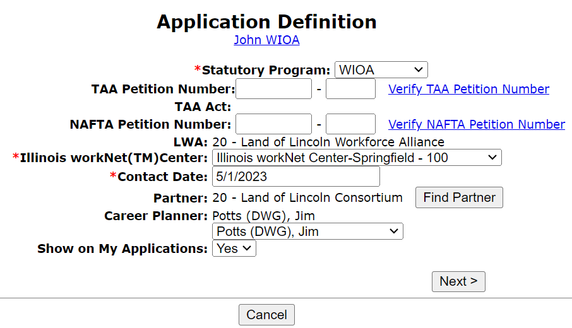
Application Definition Screen
When adding an application, a key point to understand is that the “Contact Date” is established by the Career Planner
It is encouraged to populate the “Contact Date” with the date when you first began working with the client
For this “mock” example record, the contact date is 5/1/2023

Slide 29
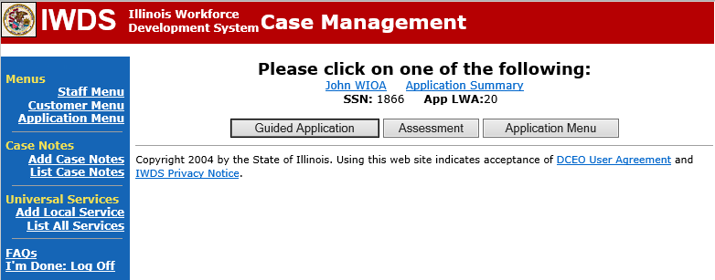
Guided Application
Guided Application is a process that should be followed to ensure that you have each of the screens/questions appropriate for the title you are attempting to qualify the client under.

Slide 30
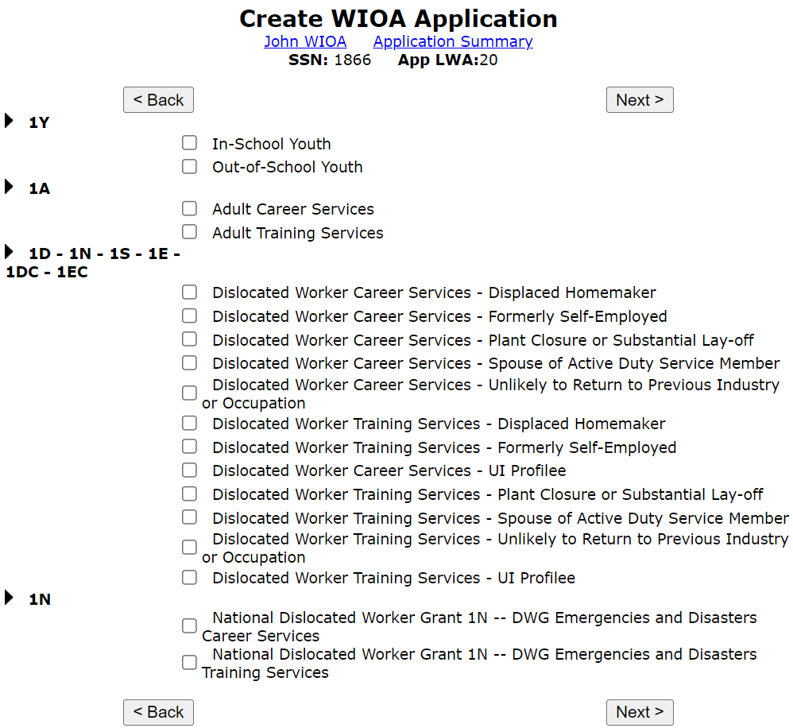
Guided Application
Choices of Guided Applications:
Both Youth (In-School and Out-of-School) applications ask the same questions
The Youth applications also encompass every question within the Adult Career Services application
If you are working with a client ages 18 up to 24 years of age, go ahead and complete the appropriate Youth guided application, which will also ask the questions for the Adult application
All Dislocated Worker/National Dislocated Worker Grant guided applications ask the same questions

Slide 31
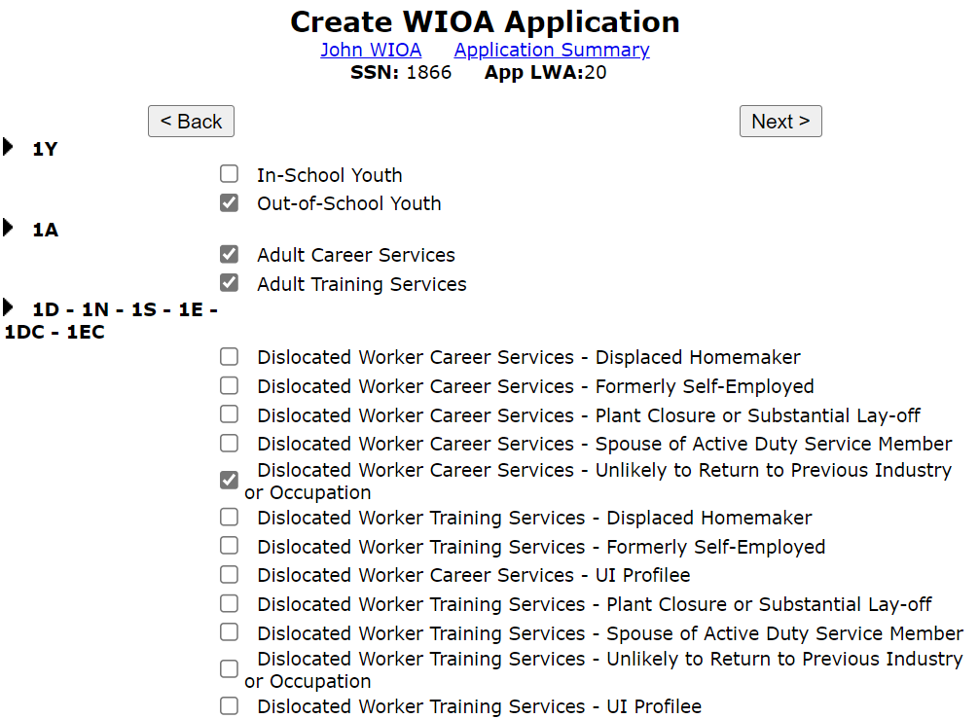
Guided Application
Completing the Guided Application under multiple titles:
Out-of-School Youth;
Adult Career and Training Services;
Dislocated Worker – Unlikely to Return to Previous Industry or Occupation Career Services

Slide 32
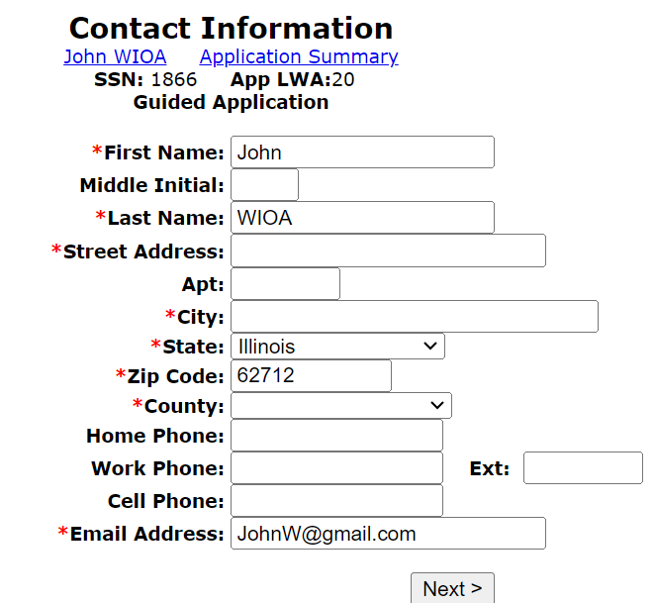
Contact Information Screen
Every block with a red (*) asterisk must have a response; however, even though the various blocks for phone numbers do not have a red asterisk, this very important contact information should always be captured:

Slide 33
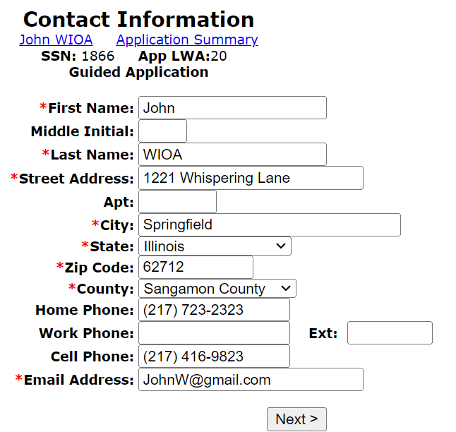
Contact Information
With a requirement to have two-way communication between the client and the Career Planner every 30 days while the client is enrolled in WIOA services, it is very important to capture as much contact information as possible
This client only has a home phone and a cell phone as he is not currently working

Slide 34
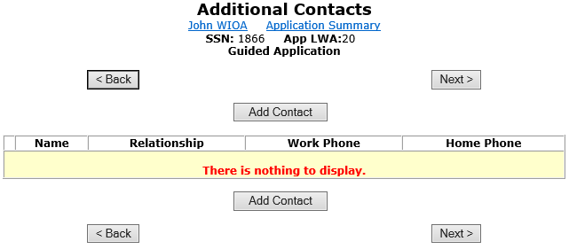
Additional Contacts
Additional Contacts are individuals whom the Career Planner could contact in situations where the client themselves is unavailable:

Slide 35
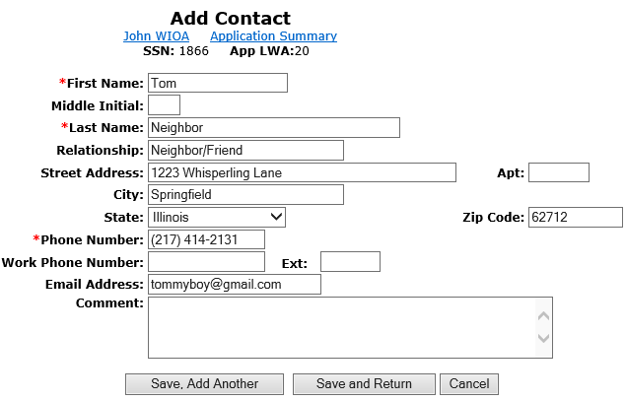
Additional Contacts
The more information you can get on these Additional Contacts, the easier it will be for you in the future if you need to utilize them in situations where you cannot reach the client
At least one contact should be outside of the same physical address as the client

Slide 36
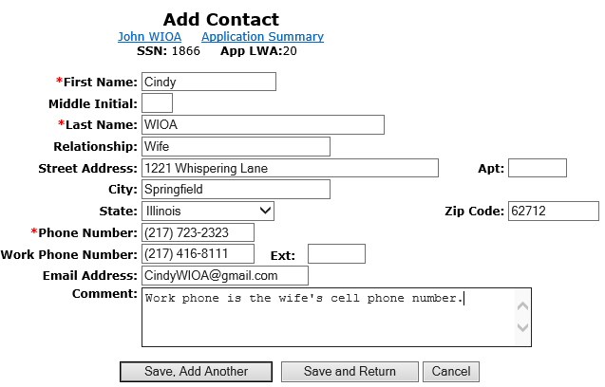
Additional Contacts
There is no guidance given by Commerce on the number of contacts required
Most Career Planners try to record at least two additional contacts

Slide 37
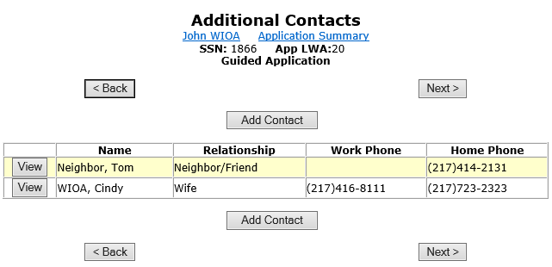
Additional Contacts
In this case, we have the neighbor/friend and then the spouse of the client as the additional contacts:

Slide 38
Private Information Screen

Slide 39
Private Information Screen
For race and ethnicity – whatever the client claims is what should be recorded
Multiple choices of race and ethnicity may be selected – again, whatever the client claims is how the record should be documented

Slide 40
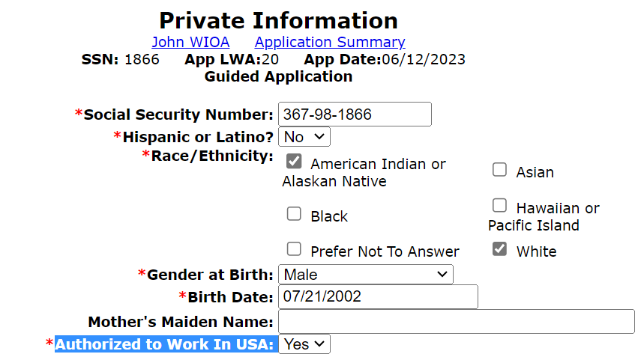
Authorized to Work in the U.S.
All individuals must meet the “Authorized to Work in the United States” criteria and have the documentation to support the response of “Yes” to be certified eligible for any WIOA title.

Slide 41
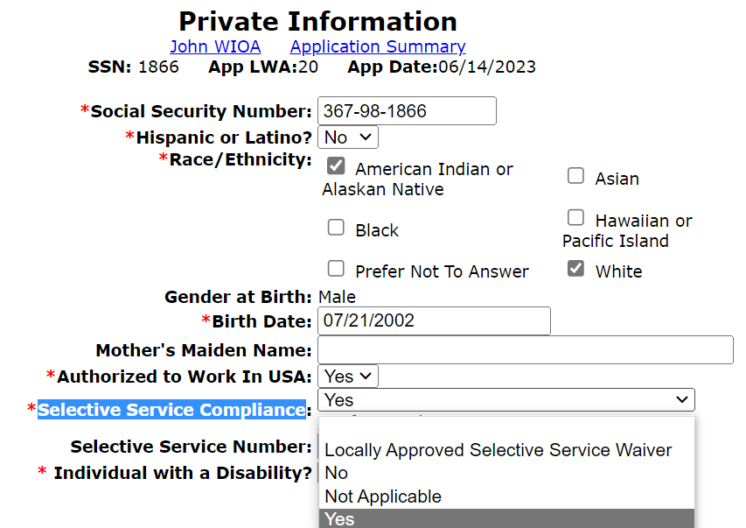
Private Information Screen
Males between the ages of 18 and 26 must register with Selective Service
If they are not registered, they can go to http://www.sss.gov to register
If they are under 18 or a female, you select “Not Applicable” from the drop-down menu

Slide 42
Selective Service Compliance
If the client was born male on or after January 1st, 1960 and now is age 26 or older and not compliant with Selective Service, he must receive a Locally Approved Selective Service Waiver before he can receive WIOA Services (see separate WIOA General Eligibility PowerPoint that includes details about Selective Service waiver)
If the client is born female, then the correct and only possible answer for Selective Service compliance is “Not Applicable”
If the client was born a male under age 18 at the time of application, then the correct and only possible answer for Selective Service is “Not Applicable” (will be required to register when they turn age 18)

Slide 43
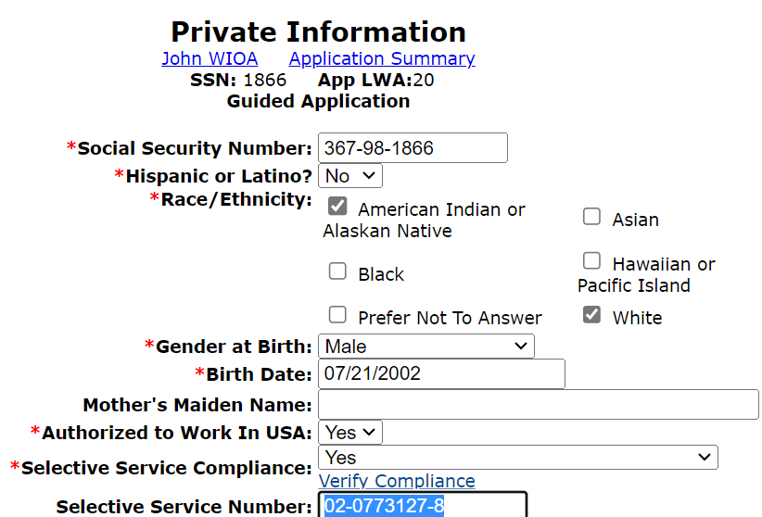
Private Information Screen
For this client, who was born a male in 2002, he is compliant with Selective Service and his Selective Service Number has been recorded
The documentation supporting compliance with Selective Service must be provided at the time of certification

Slide 44
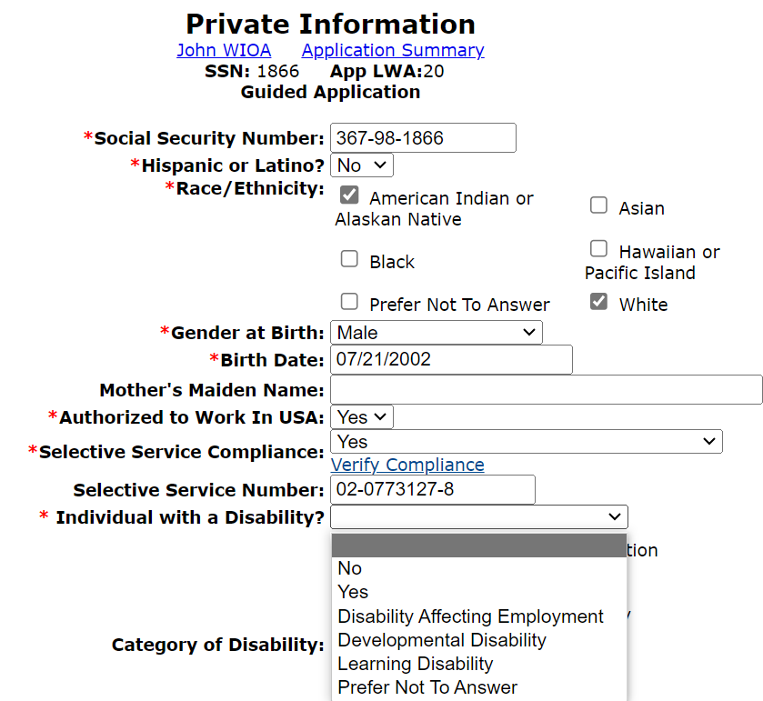
Individual with a Disability
There are various choices to the question “Individual with a Disability” and any reply other than “No” or “Prefer Not to Answer” will indicate that the client has disclosed a disability
There are eligibility considerations for a client that does have a disability

Slide 45
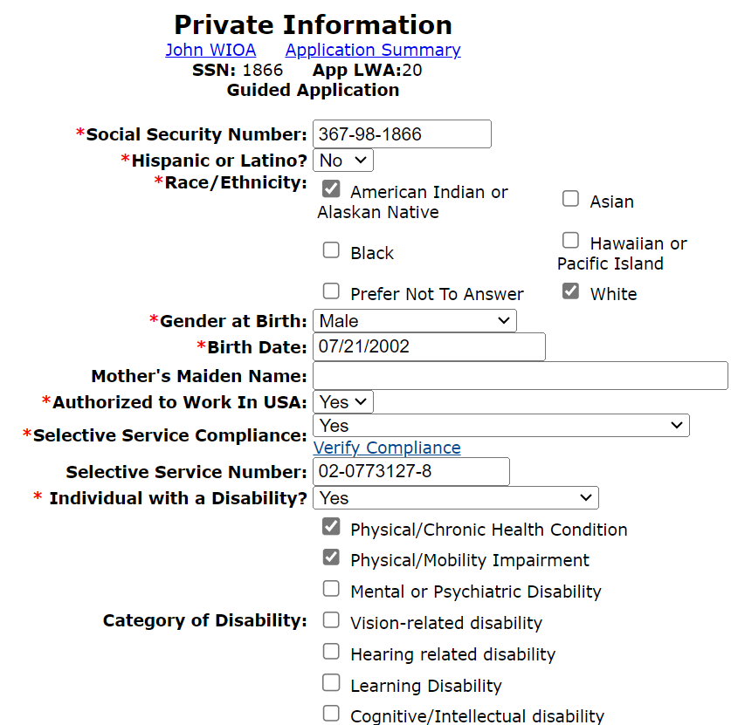
Category of Disability
If a client is recorded as having a disability in their WIOA application, then the “Category of Disability must be recorded with one or more of the choices provided:
No specific documentation is needed regarding “Category of Disability”; the responses are required for federal reporting

Slide 46
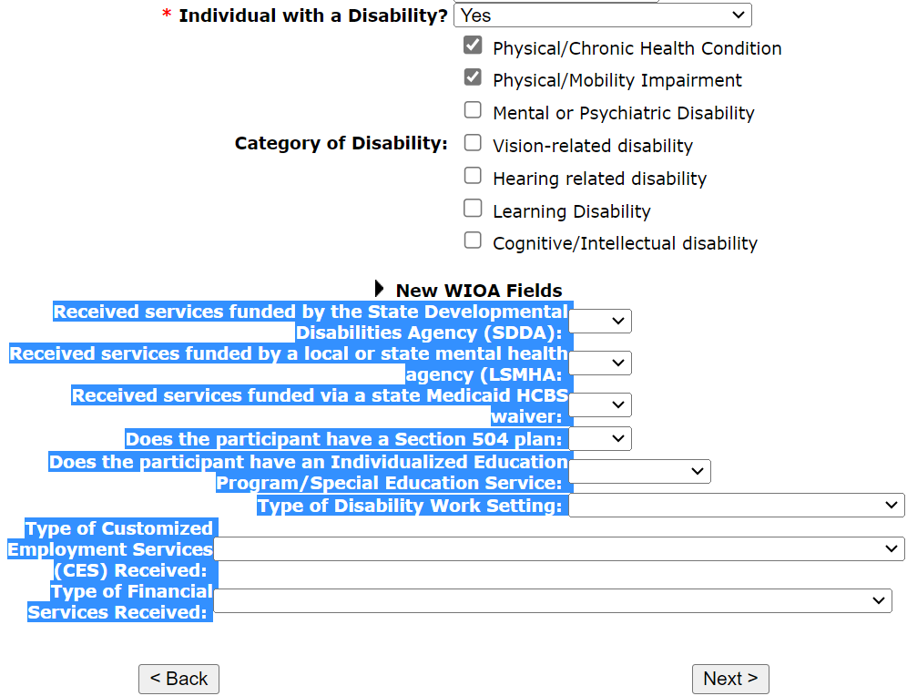
WIOA Disability Reporting Fields
The “New WIOA Fields” are questions for federal reporting tied to an individual with a disability
If the questions are relevant to the client then they should be accurately recorded

Slide 47
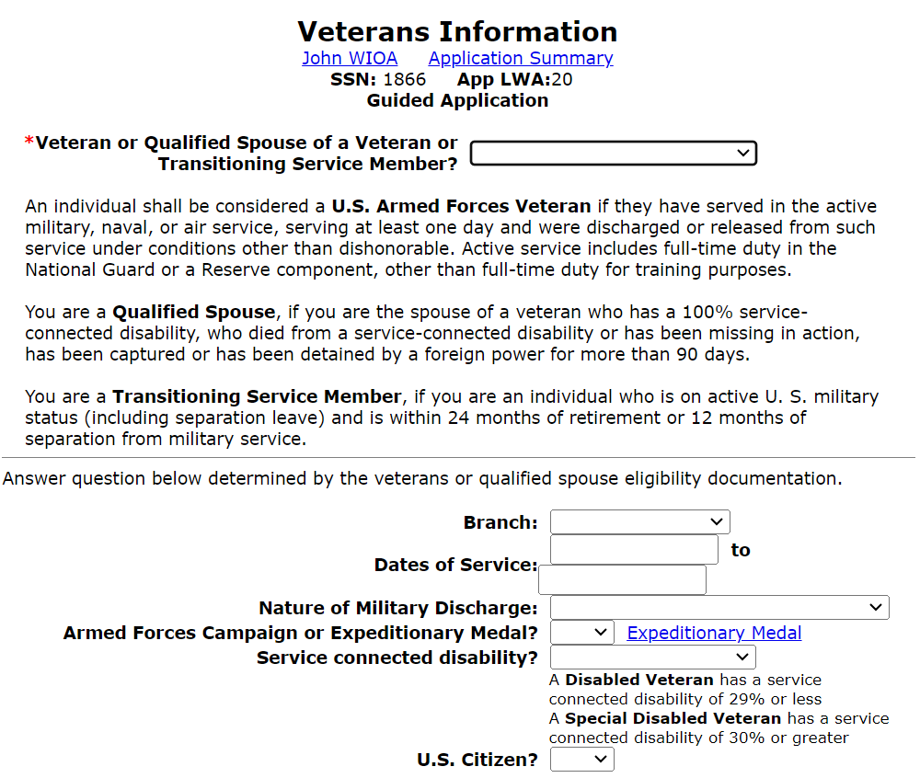
Veterans Information Screen
“Veterans Information” is relevant for Veterans Priority of Service and federal reporting under the Jobs for Veterans Act.

Slide 48
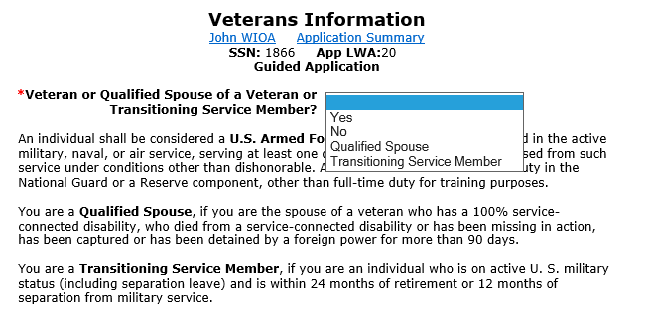
Veteran Status Choices
Any individual that meets the criteria of a Veteran, Qualified Spouse of a Veteran, or Transitioning Service member must receive Veterans Priority of Service.

Slide 49
Additional Veterans Information
It is important to understand the various definitions of Veteran, Qualified Spouse, and Transitioning Service Member
Very few spouses will meet the criteria of a qualified spouse
If a client claims Veteran, Qualified Spouse, or Transitioning Service Member status, then they are eligible for priority of service under the Jobs for Veterans Act:
This entitles qualified client service before any other non-covered person

Slide 50
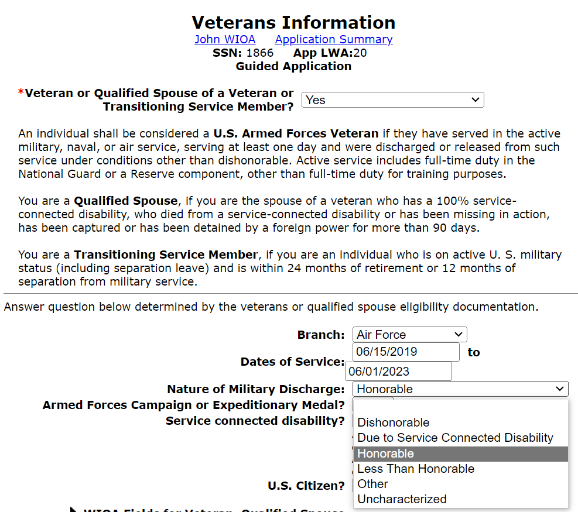
Veterans Information Screen
For a Veteran - any discharge other than “Dishonorable” or “Uncharacterized” will typically support the individual receiving Veterans Priority of Service.

Slide 51
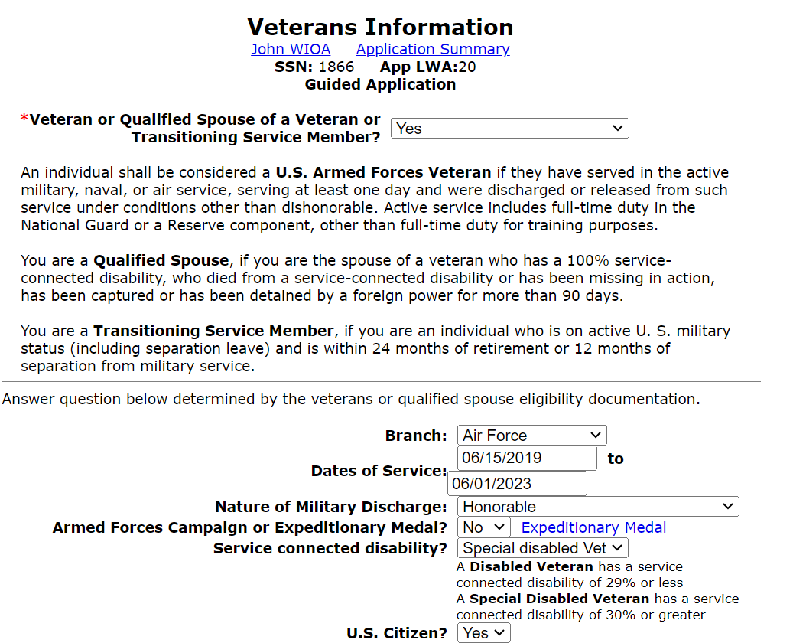
Veterans Information Screen
The remaining details in the middle of the Veterans Information screen will be obtained from the Veteran client and the documentation they provide to support their status.

Slide 52
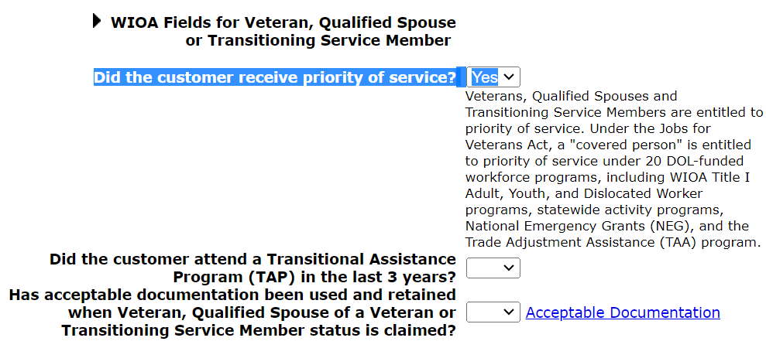
Veterans Information Screen
The question, “Did the customer receive priority of service?” must be populated with a “Yes”. If you mark that as “No” then you would be saying that you did not provide the Veteran Priority of Service.

Slide 53
Veterans Priority of Service
The Jobs for Veterans Act requires that all Veterans who have served at least one day on active duty beyond training and have a discharge other than dishonorable must receive Veterans Priority of Service.

Slide 54
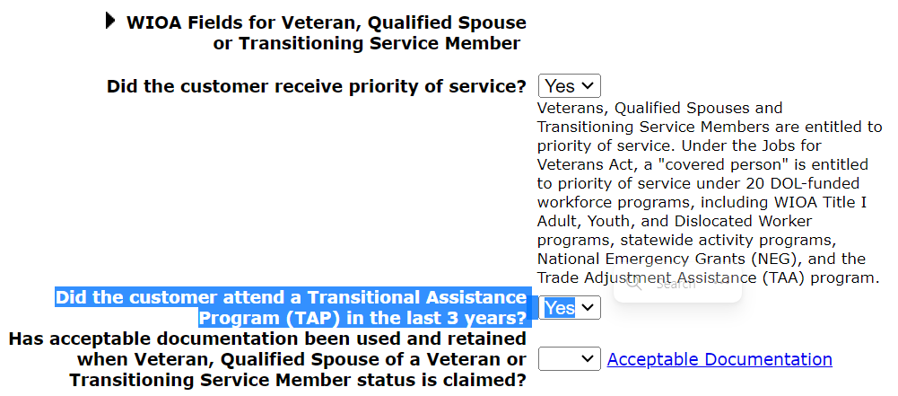
Veterans Information Screen
Transitional Assistance Program (TAP) is something that most veterans who have been discharged within the last three years should have
Documentation is not required to support the response of “Yes” to the TAP question

Slide 55
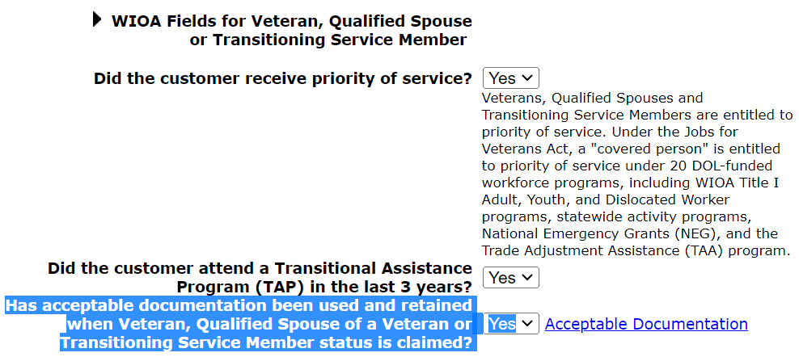
Veterans Information Screen
“Has acceptable documentation been used and retained when Veteran, Qualified Spouse of a Veteran or Transitioning Service Member status is claimed?” must be populated with a “Yes” before internal logic will allow a client that has been recorded as a Veteran to be certified as eligible for WIOA programs.

Slide 56
Veterans Information Screen
Has acceptable documentation been used and retained to support veteran status?
A copy of D.D. 214 is the document a veteran is given when they are discharged from the Armed Forces
A Veterans Identification Card was approved by Congress and signed into law by the President on August 6th, 2015
A letter from the Veterans Administration (VA) or Cross Match Records from VA could be used

Slide 57
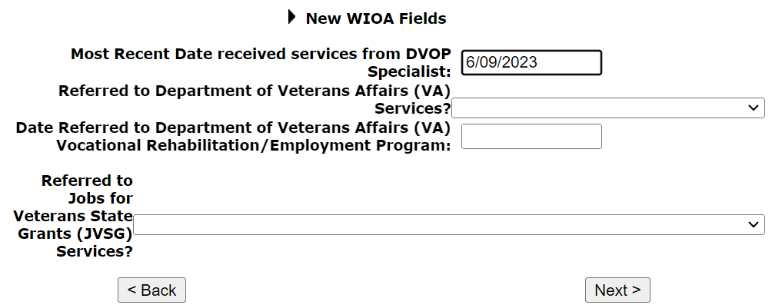
Veterans Information Screen
Bottom of the “Veterans Information” screen are additional WIOA Reporting questions that were added for recording any referral to various Veterans organizations that a client might be referred
These “New WIOA Fields” remain open to update through Participation in WIOA if not populated at the time of the WIOA application

Slide 58
Concurrent Programs Screen
The next screen in all guided applications within IWDS is the “Concurrent Programs” screen, those questions are the Department of Labors (DOL) way of checking what other types of programs a client is enrolled in
You do not have to collect documentation to prove any of this, so if a client states they are in these, it is okay to check “Yes”

Slide 59
Concurrent Programs Screen

Slide 60
Concurrent Programs
It is important to document the actual concurrent programs that a client is participating in at the time of application
Braided funding is allowed where different funding streams are used together to support different needs of the same customer
You can update the concurrent programs screen during participation if a client was not working with one of the programs at application but does begin to work with one of those partner programs during participation in WIOA

Slide 61
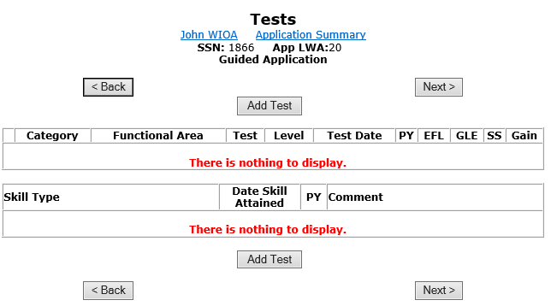
Recording Assessment Testing
On May 17TH, 2023 updated policy guidance related to assessment testing was issued
Details of this updated policy guidance were covered during the Basic Skills Deficient (BSD) presentation

Slide 62
Assessment Testing
This client is an example of a client that is putting in applications for multiple WIOA Programs (Youth, Adult, and Dislocated Worker). All Youth clients are required to take a Math and Reading Assessment test (part of the overall Youth Assessment) on or prior to certification of their WIOA Youth Eligibility
This presentation will now demonstrate recording Math and Reading assessment tests for this example client

Slide 63
Exceptions to Testing
Based on the Basic Skills Deficiency Assessment Requirements policy under section 5.9.5, there are several “Exceptions to Basic Skills Deficient Assessment Testing”
Can anyone tell me the different reasons why someone is not required to take assessment tests?

Slide 64
Exceptions to Testing
An individual has obtained an associate degree or higher
Adult and Dislocated Worker who, within the last year, had taken a placement test at a post-secondary institution with scores that support they do not need developmental or remedial coursework
Youth who, within the last six (6) months, have taken the entrance or placement exam for the postsecondary institution with scores that do not need developmental or remedial coursework
Individuals who are currently enrolled in post-secondary education or have already taken and passed college freshman level in both math and reading

Slide 65
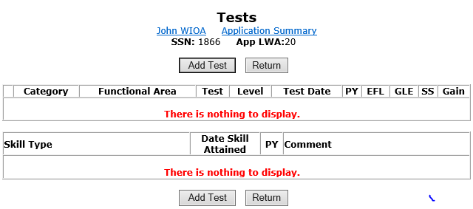
Recording Assessment Tests
Click on “Add Test” to record an assessment test:

Slide 66
Category of Assessment Tests
Different “Category” for the assessment tests; “Adult Basic Education – ABE” are the various National Reporting Service (NRS) approved Math and Reading assessment tests; “English-As-A-Second Language – ESL” are the NRS approved ESL tests; “Other” is the place to record tests that do not fit under ABE or ESL
Often, under the “Category” of “Other” are how those various “Exceptions to Testing” will be recorded:

Slide 67
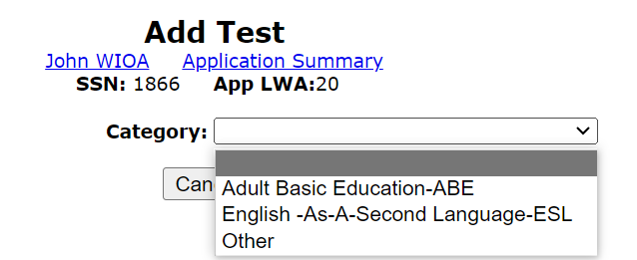
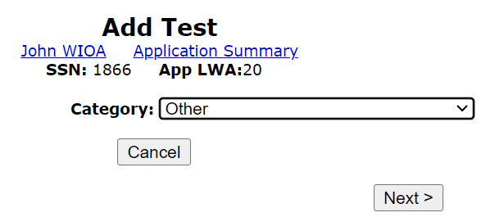
Recording Assessment Tests
In this case, the example client has an Associate’s Degree, so we will utilize the Category of “Other” to record both Math and Reading Assessment tests as discussed in previous slides:

Slide 68
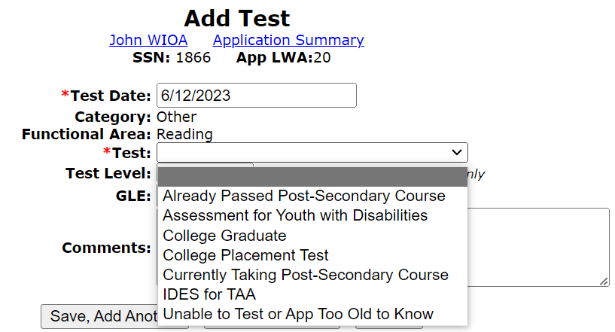
Recording Assessment Tests
Below are the various “Test” choices when recording an assessment test under the “Other” Category:

Slide 69
Scoring GLE on the various Exceptions to Testing
When recording the Grade Level Equivalency (GLE) for the various exceptions to testing, those who have an Associates Degree or higher (Bachelor, Master, Doctorate Degree) record the GLE of “99”
When recording where the individual had taken and passed the placement test at a post-secondary institution, record the GLE of “12”
If the client is currently enrolled in post-secondary coursework for either Math and/or Reading (English) record the GLE of “12”
When recording where the individual had taken and passed the various Math and/or Reading (English) at a post-secondary institution, record either 12 or higher depending on what the documentation from the school shows the client has completed

Slide 70
Test Dates on the various Exceptions to Testing
Within IWDS, there is internal testing logic that looks at the test dates, so in cases where the “Exceptions to Testing” are being utilized, the following guidance should be followed to avoid internal logic issues:
For an individual that has an Associate’s Degree or higher when a “College Graduate” test is being recorded, for any Youth if the degree was earned more than six months in the past, and/or for an Adult or Dislocated Worker, if the degree was earned more than a year in the past when recording the assessment tests use the WIOA application date for the test date
For an individual who had taken and passed post-secondary coursework in Math and Reading (English), if those classes were taken and passed more than six months in the past for a Youth, and more than one year in the past for an Adult or Dislocated Worker, use the WIOA application date for the test date

Slide 71
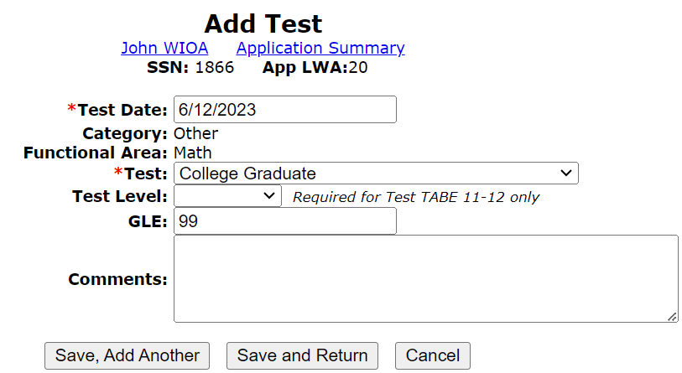
Recording Exceptions to Testing

Slide 72
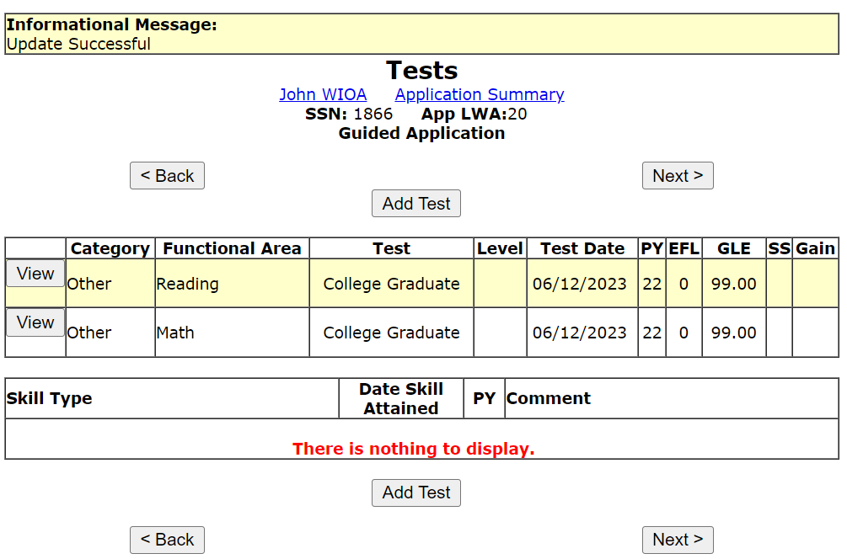
Assessment Tests
For this individual, since the “Test” of “College Graduate” was used, the correct GLE is “99”
College degree was earned in 2021, so to pass internal testing logic, the test date recorded was the WIOA application date

Slide 73
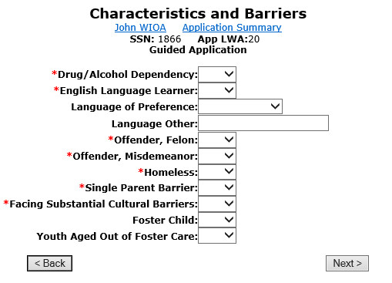
Characteristics and Barriers Screen
The next screen in the guided application for all WIOA applications within IWDS is the “Characteristics and Barriers” screen
Many of these questions have either eligibility or priority criteria or are federal reportable barriers that have reporting criteria

Slide 74
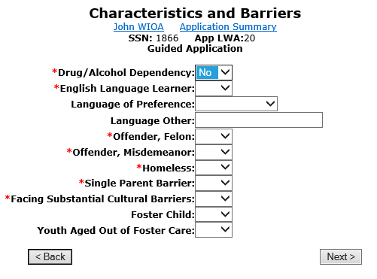
Characteristics and Barriers Screen
The top question is not associated with any WIOA eligibility, but it would be relevant for the assessment:

Slide 75
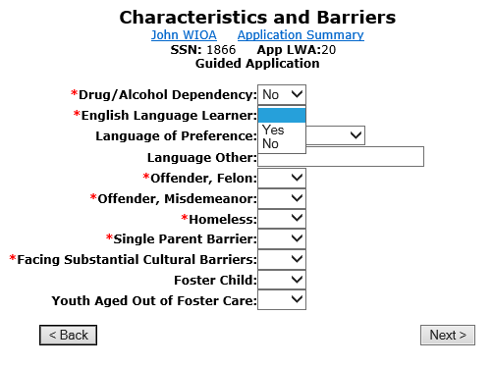
Characteristics and Barriers Screen
Part of the criteria for Basic Skills Deficient (BSD) also includes a response to “Yes” of “English Language Learner”
This is also an “Individual Barrier to Employment” from the WIOA legislation

Slide 76
English Language Learner
English language learner, when used with respect to a participant, means an eligible individual who has limited ability in reading, writing, speaking, or comprehending the English language and:
(1) Whose native language is a language other than English; or
(2) Who lives in a family or community environment where a language other than English is the dominant language.

Slide 77
English Language Learner
A common question is the documentation that is needed to support a response of “Yes” to the question of “English Language Learner” (ELL):
The Career Planners “Assessment” is an acceptable form of documentation to support a response of “Yes”.
A self-attestation by the client can also be documentation to support ELL status

Slide 78
Characteristics and Barriers Screen
When the barrier of “English Language Learner” is populated with “Yes”, a question of “Language of Preference” must be populated
If none of the selection choices are the client’s “Language of Preference”, then the Language Other is a text block to record the correct language

Slide 79
Characteristics and Barriers Screen
Offender (Felon or Misdemeanor) Status is a barrier for Youth eligibility and is also relevant for the client’s assessment as certain law violations could restrict a client’s ability to obtain various jobs
Being an ex-offender is one of the “Individual Barrier to Employment” from the legislation

Slide 80
Characteristics and Barriers Screen
Homeless is an automatic Low-Income criteria under WIOA, so it would have eligibility criteria under both the Adult and Youth titles. It is also relevant for assessment information for all WIOA titles.

Slide 81
Characteristics and Barriers Screen
The next two questions do not have eligibility criteria tied to the response of “Yes” but both are identified in the WIOA legislation as “Individual Barrier to Employment”
Single Parent barrier does include if a single woman is pregnant

Slide 82
Facing Substantial Cultural Barriers
“An individual who faces a cultural barrier” is an individual that perceives themselves as possessing attitudes, beliefs, customs, or practices that influence a way of thinking, acting, or working that may serve as a hindrance to employment
This example client is a disabled veteran and feels he meets the criteria of “Facing Substantial Cultural Barriers”

Slide 83
Characteristics and Barriers Screen
Foster Child is an automatic Low-Income criteria under WIOA and is also a barrier for Youth Eligibility, being a foster child is also identified in the WIOA legislation as a “Barrier to Employment”
Youth Aged Out of Foster Care is a barrier for Youth Eligibility and is also identified in the WIOA legislation as a “Barrier to Employment”

Slide 84
Youth Barriers Screen
The Youth barriers screen is next in this guided application since we selected the Out-of-School Youth application as one of our choices when we began the guided application.

Slide 85
Youth Barriers Screen
This information was covered under the WIOA Youth Eligibility presentation
I will pass on that for an Out-of-School Youth (OSY) who has either an “Offender” question on the Characteristics and Barriers screen marked as a “Yes”, should have the “Subject to Juvenile or Adult Justice System” marked with a “Yes” to pick-up that barrier for OSY eligibility

Slide 86
Education Status Screen
The Education status screen has some eligibility criteria tied to the Youth titles (both ISY and OSY) and has some criteria tied to the Adult Priority of Basic Skills Deficient from this screen.

Slide 87
Education Status Screen
This screen should capture the client’s “Education Status” at the time of their application
Choices from grade 0 (zero) to Doctorate

Slide 88
Education Status Screen
The question of “Attending School” has the internal logic for determining In-School Youth (ISY) or Out-of-School Youth (OSY) status for Youth clients:
Yes = ISY
No = OSY

Slide 89
Education Status Screen
For an application that has the High School Dropout question populated with a “Yes”; if the client’s highest grade completed is below High School Graduate, the client would be determined eligible as an OSY
If a client went back to school and obtained their High School Diploma or equivalency after dropping out, they are no longer a dropout

Slide 90
Education Status Screen
On the “Education Status” screen within the IWDS application, is where the question, “Based on a completed Basic Skills Screening Tool, does the client meet Basic Skills Deficient Criteria?” has been added
If any question on the screening tool was answered “No” by the client, then the question related to the BSD screening tool on the “Education Status” screen should be answered “Yes”; (see example on next slide)

Slide 91
Basic Skills Screening Tool

Slide 92
Education Status Screen
In this situation, the client had a “No” to question #4 on the screening tool, so then the correct response to the “Basic Skills Screening Tool” question is “Yes”.

Slide 93
Employment Characteristics Screen
The next screen in the guided application for all WIOA titles is the “Employment Characteristics” screen
We will discuss this screen in detail over the next several slides

Slide 94
Employment Characteristics Screen
The “Employment Characteristics” screen is designed to capture what is going on with the client at the time of application
For the Dislocated Worker titles, some of the responses do have eligibility criteria
Anything with a red (*) asterisk requires a response

Slide 95
Employment Characteristics Screen
Choices of Labor Force Status – if “Unemployed” or “Employed but Received Notice of Termination/Military Separation” is the status, those responses have eligibility criteria tied to Dislocated Worker criteria.

Slide 96
Employment Characteristics Screen
For UI Status, these responses have eligibility criteria tied to eligibility under the Dislocated Worker title of Unlikely to Return to Previous Industry or Occupation
There was an alternative Pandemic Unemployment Assistance (PUA), if a client is eligible or exhausted for PUA or traditional UI, they should be recorded accordingly

Slide 97
Employment Characteristics Screen
Next question on the “Employment Characteristics Screen” is the “Tenure” question:

Slide 98
Tenure Definition
This individual that has been terminated or laid off or has received notice of employment termination or layoff; and as listed WIOA ePolicy Chapter 5.3 Dislocated Worker Eligibility - paragraphs I.1.a.2.b)
Tenure = has been employed for a duration sufficient to demonstrate attachment to the workforce (meaning the individual must have at least thirty (30) days of employment in the industry or occupation from which they were dislocated) but is not eligible for unemployment compensation due to insufficient earnings or having performed services for an employer that were not covered under a state unemployment compensation law;

Slide 99
Tenure Alternative to UI
“Tenure” is for an individual who worked at a job (or in the industry) for at least 30 days, where the employer did not pay into the UI system on behalf of the employee
OR “Tenure” is for an individual who worked full-time at their dislocation job (or in the industry) for at least 30 days and had insufficient wages to draw a monetary UI benefit

Slide 100
Recent Guidance from IDES
Based on recent guidance provided by IDES to our Policy Unit, for an individual to be eligible to draw a monetary UI benefit, the person must have earned at least $2,000 in at least two (2) of the last four (4) calendar quarters which should be supported by either an IBIS document or the client's pay records
If an individual has worked full-time at their dislocation job for at least 30 days but does not meet the above criteria (due to insufficient earnings), then that individual would meet the alternative criteria to UI known as “Tenure”

Slide 101
Tenure – Military Separation
Often people who separate from the armed forces after their enlistment (discharged from active duty) are not eligible for UI. If that is the case, then the Illinois Department of Employment Security has given guidance that those people would meet “Tenure” if they had served at least six months in the armed forces and are not eligible for UI.

Slide 102
Employment Characteristics Screen
For this “example” client, he did meet “Tenure” as he was medically retired from the Air Force and, with his retirement and disability income, was not eligible for UI benefits.

Slide 103
Example of “Tenure” Jobs
Some examples of jobs not covered under the state unemployment compensation law are:
Church or religious organizations
Railroad
Insurance agent
Agricultural labor
Domestic Service
Family Business
Many of these jobs did receive Pandemic Unemployment Assistance (PUA) benefits during COVID

Slide 104
Employment Characteristics Screen
The questions tied to farm work are required responses and should be answered accurately for the client’s circumstances
In addition, the Migrant status questions should also be recorded if accurate for the client’s circumstances

Slide 105
Employment Characteristics Screen
Under-employed is relevant for federal reporting and for some of the WIOA Dislocated Worker eligibility criteria
An individual cannot be unemployed and under-employed

Slide 106
Under-Employed Definition/Criteria
Definition for Under-Employed – An individual who is working part-time but desires full-time employment or who is working in employment not commensurate with the individual’s demonstrated level of educational attainment
Recent guidance provided by DOL states that if an individual is working full-time but on public assistance (Food Stamps, Cash Welfare, etc.), then they should also be considered under-employed

Slide 107
Under-Employed Definition/Criteria
TEGL 19-16 - Guidance on Services Provided through Adult and Dislocated Worker Programs under WIOA added additional criteria for Underemployed:
Individuals who meet WIOA Low-Income criteria but are working full-time are considered under-employed
Individuals who are employed but whose current job’s earnings are not sufficient compared to their previous job’s earnings from their previous employment
LWIA’s local policy on self-sufficiency criteria for Dislocated Worker (DW) Clients can be based on the individual finding employment equal to or greater than a percentage of a client’s dislocation lay-off wage. (Example might be a local policy that states self-sufficiency for DW client is based on 80% of lay-off wage, meaning if a client’s dislocation wage was $50,000 per year, if the individual finds employment under $40,000 per year, that would be considered intervening employment and a qualified DW client would still be eligible for WIOA Services under DW title until they find employment greater than $40,000 per year.)

Slide 108
Dislocated Worker Characteristics
The next screen with this example guided application is the Dislocated Worker Characteristics screen.

Slide 109
Dislocated Worker Characteristics
The “Dislocated Worker Characteristics” screen has eligibility criteria for the three different programs under the Dislocated Worker Title of Unlikely to Return to Previous Industry or Occupation, Displaced Homemaker, and Spouse of an Active-Duty Service Member.

Slide 110
Dislocated Worker Characteristics
The top question is relevant for eligibility associated with a client being unlikely to return to a previous industry or occupation
It is important to understand why you are answering “Yes” to this question

Slide 111
Requires Additional Assistance
After an assessment of education, skills, and work experience, have been determined by the Title 1B entity to “require additional assistance” to qualify for any available openings in the industry or occupation from which the person was laid off or to obtain employment in another occupation. Such determination must be documented in the person’s file with a case note.

Slide 112
Require Additional Assistance
Examples of requiring additional assistance laid out in Dislocated Worker Policy under section I.1.a.3)b)i) - include, but are not limited to, the following:
An individual who meets the long-term unemployed criteria (unemployed for twenty-seven (27) or more consecutive weeks);
The individual is a separating or separated member of the U.S. Armed Forces;
The individual has a history of involvement at any stage with the criminal justice system (justice-touched individual);
The individual is likely to enter a new job that is different structurally or organizationally than their previous job;
The individual is likely to enter a new job with lower seniority compared to their previous position;
The individual has a gap in employment that decreases their chances of returning to the same level of occupation or type of job, including justice-touched individuals;
There are limited employment opportunities in the occupation or industry within the local area;
There is an excess number of workers with similar skill sets and experience in the local area;
The individual has out-of-date or inadequate skills;
The individual has adequate skills but lacks a credential required by most employers;
The individual has a barrier to employment such as a disability, medical condition, or legal issues that could prevent a return to employment in the same industry or occupation; or
An unsuccessful job search suggests the individual is unlikely to regain employment in their previous occupation or industry.

Slide 113
Requires Additional Assistance
The eligibility criteria is captured on the Dislocated Worker Characteristics screen. The question “Require Additional Assistance” can only be justified in the assessment by the grantee staff explaining why the individual requires additional assistance to regain full-time, self-sustaining employment.

Slide 114
Unlikely to Return Criteria
It is important to understand this alternative criteria under “Unlikely to Return” is related to the questions of “Required additional assistance to regain employment,” would only be needed if the client’s dislocation job is not from a declining industry or low growth occupation
Most dislocation jobs are from either a declining industry, a low-growth occupation, or both

Slide 115
Unemployed Six Months with One Month of Job Search
With the updated Policy Chapter 5 Section 3 under Unlikely to Return to Previous Industry or Occupation, the eligibility criteria that had been tied to the two (2) questions highlighted in blue on the adjacent screen print have been removed
This means that they no longer have eligibility criteria, so do not respond to those two questions
There is a request for the programmers to remove those two questions from this screen

Slide 116
Dislocated Worker Characteristics
Displaced Homemaker is only populated with “Yes” if the client meets the eligibility for a Displaced Homemaker:
If populating with “Yes” the system (IWDS) presumes the client is qualified as a Displaced Homemaker and you have all documentation required to support this claim

Slide 117
Displaced Homemaker
For an individual to meet the eligibility criteria under “Dislocated Worker - Displaced Homemaker” they must have been providing unpaid services to family members and who:
Has been dependent on the income of another family member but is no longer supported by that income; and
Is unemployed or under-employed and is experiencing difficulty in obtaining or upgrading employment

Slide 118
Dislocated Worker Characteristics
Under WIOA there is a dislocated worker title of “Spouse of an Active-Duty Service Member”
If the response to the questions of “Spouse of Active-Duty Service Member” is “No” - no other action needs to be taken as questions a. and b. are only available for eligibility for those that answer “Yes” to the “Spouse of Active-Duty Service Member”

Slide 119
Spouse of Active-Duty Service Member
If the response to the questions of “Spouse of Active-Duty Service Member” is “Yes” – then if the response to either of the subsequent questions is “Yes” the client would meet eligibility under this Dislocated Worker criteria:
Employment loss due to relocation, OR
Unemployed or Underemployed and experiencing difficulty obtaining or upgrading employment

Slide 120
Alternative DWG 1N Criteria
These seven (7) questions only need responses if you have one of the DWG 1N grants, you would like to serve the client who does not meet any traditional Dislocated Worker eligibility criteria, and the client does meet one of the alternative criteria from one or more of those questions.

Slide 121
Alternative Employment Recovery Criteria
The question highlighted in “blue” was only used in cases where an LWIA had a DWG ER grant, and the client had not met any traditional Dislocated Worker eligibility, but met the criteria laid out in this question.

Slide 122
Dislocated Worker Characteristics
The bottom four questions on the “Dislocated Worker Characteristics” screen are only needed if planning to serve a client under one of the 1N DWG grants with the Disaster Recovery services that require a client to have a physical, tetanus shot, background check, or drug screening.

Slide 123
List Work History
The next screen in this guided application within IWDS is the “List Work History”; this screen is only needed for Dislocated Worker clients as previous work history has no eligibility criteria under Adult or Youth titles.

Slide 124
List Work History
An important detail to understand when recording the “List Work History” screen is that you are only recording the job that qualifies the individual as a “Dislocated Worker”.
This means that you are recording the details about the dislocation job only and not the client’s entire work history
This is important because an individual’s Dislocated Worker eligibility is based on their most recent, full-time, self-sustaining employment and their circumstances around this last full-time, self-sustaining employment.

Slide 125
Searching DETS/IEBS
It is essential when recording the Dislocation Job for each Dislocated Worker client that the Dislocation Event Tracking System (DETS) / Illinois Employment Business System (IEBS) is checked to see if there is a current DETS/IEBS event in the system.
When searching for a DETS/IEBS event, you can search by name, location, and by the LWIA. All ways should be attempted to see if there is a current DETS/IEBS event

Slide 126
Checking DETS/IEBS ID:
Each time you record the Dislocation job for a WIOA Dislocated Worker client, you should always check the DETS/IEBS ID:
There is an interface set-up between IWDS and IEBS

Slide 127
Searching DETS/IEBS ID:
1. IEBS ID (most accurate)

Slide 128
Search by City & State
In cases where you already know the specific event number, that will always be the easiest way
However, the actual event might not be known, and the name could be different based on who created the event

Slide 129
Working in “Training IWDS”
Since we are working in the “Training Platform” of IWDS, it did not have a (current) IEBS/DETS event; I worked with Levi Beerup with the Rapid Response team to create an event:

Slide 130
IEBS/DETS Events for all Armed Services Created
In the future, if you work with an individual who had recently separated from the Armed Forces and their military job is their Dislocation job, the following IEBS/DETS events have been created in IEBS.

Slide 131
List Work History
For this example client, his last job (dislocation job) was United States Air Force
The guidance provided by DOL related to individuals who separate from the Armed Forces, the “Employment Status” should be recorded as “Laid Off”

Slide 132
Add Job
Based on guidance from DOL, the “Layoff Reason” for most individuals who separate/get out of the Armed Forces should be recorded as “Lack of Work at Employer”.

Slide 133
Add Job
For the remaining blocks on “Add Job” for this example client, must populate “Primary Occupation” and “Dislocation” with a “Yes” for any dislocation job.

Slide 134
List Job History
As mentioned previously, you only need to record the dislocation job for Dislocated Worker clients:

Slide 135
Public Assistance Screen
The next screen for any WIOA guided application is the Public Assistance screen
These questions are relevant for WIOA Eligibility for Adult and Youth titles, and reporting criteria for Dislocated Worker clients

Slide 136
Public Assistance Screen
This screen requires documentation to be captured to support any “Yes” answer:
If “Yes” to Transitional Assistance; Refugee Help; SSI; or TANF is marked, then it will be considered a form of Cash Welfare and the client will be determined qualified as WIOA Low-Income within IWDS
If “Yes” is marked to Food Stamps the client meets WIOA Low-Income within IWDS

Slide 137
Public Assistance Screen
Internal logic within IWDS requires that if a client is receiving TANF benefits, the DHS Case # must be recorded
In this case, the client is not on any form of public assistance, but internal logic still requires the # of months prior on TANF be recorded. So, in this case, the client has never been on TANF so the correct response is “0”

Slide 138
Public Assistance Screen
In the recent past, DOL has required all WIOA applicants are required to report if they are receiving Social Security Disability Insurance (SSDI)
We added this question to the Public Assistance screen; SSDI is not a form of Public Assistance and does not have any Low-Income eligibility criteria if an individual is receiving SSDI
One caveat that is important to understand is that if a WIOA client is on SSDI, that income is included if a family income calculation is completed on the client

Slide 139
Public Assistance Screen
New WIOA Fields on this screen:
These questions are not directly tied to any eligibility criteria within IWDS, but responses are needed for WIOA Federal reporting
If the client meets any of the criteria, these are tied to “Individual with Barriers to Employment” in the WIOA Legislation

Slide 140
Public Assistance Screen
New WIOA Fields on this screen:
Long-Term Unemployed at Program Entry? Yes = Unemployed 27 or more consecutive weeks

Slide 141
Public Assistance Screen
New WIOA Fields on this screen:
Exhausting TANF within two years? TANF has a lifetime eligibility of 60 months. So if an individual has received TANF for 36 months or more, then the appropriate response to the question of “Exhausting TANF within two years?” would be “Yes”

Slide 142
Public Assistance Screen
New WIOA Fields on this screen:
Ticket to Work Holder? - Ticket to Work is a free and voluntary program that can help Social Security beneficiaries go to work, get a good job that may lead to a career, and become financially independent, all while they keep their Medicare or Medicaid. Individuals who receive Social Security benefits because of a disability and are aged 18 through 64 probably already qualify for the program – if so the response to this question would be “Yes”

Slide 143
Public Assistance Screen
New WIOA Fields on this screen:
Employment and Training Programs Related to SNAP?
First, Supplemental Nutrition Assistance Program (SNAP) or Food Stamps The SNAP Employment & Training Program's (SNAP E&T) goal is to help improve work skills and assist with finding a job through short-term training and work assignments as well as GED, resume-writing and interviewing classes
Populate the “Employment and Training Programs Related to SNAP?” with “Yes” if an individual is participating in any SNAP E&T

Slide 144
Public Assistance Screen
Most Recent Date Referred to Other Federal/State Assistance:
Record the most recent date a job seeker was referred to Other Federal/State Assistance. This may include Supplemental Nutrition Assistance Program (SNAP) benefits, Temporary Assistance for Needy Families (TANF), health insurance assistance, child support assistance, tax preparation support, and any other Federal or State assistance programs

Slide 145
Family Characteristics Screen
In the guided application, the next screen that comes up is the Family Characteristics Screen
The family needs to be recorded in instances that the family has WIOA eligibility considerations:
Family Income calculation;
Low-Income due to member of the family being on food stamps or cash welfare;
Displaced Homemaker;
Spouse of Member of Armed Forces

Slide 146
WIOA Family Definition
When recording family, it is important that the WIOA family definition be followed and is shown below:
Two or more persons related by blood, marriage, or decree of court who are living in a single residence and are included in one or more of the following categories:
Married couple and dependent children
parent or guardian and dependent children
Married couple

Slide 147
Family Characteristics Screen
Please understand that the WIOA application in IWDS is just that, the application to make a client qualified, and the family only needs to be recorded in this part of the application if the family is being utilized for eligibility criteria
When the family is recorded it should be in relation to how the family is being utilized as part of WIOA Eligibility
This means that if the client is a Youth, but eligibility is going to be based on the family income calculation, then the family characteristics screen would be populated as the parents, applicant, and siblings

Slide 148
Family Characteristics Screen
When the family is being recorded, “Family Type” must use one of the choices shown in the drop-down, but it is important to understand that the “Family Type” response has no bearing on the actual WIOA eligibility
Give the response that closest resembles the circumstances of the need to record the family within the application

Slide 149
Family Characteristics Screen
For this “example” application, the client is married, but the client has a disability, so utilizing Family of one Due to Disability as if the spouse's income would be included, would put the client over the WIOA Low-Income criteria
In this case, describing as “Not Reported”
Remember, the family type carries no eligibility criteria

Slide 150
Family Characteristics Screen
Family of one due to Disability should be utilized when it is in the best interest of the client
You do not need to “List Family” members when it is a Family of 1 due to Disability as it is known the client is the family of 1

Slide 151
Income Calculation Screen
The Income Calculation screen is completed on an Adult or Youth client when you are utilizing a family income calculation to determine the Low-Income status of the client.

Slide 152
Family Income Calculation
A Family Income Calculation is only needed to determine Low-Income if the Adult or Youth client does not meet any of the automatic Low-Income qualification criteria; (Food Stamps, Cash Welfare, Foster Child, Homeless, Free or Reduced Priced Lunch, Youth Living in a High Poverty Area), and the client would meet WIOA Low-Income based on the family income meeting Low-Income criteria.

Slide 153
Family Income Calculation
A Family Income Calculation is only needed in instances that the total family income does not exceed the higher of:
The poverty line; or
Seventy percent (70%) of the lower living standard income level

Slide 154
Family Income Calculation
WIOA Notice NO. 22-NOT-01 – Revised Income Guidelines for Determining Low-Income Status for WIOA Eligibility – dated May 12th, 2023, under Attachment “B” lists the income thresholds by Local Workforce Innovation Area (LWIA) and family size when determining Low-Income using a Family Income Calculation
The next slide shows the current income chart

Slide 155
Current Low-Income Levels

Slide 156
Family Income Calculation
Must capture the income of everyone within the WIOA defined family
Pay stubs or other acceptable documentation for each of the family member’s income
Documentation supporting family size

Slide 157
Family Income Calculation Requirements
It is essential to view DCEO WIOA Policy 5-5 – Low-Income Individuals – specifically Attachment “B” – Inclusions and Exclusions for Determining Family Income
Any family member that is included in the WIOA defined family of the applicant must have their included income for the previous six months before the application date recorded as part of the family income calculation

Slide 158
This Income Calculation
In this situation, the “example” client was medically retired from the Air Force effective June 1st, 2023:
Based on the guidance under DCEO WIOA Policy 5-5 – Low-Income Individuals, Attachment “B” – Inclusions and Exclusions for Determining Family Income – all military pay and allowances earned on active duty are excludable income
His WIOA application date is 6-14-2023, and he has not had any additional “includable” income since he separated from the Air Force
His wife did work and has “includable income”, however, for this situation, the client has a disability, so his WIOA Low-Income determination will be based on “Family of One Due to a Disability”

Slide 159
Income Calculation Screen

Slide 160
Family Income Calculation
When referring to WIOA Notice No. 22-NOT-01 – Revised Income Guidelines for Determining Low-Income Status for WIOA, where the maximum income allowed for a family size of one (1) is $14,580 or less
For the example, as demonstrated on the previous slide, the income calculation was $0.00 due to all income this client had earned over the previous six (6) months was excludable income

Slide 161
WIOA Training Criteria Screen
The final screen for this guided application in IWDS is the WIOA Training Criteria screen
The WIOA Training Criteria screen is required for any Adult or Dislocated Worker client that is attempting to be certified up to the “Training” service level

Slide 162
WIOA Training Criteria Screen
As part of the Adult or Dislocated Worker Training applications, the client must have an Assessment and Individual Employment Plan (IEP) completed before they can be certified into Training
Must state who completed the assessment and the IEP

Slide 163
WIOA Training Criteria Screen
“Core Partner” = Adult Education OR Wagner Peysner OR Vocational Rehabilitation
LWIA is the WIOA Career Planner or other staff who work for LWIA
Other 3rd Party Provider could be anyone else other than the training provider
Training Service Provider would be staff at the training location, barring it is not an LWIA staff member (For example – DeVry is a training provider and their staff assessment and complete IEP and send to an LWIA – then nobody at LWIA conducts their own assessment and IEP)

Slide 164
WIOA Training Criteria Screen
In most instances, the LWIA staff (Career Planner) will have conducted the assessment and completed the IEP supporting the client to receive WIOA Training services.

Slide 165
WIOA Training Criteria Screen
The bottom three questions must be populated with a “Yes” to support the client going into “Training Services”
See the block on documenting an assessment within IWDS for the details about the bottom three questions

Slide 166
Eligibility Determination Screen

Slide 167
Application Date
The Application date can be on or after any date from the original application contact date
For this example client, any date on or after 5/1/2022 could be the application date

Slide 168
Eligibility Determination Screen
Your application date and eligibility determination date are not required to be on the same date
For most WIOA titles, internal IWDS logic requires eligibility determination date must be within 30 days of the application date

Slide 169
Eligibility Determination Screen
When we clicked on “Determine Eligibility”, IWDS logic went through the responses that were recorded in the application and is now displaying the different WIOA eligibility criteria this individual has met under WIOA.

Slide 170
WIOA Eligibility Results
This client is qualified for several different WIOA criteria based on the responses to the various questions that were answered in the application
To certify the Career Planner must have documentation to support the answers to the questions within the application to certify the client in any WIOA title

Slide 171
Concludes this PowerPoint
This concludes the presentation on building a WIOA client application from start to finish in IWDS
We will utilize a separate PowerPoint on certifying eligibility and enrollment in WIOA services
If you have questions related to this presentation, feel free to contact me by email at James.potts@Illinois.gov or by phone at (217) 416-7097

