Slide 1
IWDS Eligibility and Enrollment in WIOA Services
June 22nd, 2023

Slide 2
Objective
The primary objective of this PowerPoint is to demonstrate the steps required for taking a previously completed Workforce Innovation and Opportunity Act (WIOA) client in Illinois Workforce Development System (IWDS), determining eligibility, certifying eligibility, and then enrolling the client in WIOA services.

Slide 3
Eligibility and Certification
We are going to pick up the previously created client John WIOA within the “Training” platform of IWDS; this is an example client who had a guided application for an Out-of-School Youth, Adult Career and Training Services; and Dislocated Worker Unlikely to Return to Previous Industry or Occupation Career Services completed.

Slide 4
Eligibility Determination Screen

Slide 5
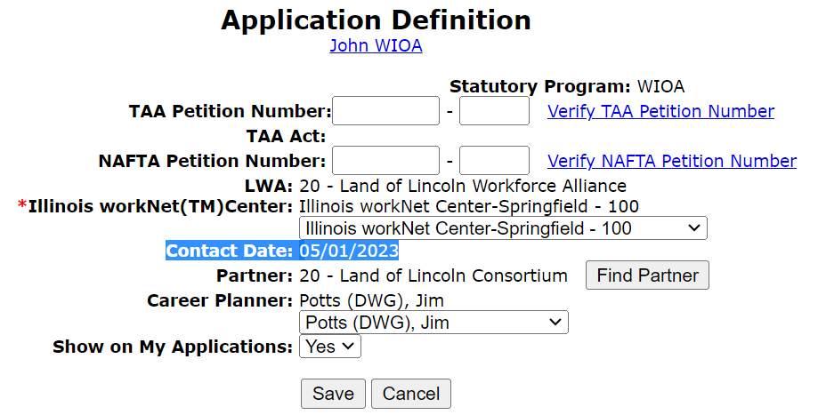
Application Date
The Application date can be on or after any date from the original application contact date
For this client, the original contact date was 5/1/2023
Any date on or after 5/1/2023 could be the application date in IWDS

Slide 6
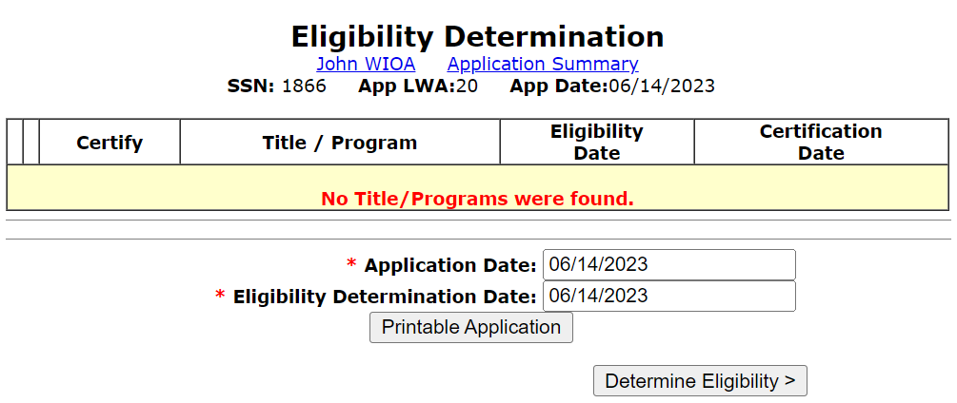
Eligibility Determination Screen
The application date and eligibility determination date are not required to be on the same date
Office of Employment and Training (OET) Career Planning Policy Chapter 4 Section 2 provides guidance that eligibility determination must be within 30 days of the application date

Slide 7
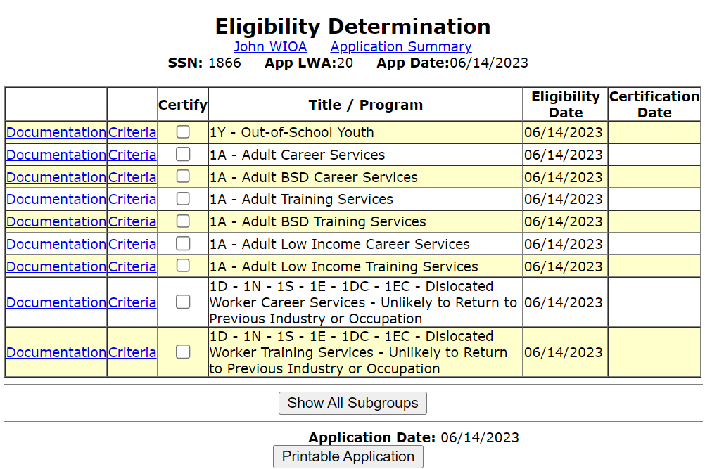
Eligibility Determination Screen
When we clicked on “Determine Eligibility”, IWDS logic went through the responses that were recorded in the application and is now displaying the different WIOA eligibility criteria this individual has met under WIOA.

Slide 8
Criteria VS Documentation

Slide 9
Criteria VS Documentation
Criteria describes why a client is qualified based on certain answers that were given in the application
Documentation must be populated by the Career Planner describing the actual documents used to support the client’s eligibility criteria

Slide 10
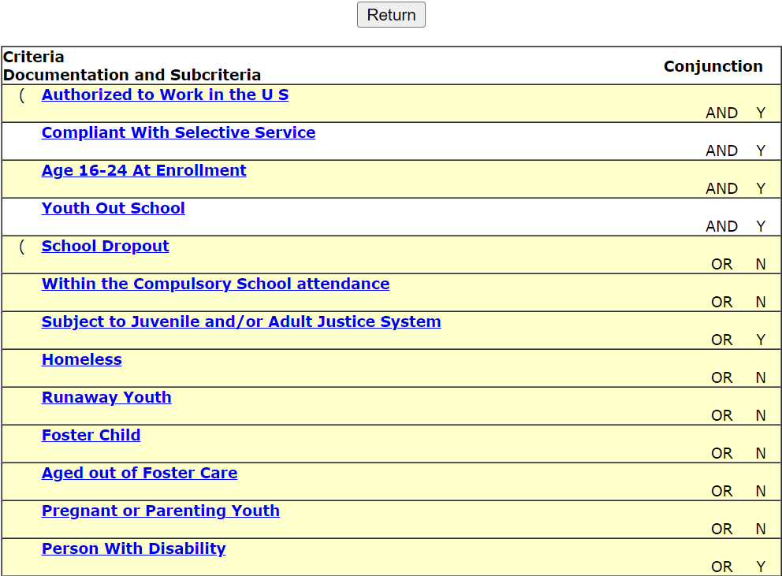
Criteria
Under the Out of School Youth Criteria, explains the “why” and “how” someone meets certain criteria by the “Y” on the far right
If you click on the criteria, it describes the details about the specific criteria. (see next slide)

Slide 11
Criteria
When clicking on the criteria for “Authorized to Work in the U.S.”, as shown below, it explains the details for the criteria associated with “Authorized to Work in the U.S”:

Slide 12
Documentation – What is Used ?
Versus documentation, which asks for the specific tailored documentation that is being used for each of the eligibility criteria that has been met.

Slide 13
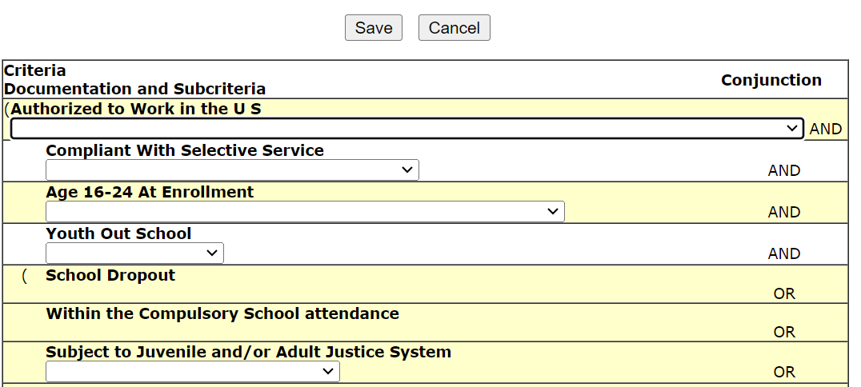
Documentation
When you click on “documentation”, it provides the location where the specific documentation that is going to be used to support the various criteria that was identified in the WIOA application.

Slide 14
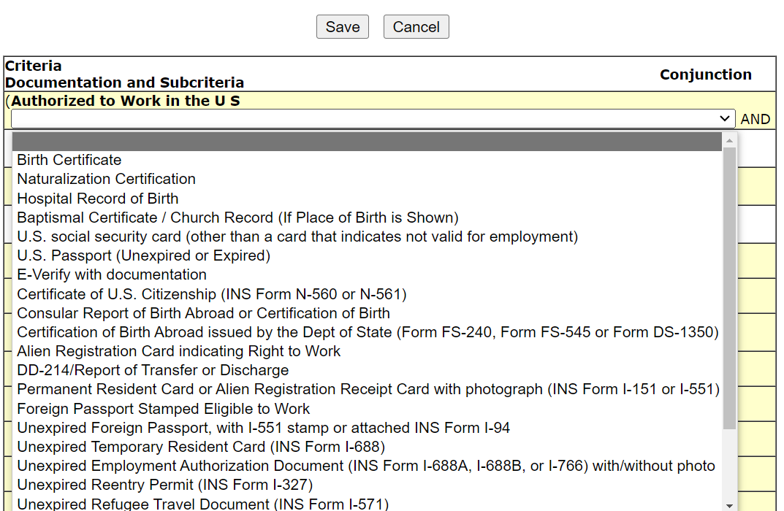
Documentation
Once you click in the drop-down, you will see the choices of documentation that could be used to support the criteria:

Slide 15
Documentation
It is important to understand that you only need to provide the documentation under the program titles that you intend to enroll the client in services
Meaning, if a client is eligible for multiple titles like this example client is, but you only intend to enroll the client under one title, then you would only be required to populate the documentation under the eligibility certification for that title you are going to enroll the client in services
However, if the plan is co-enrolling under multiple titles, then the documentation will need to be provided for all titles that you intend to enroll the client in

Slide 16
Certification under Adult & Youth
For this client, we are going to certify them under the Adult title for all priority programs the client had met criteria and under the Out-of-School Youth title:
Adult BSD Career Services
Adult Low-Income Career Services
Adult BSD Training Services
Adult Low-Income Training Services
Out-of-School Youth

Slide 17
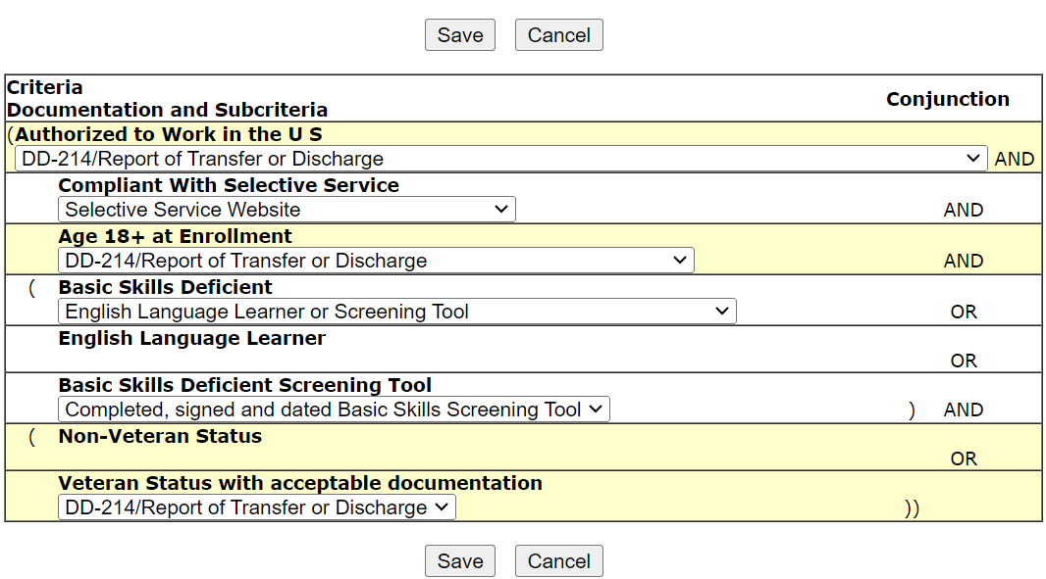
Documentation
Documentation for Adult Basic Skills Deficient Career Services:

Slide 18
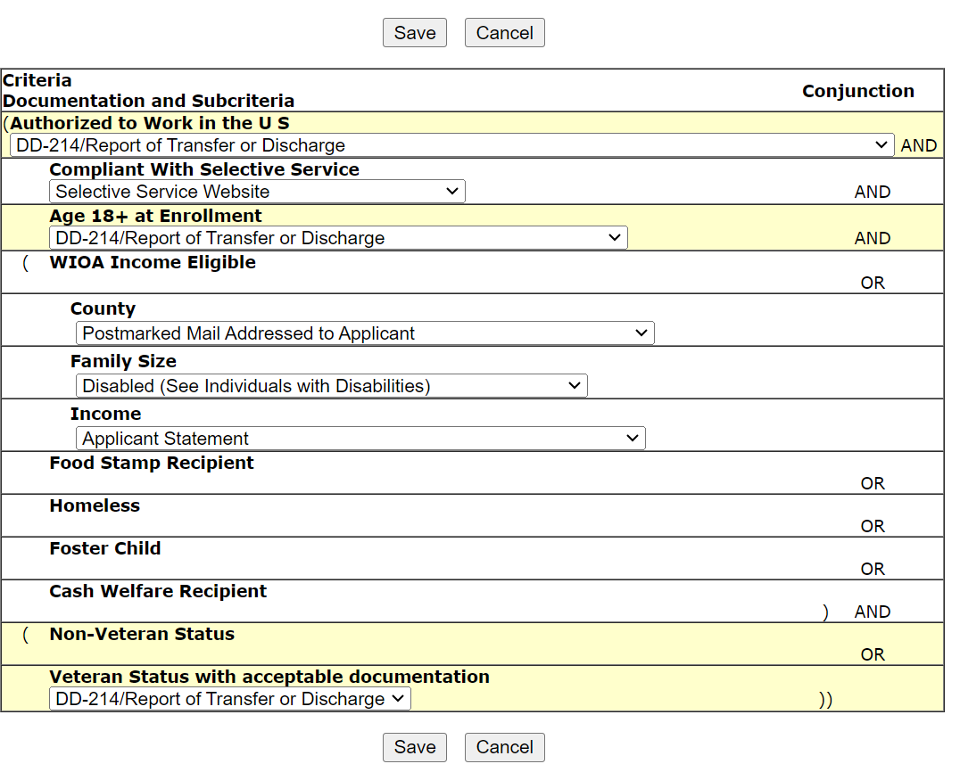
Documentation
Documentation for Adult Low-Income Career Services:

Slide 19
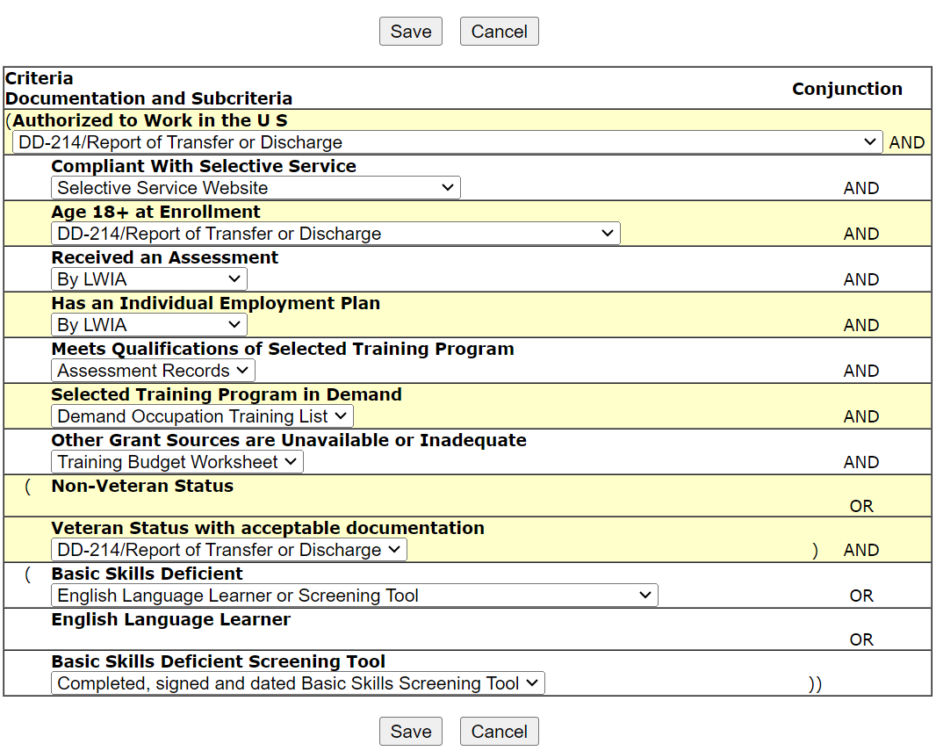
Documentation
Documentation for Adult Basic Skills Deficient Training Services:

Slide 20
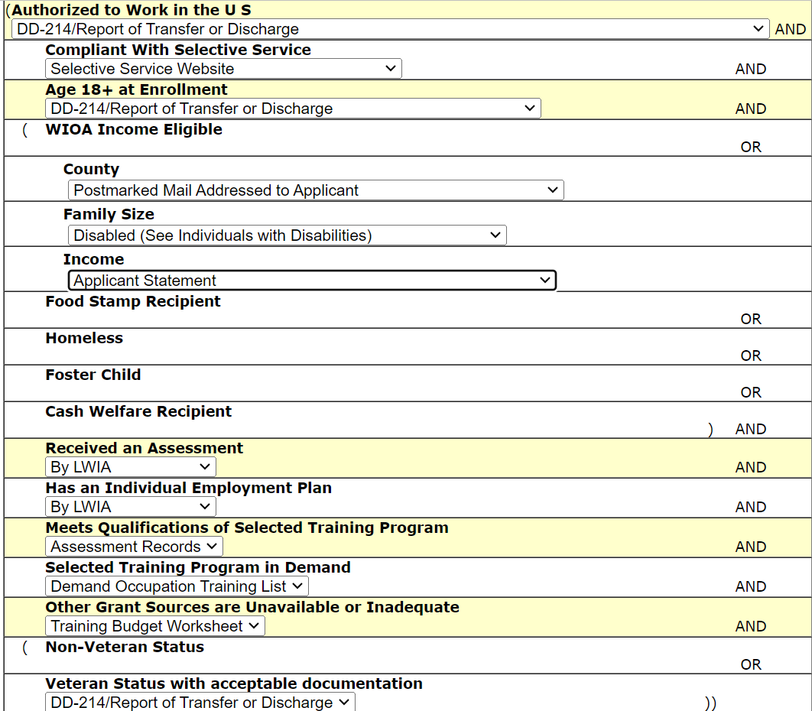
Documentation
Documentation for Adult Low-Income Training Services:

Slide 21
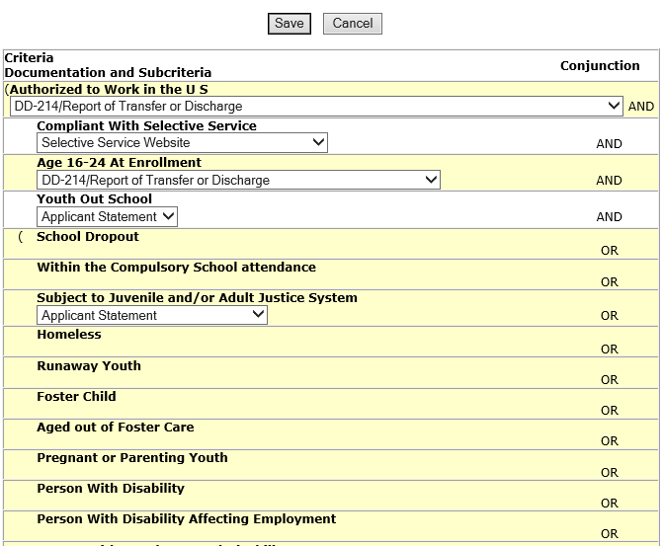
Documentation
Documentation for Out-of-School Youth
For a Youth client that has the barrier of a disability but has other barriers that will support Youth eligibility, they are not required to provide formal documentation about the disability barrier
In this instance, since the client had other Youth barriers to support eligibility, the documentation for the disability was not required

Slide 22
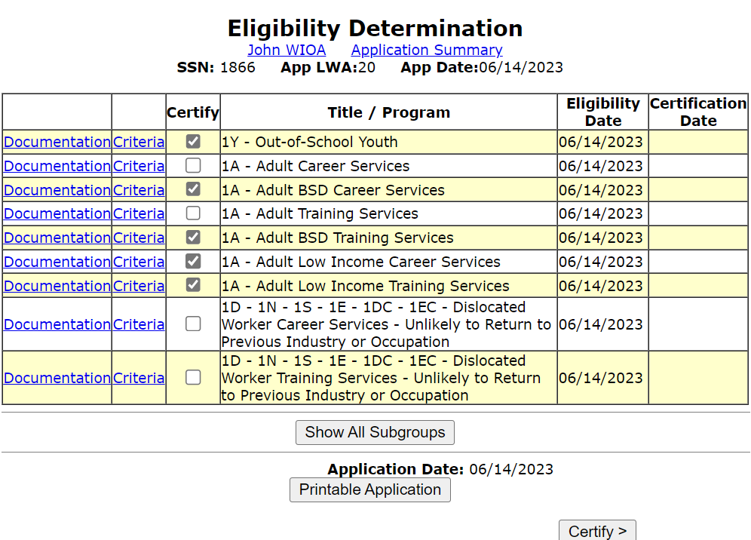
Eligibility Certification
Must check all the titles that are being certified.

Slide 23
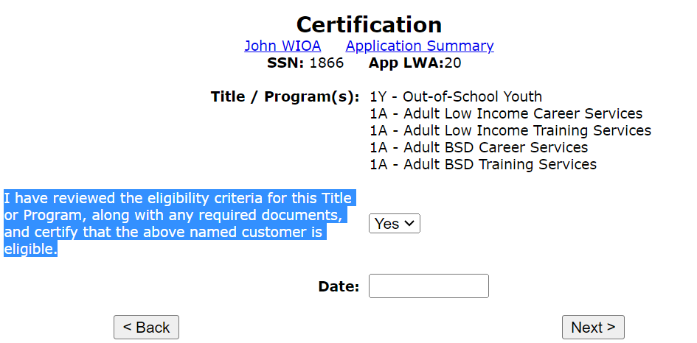
Eligibility Certification
Review the titles and the certification statement. Once verified, you must change the response on the statement from “No” to “Yes”.

Slide 24
Certification Date
The certification date is the most important date for the application
The certification date must be on or after the application date; it must be within 30 days of the application date, but cannot be a date in the future
The date that is recorded as the certification date for a client means all documentation, including the signed application, must be dated on or before the recorded “Certification Date”

Slide 25
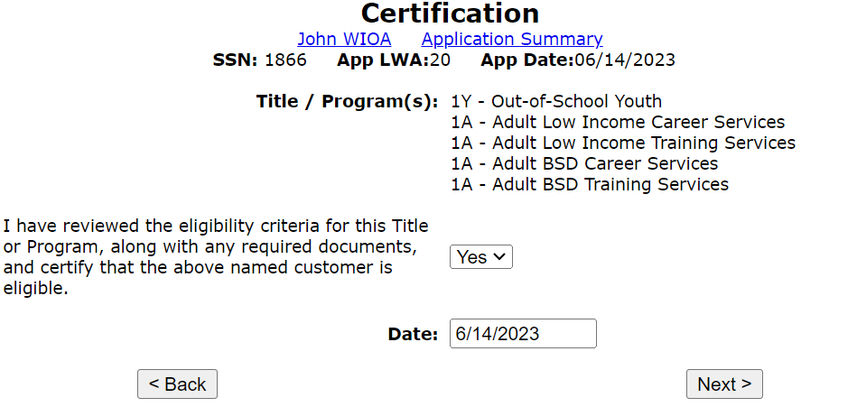
Certification
In this instance, the certification date is 6/14/2023, which is the same date as the application (not required, could be up to 30 days); then hit “next”.

Slide 26
WIOA Eligibility Results
After the customer is determined eligible by hitting “Next”, they go from being an “Inquirant” to an “Applicant”
Most of the information in the IWDS application is now locked and saved as it was entered into the system at the time of application
OET Career Planning Policy provides guidance that “The applicant must be enrolled in a WIOA Title IB service within forty-five (45) days from the date their eligibility was certified.”
If not enrolled in WIOA services within 45 days of the certification date, the record then locks, and nothing can be done with the record

Slide 27
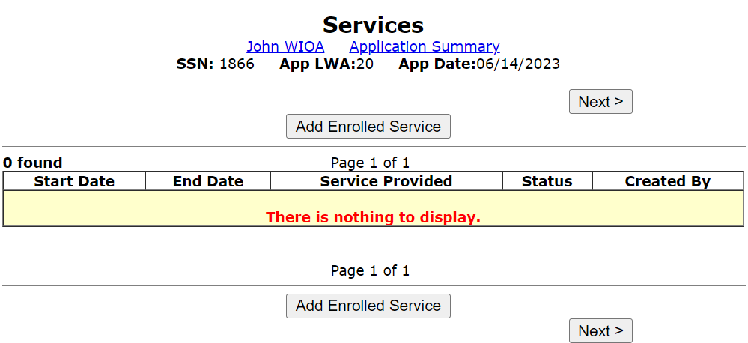
Applicant Record in IWDS
The client record is now in “Applicant” Status; to move forward with enrolling in services hit “Add Enrolled Services”:

Slide 28
WIOA Titles and Requirements
This client has been certified under 1A Adult (both priority of BSD and Low-Income); and under the 1Y Youth (Out-of-School Youth) title
For this client, all services must be either under the 1A or 1Y titles;
If the client is enrolled in services under both titles, the client will be considered co-enrolled and cannot exit from one title until finished being served under all titles enrolled
The next several slides will demonstrate enrollment in WIOA Services under both the 1Y and the 1A title

Slide 29
Enrollment in 1Y Youth
As previously addressed in the WIOA Assessment presentation, all Youth clients must have their three non-enrolling Youth activities recorded before any enrolling Youth activities can be recorded:
YOUTH Comprehensive and Specialized Assessments;
Development of an Individual Service Strategy (ISS);
YOUTH Career Planning (Case Management)

Slide 30
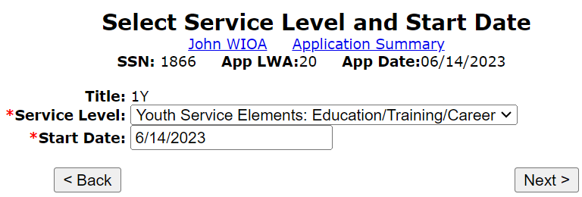
Enrolling in 1Y Activity
Select the Youth Title, which is “1Y” and then select the “Start Date” of the activity:

Slide 31
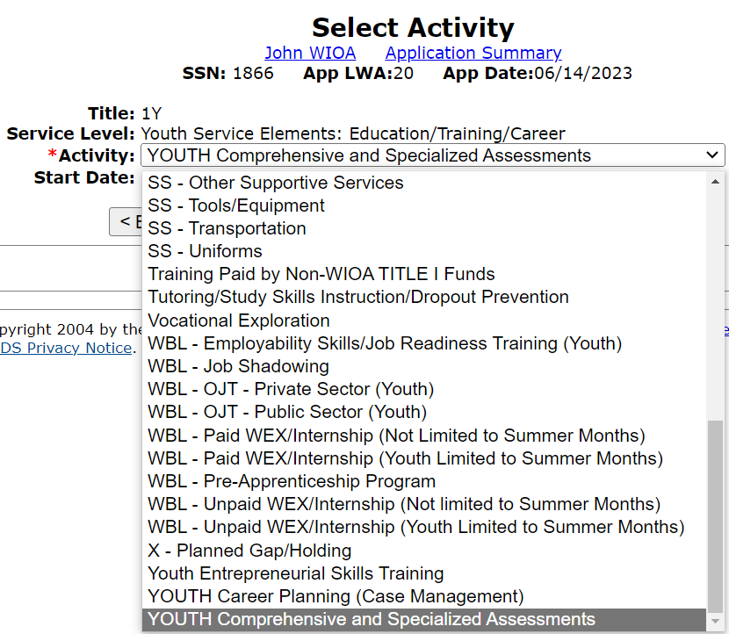
Youth Non-Enrolling Activities
As mentioned previously, the first activity/service recorded for Youth after certification should be the Individual Service Strategy.

Slide 32
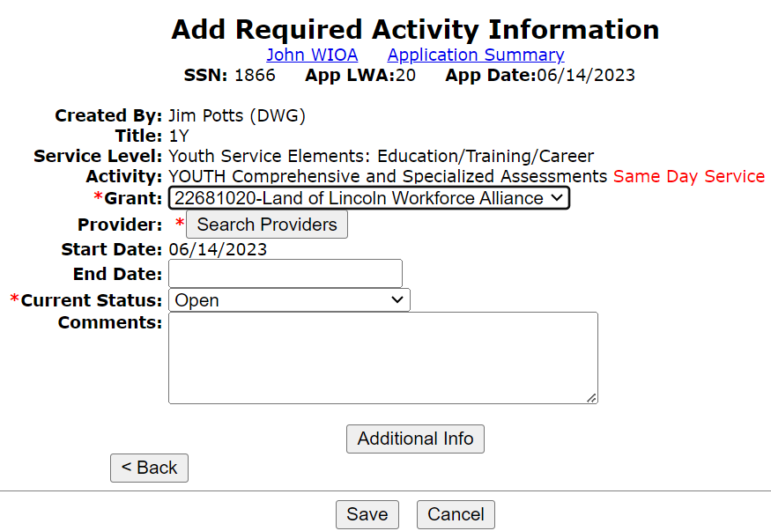
Youth Comprehensive and Specialized Assessment
Must record the accurate grant that will fund the service
Must record the appropriate provider
If the provider you need is not available when you “Search Provider”, contact your Local Systems Administrator who is responsible for managing the providers

Slide 33
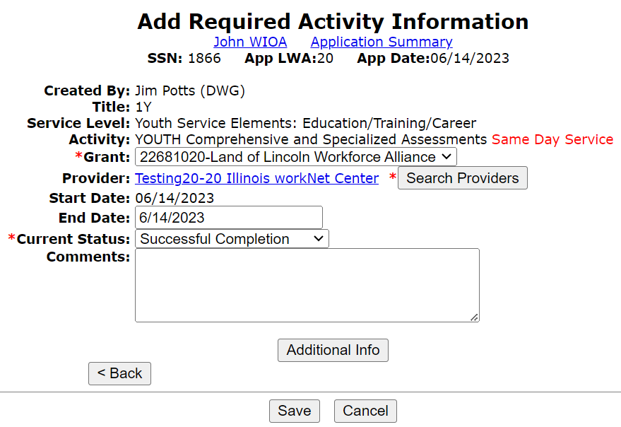
Same Day Service
All three of the non-enrolling Youth activities are “Same Day Services”, meaning they must be closed on the date the service was provided
Each of the non-enrolling Youth activities should be closed with the current status of “Successful Completion”

Slide 34
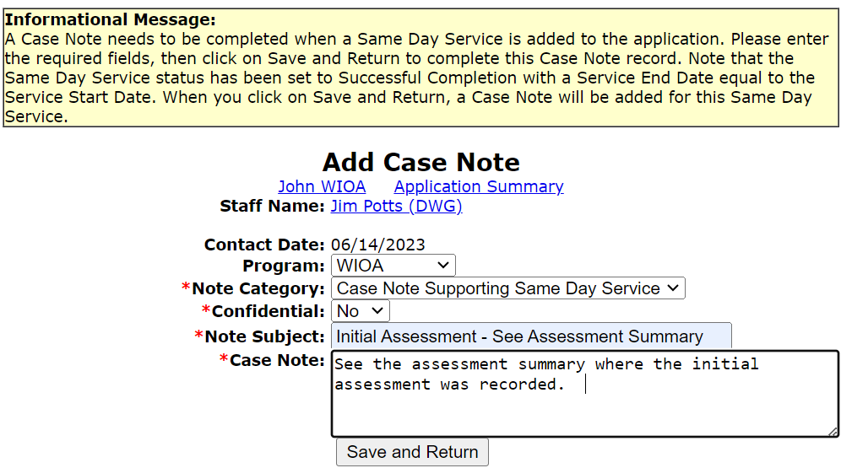
Same Day Service Case Note
All same day services are required to have a same day service Case Note that supports the actions taken for the service/activity:

Slide 35
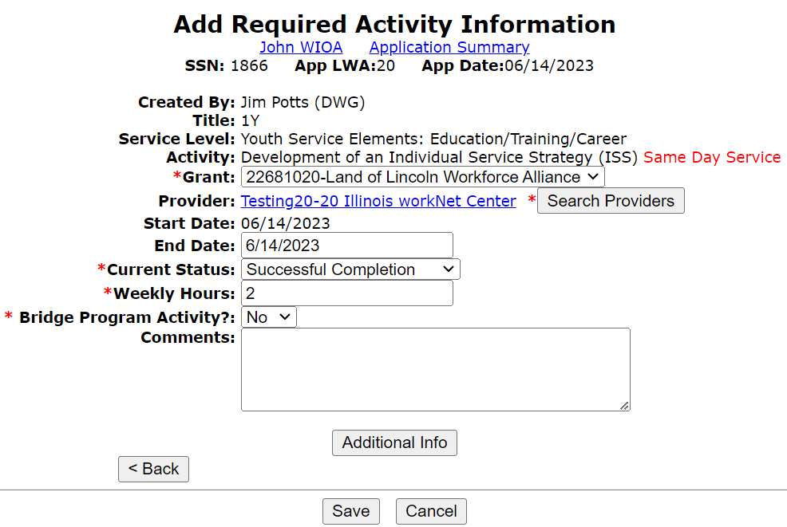
Development of Individual Service Strategy
The second non-enrolling activity recorded should be the Youth non-enrolling activity of Development of an ISS
System does require “Weekly Hours”, which should be an estimate of the number of hours that had been used for the initial assessment and creating the ISS

Slide 36
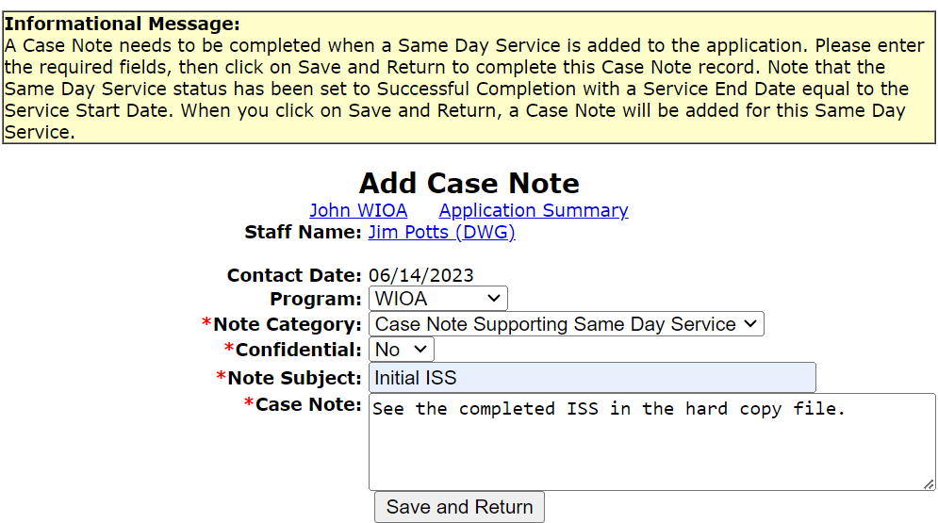
Same Day Service Case Note
For the Non-enrolling Youth activity of “Development of Individual Service Strategy”, since it is a same day service, there will be a same day service case note
In instances where a hard copy document of the ISS was used, it would be acceptable to reference those details in the same day service case note
OR, the entire ISS could be spelled out in the case note if that is your local process

Slide 37
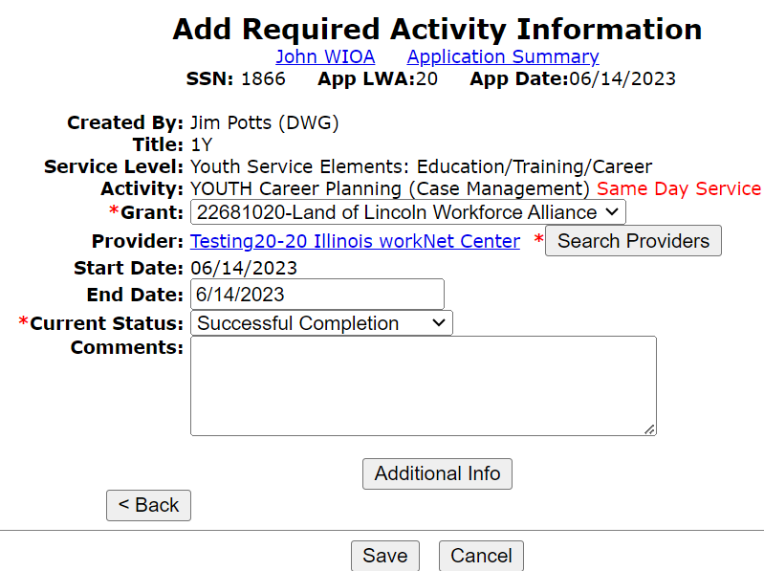
Youth Career Planning (Case Management)
YOUTH Career Planning (Case Management) should be the third non-enrolling Youth activity that is recorded
Technically, there is no required order that these three non-enrolling activities must be recorded

Slide 38
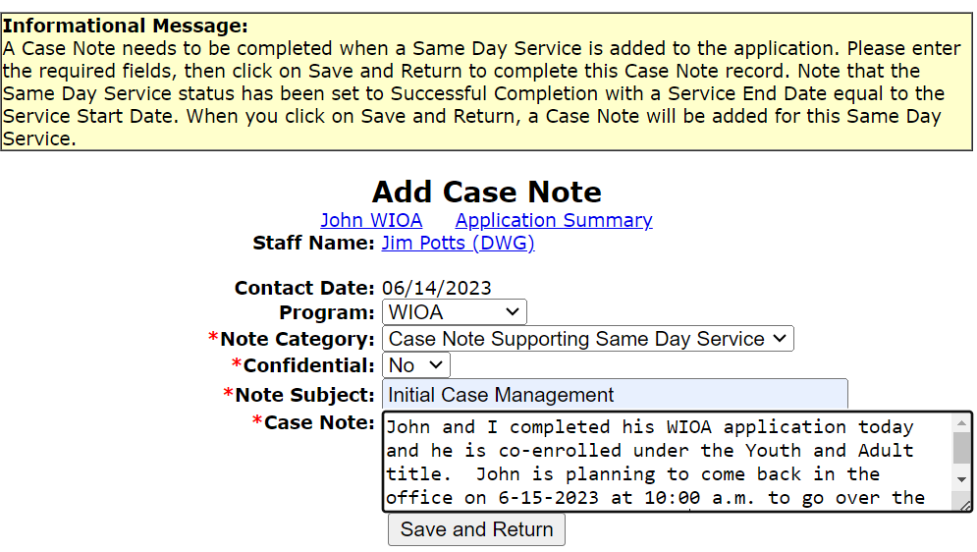
Same Day Service Case Note
For a Youth client, under the non-enrolling Youth activity of Career Planning (Case Management) should be where the two-way communication between the client and the Career Planner is recorded.

Slide 39
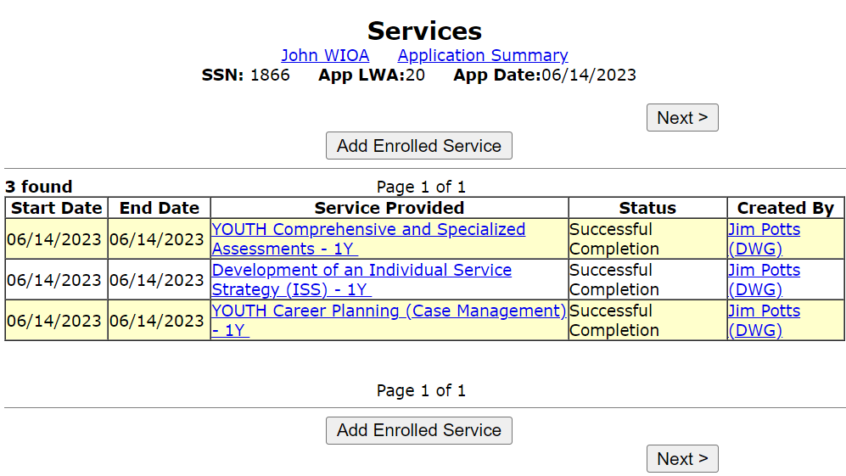
Three Non-enrolling Youth Activities
As mentioned previously, these three non-enrolling Youth activities do not register the client into the WIOA Youth program but are required before the system will allow the client to be enrolled in any WIOA enrolling Youth activities.

Slide 40
Client is still in “Applicant” Status
Since this client currently only has the three non-enrolling Youth activities recorded on the IWDS record, the client is still reflected as an “Applicant” in IWDS:
As a reminder, an “Applicant” record in IWDS is a client record that has had WIOA Eligibility certified, but the client has not yet been enrolled in any WIOA enrolling services
A key point to understand, internal logic within IWDS does require that a client record must be registered in one or more enrolling WIOA services within 45 days of the date the client had their WIOA Eligibility certifies

Slide 41
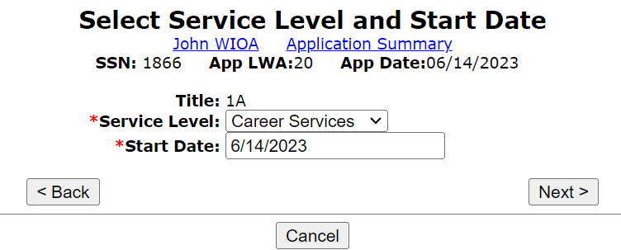
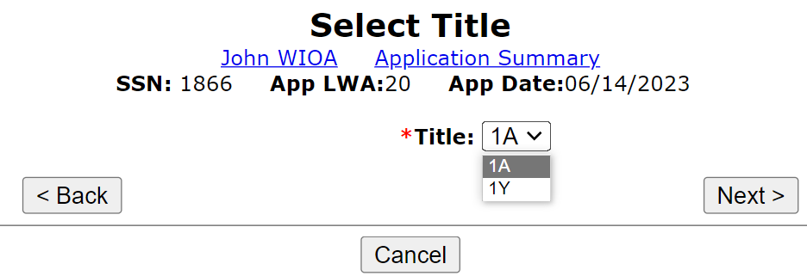
Co-Enrolled Under Adult Title
We will now demonstrate co-enrolling the client under the Adult title. Select the 1A title and then choose the service level and start date of the Adult Service.

Slide 42
Adult/Dislocated Worker Assessment Service(s)
OET Career Planning Policy 4.2 requires that all Adult and Dislocated Worker clients must have an assessment completed
The level of the assessment for the Adult/Dislocated Worker is based on if the client will only need Career Services or if the client will need both Career and Training Services
If it is thought that the client is only going to require Career Services to gain/regain self-sustaining employment, the assessment is truncated, as compared to an individual that will receive WIOA funded training services, where a much more in-depth assessment is required

Slide 43
Adult/Dislocated Worker Assessment Service(s)
For an Adult/Dislocated Worker who should only receive WIOA Career Services, then the Assessment Service would be “Initial Assessment of Skill Levels & Other Service Needs (STAFF ASSISTED)” as shown in the example below:

Slide 44
Adult/Dislocated Worker Assessment Service(s)
For an Adult/Dislocated Worker that will receive WIOA Training Services, then the complete assessment must be conducted, and the service is titled “Comprehensive and Specialized Assessment”:

Slide 45
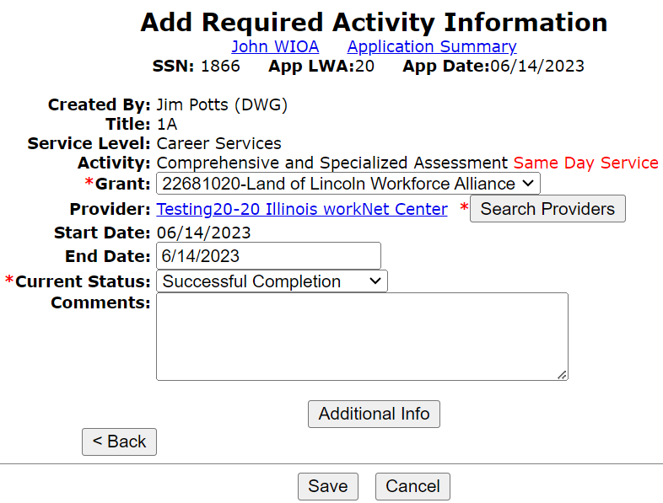
Adult/Dislocated Worker Assessment Service(s)
This example Adult client has been certified up to the WOIA Training services level, so the “Comprehensive and Specialized Assessment” is the correct assessment service to record
This is a same day service, meaning the service must be completed the day it began

Slide 46
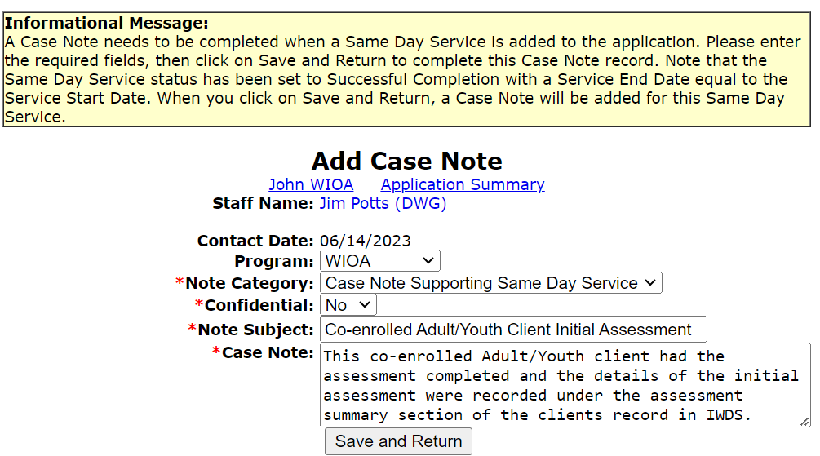
Same Day Service Case Note
All same day services must have a same day service case note that describes the details of the service/activity.

Slide 47
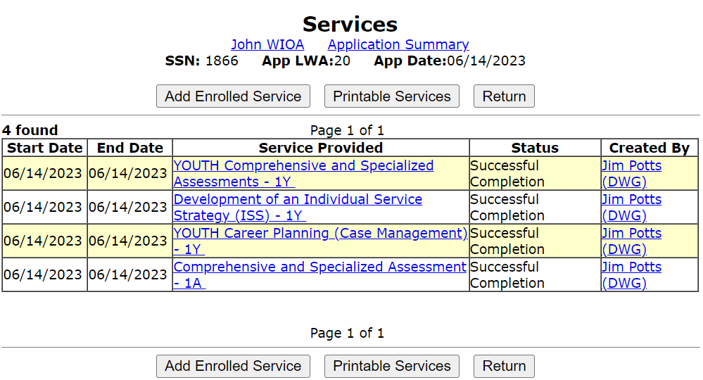
Transition from Applicant to Registrant
The service of “Comprehensive and Specialized Assessment” OR the shorter, “Initial Assessment of Skill Levels & Other Service Needs (STAFF ASSISTED)” are both considered enrolling services under the Adult or Dislocated Worker titles.

Slide 48
Transition from Applicant to Registrant
As shown below, with that enrolling service related to the Adult assessment, this client is now considered a WIOA “Registrant”:

Slide 49
Individual Employment Plan
OET Career Planning Policy 4.2 requires that all Adult and Dislocated Worker clients must have an Individual Employment Plan (IEP) created to support enrollment in the WIOA program
After the appropriate Career Service assessment has been recorded, then any Adult client (or Dislocated Worker client) must have the service of “Development of an IEP” recorded

Slide 50
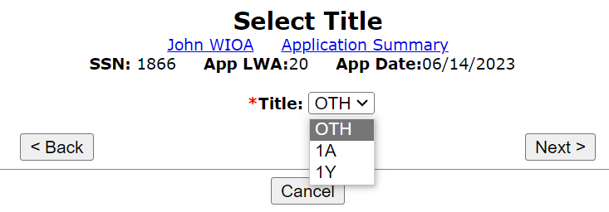
Selecting the Correct Title
Within IWDS, after the first enrolling service has been recorded, when additional enrolling services are going to be recorded and when choosing the title, you will now notice there is an option of “OTH” for a Title:
NEVER select the title of “OTH” when enrolling a client in WIOA services in IWDS

Slide 51
Enrollment in Development of an IEP

Slide 52
Enrollment in Development of an IEP
The service of “Development of an IEP” is a same day service, meaning it must be closed on the date the service was opened:
Will require populating the end date of the service;
Updating the Status to “Successful”;
Recording the “Weekly Hours” – (estimate the time required to complete the IEP)
Complete the Same Day Service Case Note about the service

Slide 53
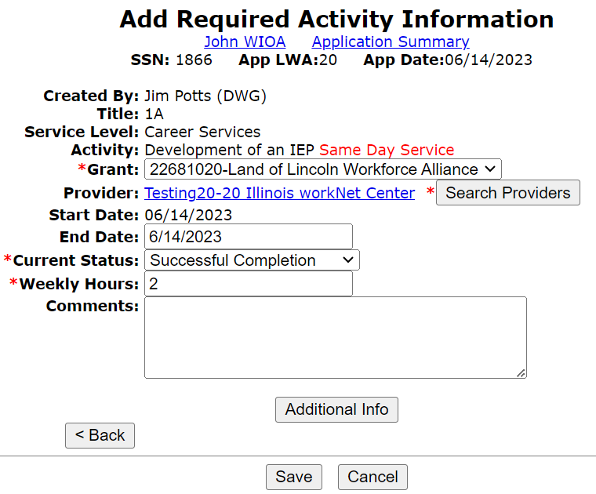
Enrolling in Development of an IEP

Slide 54
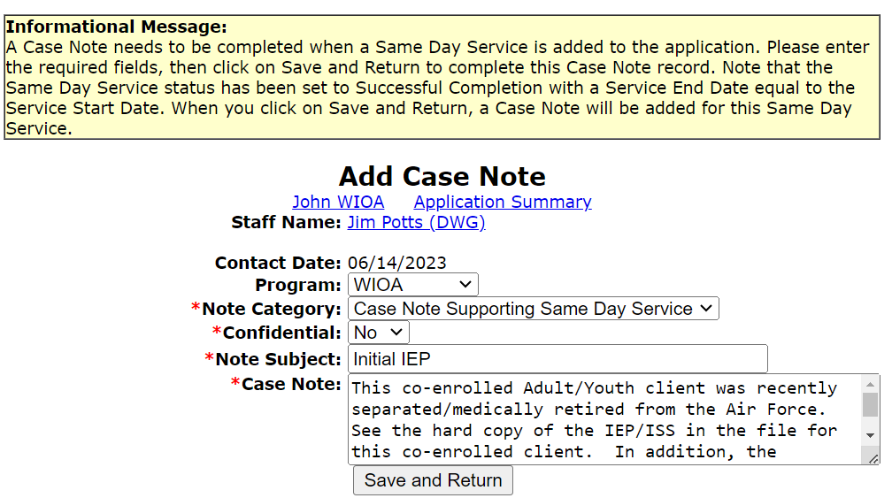
Enrolling in Development of an IEP
The Same Day Service Case Notes are used to support the client’s enrollment in the 1A service of Development of an IEP.

Slide 55
Follow-Up Appointment
The client came back on Thursday, 6-15-2023, and spent significant time conducting Labor Market Information (LMI) research and met with Career Planner
His job in the Air Force was Aircraft Scheduler, he wants to transition to a different career, so he has researched the various Career Opportunities that would go along with his skill sets and current education
We will now demonstrate updating his services accordingly

Slide 56
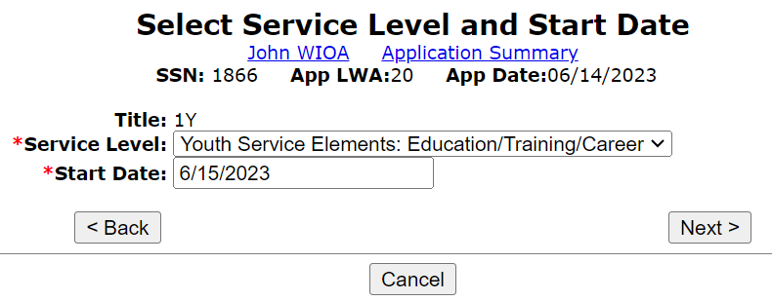
Updating Services

Slide 57
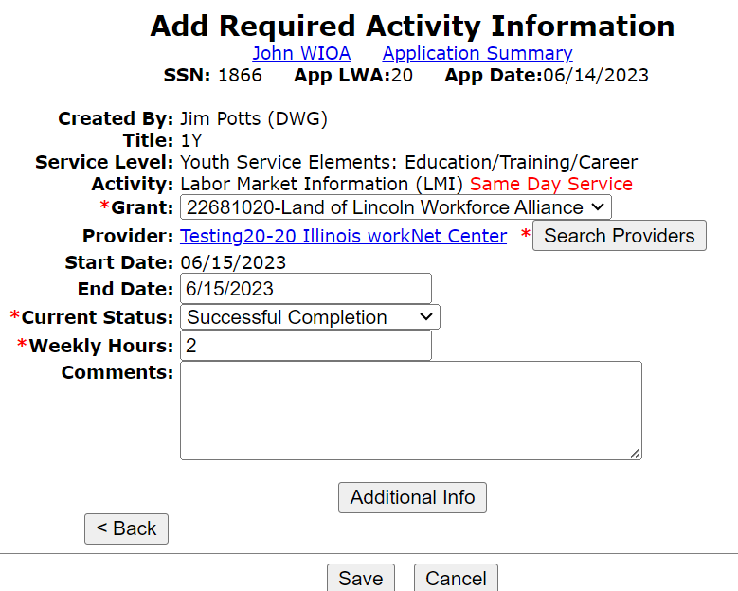
WIOA Youth Activity of Labor Market Information (LMI)

Slide 58
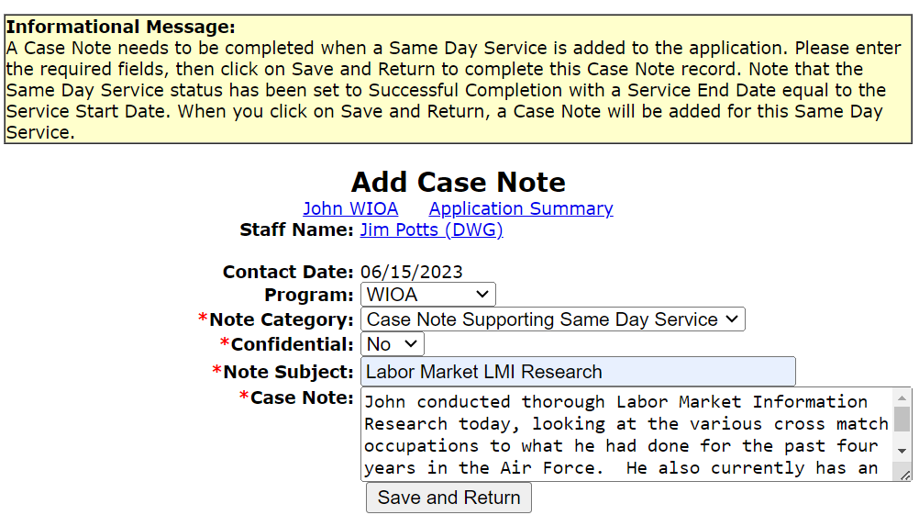
Same Day Service Case Note
All same day services must have a same day service case note that describes the details of what occurred during the service/activity.

Slide 59
Services Screen

Slide 60
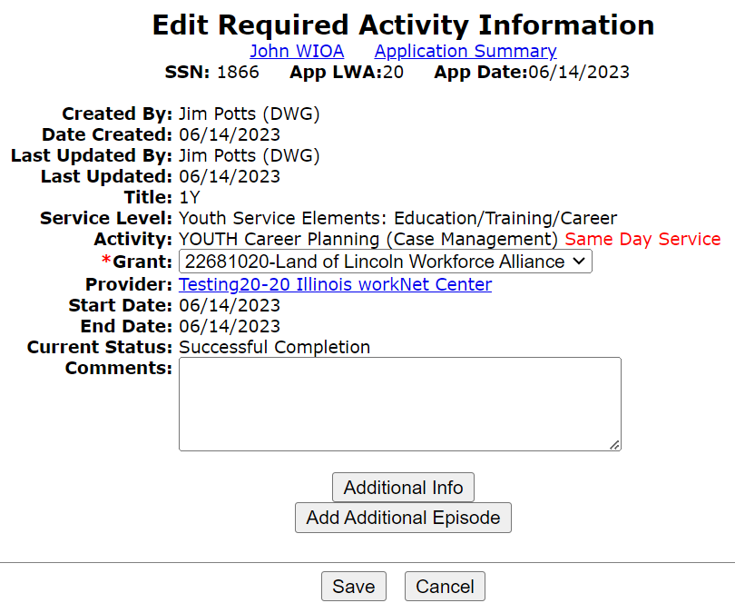
Adding Additional Episode
Career Planner and client met today to go over LMI research, recording an additional episode of the YOUTH Career Planning (Case Management).

Slide 61
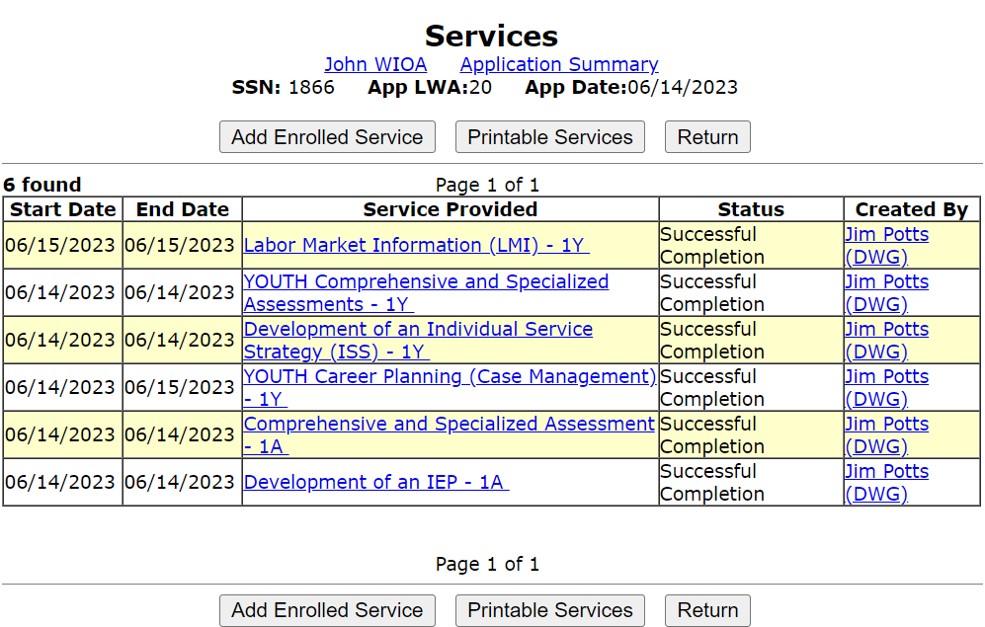
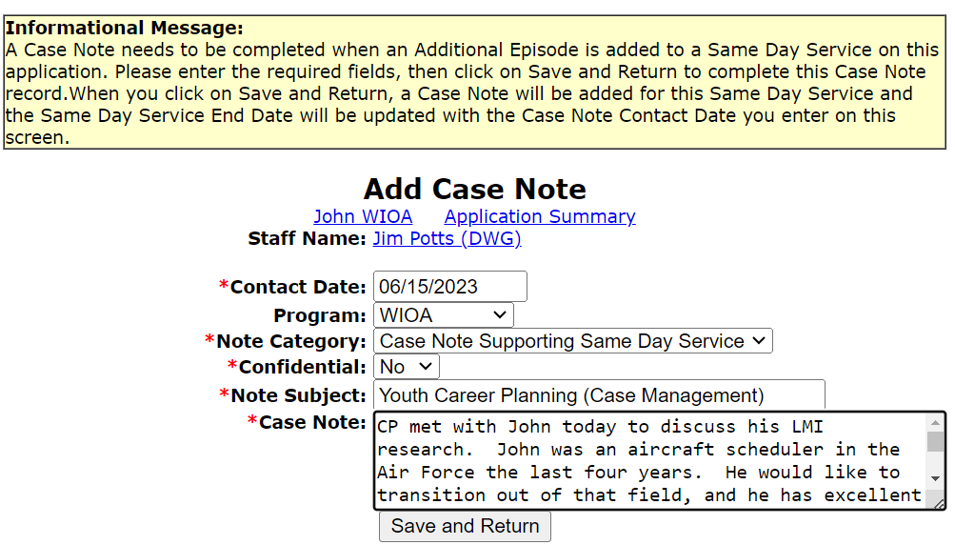
Adding Additional Episode
Recording same day service case note:

Slide 62
Concludes the Presentation
This concludes the presentation on the steps required for taking a previously completed WIOA application for a Workforce Innovation and Opportunity Act client in IWDS, determining eligibility, certifying eligibility and then enrolling the client in WIOA services, including demonstrating adding an additional episode of a same day service
If you have questions related to this presentation, feel free to contact me by email at James.potts@Illinois.gov or by phone at (217) 416-7097

