Slide 1
WIOA Low-Income Eligibility
June 15th, 2023

Slide 2
Objective
The primary objective of this presentation is to discuss the various ways a Workforce Innovation and Opportunity Act (WIOA) client could meet WIOA Low-Income criteria
Secondarily, it will demonstrate how the various WIOA Low-Income criteria are recorded on a client's electronic record in the Illinois Workforce Development System (IWDS)

Slide 3
Federal Guidance
Workforce Innovation and Opportunity Act of 2014 is the overall driving factor for all the WIOA programs
TEGL 19-16 – Guidance on Services Provided through Adult and Dislocated Worker under WIOA – dated March 1st, 2017
TEGL 21-16 – Third WIOA Title I Youth Formula Program Guidance – dated March 2nd, 2017
Change 1 to TEGL 21-16 was issued July 30th, 2021 – Deals with the updated process for Determining Low Income for Youth Living in a High Poverty Area
TEGL 09-22 – WIOA Title I Youth Formula Guidance – dated March 2nd, 2023

Slide 4
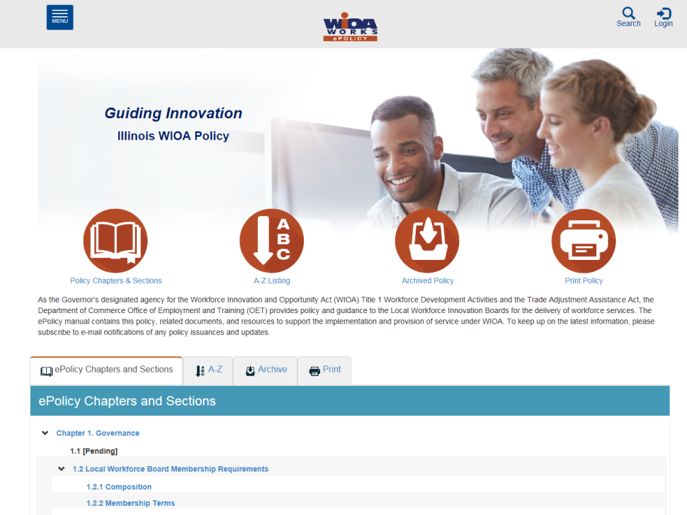
Understanding the ePolicy Manual
The Illinois Department of Commerce and Economic Opportunity, Office of Employment and Training (OET) utilizes a WIOA ePolicy portal to maintain all current and new guidance issued by the Illinois Workforce Innovation Board (IWIB) and OET.
Homepage: www.illinoisworknet.com/DCEOPolicies

Slide 5
State Policy Guidance
WIOA ePolicy Chapter 5 Section 5 - Low-Income Individuals
Attachment A – Documentation
Attachment B – Income Inclusions/Exclusions
WIOA Notice NO. 22-NOT-01 – Revised Income Guidelines for Determining Low-Income Status for WIOA Eligibility – dated May 12th, 2023

Slide 6
WIOA Low-Income
The eight ways a WIOA Client could become qualified as Low-Income:
Cash Welfare
Food Stamps
Homeless
Free or Reduced Priced Lunch
Foster Child
Youth Customer Living in a High Poverty Level
Family Income Calculation
Family of One Due to Disability

Slide 7
Low-Income Verification
To meet WIOA Low-Income criteria, a client would only need to meet one of the eight different Low-Income criteria
However, if a client claims to meet Low-Income criteria multiple ways, then the expectation at eligibility determination/certification would be to have verification documentation to support each Low-Income criteria claimed

Slide 8
Low-Income: Cash Welfare
WIOA Low-Income Criteria that do not require an income calculation:
Cash Welfare
Food Stamps
Homeless
Free or Reduced Priced Lunch
Foster Child
Youth Customer Living in a High Poverty Area

Slide 9
WIOA Low-Income Criteria
The criteria for Cash Welfare and Food Stamps is:
Personally receives or is a member of a family that receives or received in the past six (6) months either Cash Welfare or Food Stamps. (This wording for these low-Income criteria is directly out of the Federal and State WIOA guidance.)

Slide 10
WIOA Family Definition
The term “family” means two or more persons related by blood, marriage, or decree of the court who are living in a single residence and are included in one or more of the following categories:
(A) A married couple and dependent children
(B) A parent or guardian and dependent children
(C) A married couple

Slide 11
WIOA Low-Income Criteria
To tie this criteria together, the client or a member of the client’s WIOA defined family must either be on Cash Welfare or Food Stamps, either currently or within the past six months of the client’s WIOA application before a client could be determined Low-Income due to Cash Welfare or Food Stamps.

Slide 12
Question about Family?
Referring to the WIOA family definition, Charlie and Betty live together, are not married, and have a son, Tommy.
Q - Betty comes in for WIOA services; how many people are in her WIOA defined family, and who are they?

Slide 13
Response to the Family Question
Referring to the WIOA family definition, Charlie and Betty live together, are not married, and have a son, Tommy.
Q - Betty comes in; how many people are in her WIOA defined family, and who are they?
A – Family size of two, Betty and Tommy. Based on the WIOA Definition of family, Charlie and Betty would need to be married to be considered a family of three in this situation.

Slide 14
WIOA Low-Income: Cash Welfare
Temporary Assistance for Needy Families (TANF) program under Part A of Title IV of the Social Security Act, or
Supplemental Security Income (SSI) program established under Title XVI of the Social Security Act, or
State or local income-based public assistance.

Slide 15
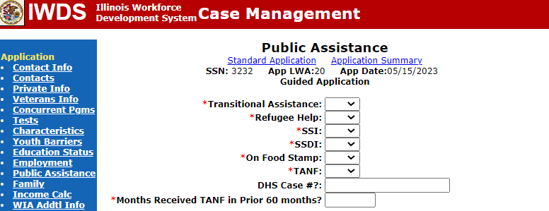
Public Assistance Screen
If “Yes” is entered on the IWDS Public Assistance screen for any of the following, the client will be determined Low-Income based on “Cash Welfare”.
Transitional Assistance
Refugee Help
SSI
TANF

Slide 16
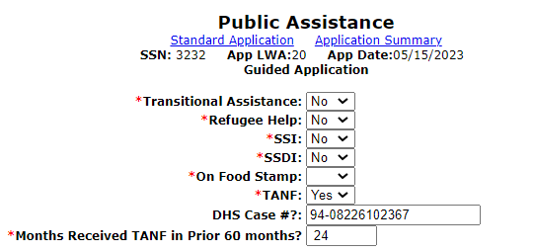
Temporary Assistance for Needy Families (TANF)
If the TANF question is populated with “Yes”, internal logic within IWDS will require that the client’s DHS Case # be recorded, and the number of months in the prior 60 months the individual has been on TANF must be included.

Slide 17
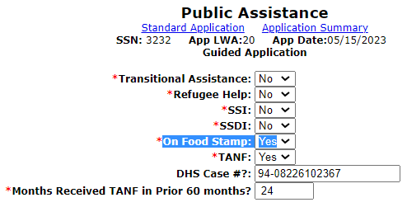
Low-Income: Food Stamps
Personally receives, or is a member of a family that receives or received in the past six (6) months the Supplemental Nutrition Assistance Program (SNAP) assistance
If Food Stamp and TANF are both populated with “Yes” in their application, at certification the documentation must be on hand to support both criteria

Slide 18
Food Stamp Program for School Aged Youth
In the past, as recently as February 2023, Illinois Department of Human Services (IDHS) in collaboration with Illinois State Board of Education has issued School Pandemic Electronic Benefit Transfer (P-EBT) cards for families with children who are eligible for free or reduced lunches at school.

Slide 19
Pandemic Electronic Benefits Transfer
IDHS’ Pandemic Electronic Benefits Transfer (P-EBT) is part of a SNAP COVID-19 waiver SNAP COVID-19 Waivers | USDA-FNS
In relation to WIOA Low Income due to food stamps, any individual or member of a family that receives food stamps or has received food stamps in the past six months would meet WIOA Low-Income criteria

Slide 20
Pandemic Electronic Benefits Transfer Documentation
It has been brought to OET’s attention that there is no date provided on these P-EBT white cards, in many cases it appears that the Youth are receiving a white EBT card with only their name and no issue date
Along with capturing a copy of the white P-EBT card, staff should also obtain a client (or parent) self-attestation on when the Youth began receiving the P-EBT benefit and if they are no longer receiving the benefit, when did it end

Slide 21
P-EBT WIOA Low Income
An important distinction to reiterate, this is a food stamp benefit that will fall under the criteria of “Personally receives or is a member of a family that receives or received in the past six (6) months the Supplemental Nutrition Assistance Program (SNAP) assistance.”

Slide 22
Question about Food Stamps
Q – Tommy receives P-EBT; Tommy lives with his Mom, Betty. If Betty came in for WIOA Services, could she be determined Low-Income based on food stamps, even though she (Betty) is not receiving food stamps?

Slide 23
Answer to Food Stamps Question
Q – Tommy receives P-EBT; Tommy lives with his Mom, Betty. If Betty came in for WIOA Services, could she be determined Low-Income based on food stamps, even though she (Betty) is not receiving food stamps?
A – WIOA Low-Income criteria can be determined based on, “Personally receives, or is a member of a family that receives or received in the past six (6) months the Supplemental Nutrition Assistance Program (SNAP) assistance.”
Since Betty lives with her son Tommy, who is receiving food stamps via P-EBT, she could be determined Low-Income based on her son Tommy receiving food stamps

Slide 24
Low-Income: Homeless
Individual who lacks a fixed, regular or adequate nighttime residence; as defined under the:
Violence Against Women Act of 1994
Adult or Youth with a primary nighttime residence that is a public or privately operated shelter for temporary accommodation.
McKinney-Vento Homeless Assistance Act

Slide 25
Homeless Definitions Question
Q - Could a male client be determined homeless utilizing the definition under the Violence Against Women Act of 1994?

Slide 26
Answer to Homeless Question
Q - Could a male client be determined homeless utilizing the definition under the Violence Against Women Act of 1994?
A - Yes, for all clients (male or female) either the Violence Against Women Act of 1994 or McKinney-Vento Homeless Assistance Act definitions could be used to determine a client’s homeless status.

Slide 27
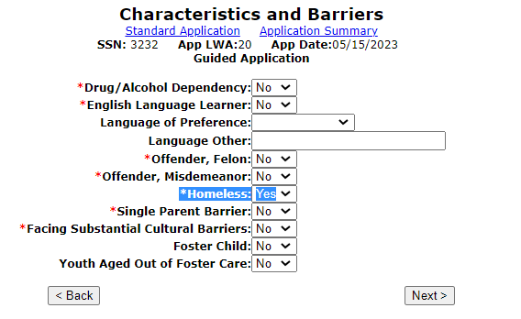
Low-Income: Homeless
If “Yes” is populated on the “Homeless” on the Characteristics and Barriers screen of the application, the client will be determined as Low-Income.

Slide 28
Low-Income: Free or Reduced Priced Lunch
Receives or is eligible to receive a free or reduced-price lunch under the
Richard B. Russell National School Lunch Act
Criteria for In-School Youth Only
Must have documentation from school

Slide 29
Low-Income: Free or Reduced Priced Lunch
TEGL 21-16 and our Low-Income Policy clarified that “In schools where the whole school automatically receives free or reduced-price lunch, WIOA programs must base Low-Income status on an individual student’s eligibility to receive free or reduced-price lunch or on meeting one of the other Low-Income categories under WIOA”
Meaning if only whole school criteria is used for free or reduced lunch, you cannot use this method to determine Low-Income criteria and must use one of the other Low-Income categories to determine an individual’s Low-Income status

Slide 30
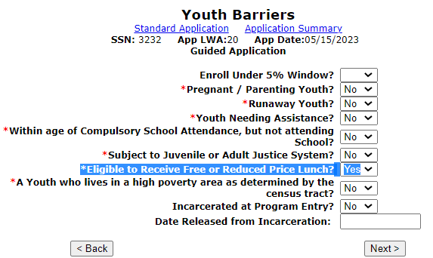
Low-Income: Free or Reduced Priced Lunch
Youth Barriers” screen is where the “Free or Reduced-Price Lunch” question is housed – if an In-School Youth client has a response of “Yes” the client will be determined as Low-Income.

Slide 31
Question about Free or Reduced Priced Lunch
Q – Sally is currently a Junior in H.S., and in the school district she attends, all students are eligible for free lunch. She has applied for WIOA services, what documentation would be needed to support her WIOA Low-Income Criteria due to free or reduced lunch?

Slide 32
Answer to Question about Free or Reduced Priced Lunch
Q – Sally is currently a Junior in H.S., and in the school district she attends, all students are eligible for free lunch. She has applied for WIOA services, what documentation would be needed to support her WIOA Low-Income Criteria due to free or reduced lunch?
A – The documentation would need to specifically address that Sally herself, by name, is eligible for free or reduced lunch. If the school will not provide information about an individual, then the client must find another way to support WIOA Low-Income criteria.

Slide 33
Free or Reduced Lunch or P-EBT
In many instances, schools may have temporarily replaced the free or reduced-price lunch program with the IDHS’ Pandemic Electronic Benefits Transfer (P-EBT), which is part of a SNAP COVID-19 waiver SNAP COVID-19 Waivers | USDA-FNS
Big difference, free or reduced-priced lunch is the only criteria for the In-School Youth client Low-Income; where the P-EBT could be for Youth and any individual in the Youth’s WIOA Family for Low-Income criteria

Slide 34
Low-Income: Foster Child
Under WIOA, a Foster Child is defined as: A minor on behalf of whom State or local government payments are made to a foster parent or other guardian
If an individual is a foster child, it is an automatic WIOA Low-Income criteria

Slide 35
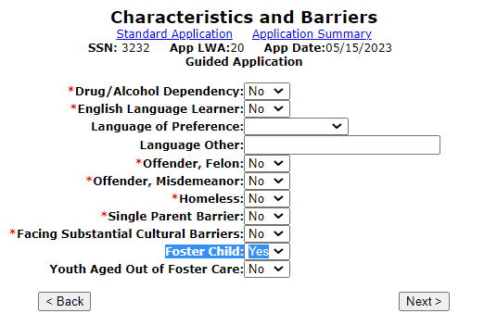
WIOA Low-Income: Foster Child
“Characteristics and Barriers” screen is where the “Foster Child” question is housed – if any client has a response of “Yes” to “Foster Child” - the client will be determined as Low-Income.

Slide 36
Question about Foster Child Documentation
Q – Conrad is currently a Senior in H.S., he lives with his foster parents. What is the documentation that could be used to support his WIOA Low-Income Criteria due to Foster Child status?

Slide 37
Foster Child Documentation
Q – Conrad is currently a Senior in H.S., he lives with his foster parents. What is the documentation that could be used to support his WIOA Low- Income Criteria due to Foster Child status?
A – The documentation choices to support Foster Child status to support WIOA Low-Income criteria are listed in Attachment “A” to Commerce WIOA Low-Income Policy WIOA ePolicy Chapter 5.5:
To support foster child status the following are acceptable choices: Court Contact; Court Documentation; Medical Card showing Foster Child Status; Verification of Payment made on behalf of the child; Written Statement from State/Local Agency

Slide 38
Youth Living in a High-Poverty Level
According to Section 129(a)(2) of WIOA legislation, for ISY and OSY, a Youth qualifies as Low-Income if the Youth lives in a high-poverty area.

Slide 39
Guidance in TEGL 21-16, Change 1
According to Section 129(a)(2) of WIOA, for ISY and OSY, a Youth qualifies as Low-Income if the Youth lives in a high-poverty area
Many rural counties in the U.S. have a poverty rate of 25 percent or above
TEGL 21-16 – Third WIOA Title 1 Youth Formula Program Guidance – dated March 2nd, 2017
Change 1 to TEGL 21-16 was issued July 30th, 2021 – Updated guidance related to the process for Determining Low-Income for Youth Living in a high-poverty area
Revised directions as of November 30, 2021

Slide 40
Revised Directions November 2021
Revised directions as of November 30, 2021, for using American Community Survey data to determine high-poverty areas are as follows:
Section 1 describes how to determine if an individual Youth lives in a high-poverty area based on their street address
Section 2 describes how to identify if an overall county has a poverty rate of 25 percent or above
Section 3 describes how to determine the poverty rate of American Indian Reservations, Oklahoma Tribal Statistical Areas, and Alaska Native Village Statistical Areas
Section 4 describes how to identify high-poverty areas in your county for targeting your services on high-poverty neighborhoods

Slide 41
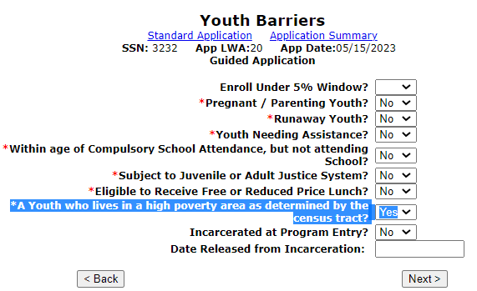
Low-Income: Youth Living in High-Poverty Area as Defined by Census
“Youth who live in a high-poverty area” question is on the Youth Barriers screen in IWDS, if the response of “Yes” - the client will be determined as Low-Income.

Slide 42
DOL Guidance

Slide 43
Question about High-Poverty Area
Q - If a Youth client is determined Low-Income based on living in a high-poverty area, and then later you would like to co-enroll the client into Adult services, could you certify under Adult Low-Income utilizing the high-poverty area criteria?

Slide 44
Answer about High Poverty Area ?
Q - If a Youth client is determined low-income based on living in a High Poverty Area, and then later you would like to co-enroll the client into Adult services, could you certify under Adult Low-Income utilizing the High Poverty Area criteria?
A – No, only Youth clients can utilize the criteria of living in a High Poverty Area for determining WIOA Low-Income.

Slide 45
Family Income Calculation
A Family Income Calculation is only needed to determine Low-Income if the client does not meet any of the six automatic Low-Income qualification criteria previously covered.

Slide 46
Family Income Calculation
A Family Income Calculation is only needed to determine Low-Income if the client does not meet any of the six automatic Low-Income qualification criteria previously covered
Total family income that does not exceed the higher of:
The poverty line; or
Seventy percent (70%) of the lower living standard income level

Slide 47
Family Income Calculation
WIOA Notice NO. 22-NOT-01 – Revised Income Guidelines for Determining Low-Income Status for WIOA Eligibility – dated May 12th, 2023, under Attachment “B” lists the income thresholds by Local Workforce Innovation Area (LWIA) and family size when determining Low-Income using a Family Income Calculation
See the next slide for the current income chart

Slide 48
Current Low-Income Levels

Slide 49
Family Income Calculation
Must capture the income of everyone within the WIOA defined family
Pay stubs or other acceptable documentation for each of the family member’s income
Documentation supporting family size

Slide 50
Must Have WIOA Defined Family Identified
The term “family” means two or more persons related by blood, marriage, or decree of court who are living in a single residence and are included in one or more of the following categories:
(A) A married couple and dependent children
(B) A parent or guardian and dependent children
(C) A married couple

Slide 51
If Not Living with WIOA Family Members
Guidance was provided on page 7., of TEGL 21-16, that “if an individual is not living in a single residence with other family members, that individual is not a member of a family for purposes of WIOA income calculations.”
Meaning, if an individual is not living with their WIOA defined family, then their income determination should be based on their own income only

Slide 52
Income Calculation Question
Q – A 19-year-old individual Tom, is applying for the WIOA program. He lives with his older sister, Tori and their cousin, Sue who is 23. Both Tori and Sue are also thinking about applying for WIOA. If each of these individuals would come in for WIOA services, How many people would be in the WIOA defined family for each individual? Whose income would be included to determine the low-income status?

Slide 53
Answer to the Income Calculation ?
Q – A 19-year-old individual Tom, is applying for the WIOA program. He lives with his older sister, Tori and their cousin, Sue who is 23. Both Tori and Sue are also thinking about applying for WIOA. If each of these individuals would come in for WIOA services, How many people would be in the WIOA defined family for each individual? Whose income would be included to determine the low-income status?
A – None of these individuals meet the criteria under the WIOA family definition, in each case it would be a family size of one – each of these individual’s Low-Income status would be based on their own income.
Note: if you are unsure of this answer, please refer to WIOA Family definition on slide 50, in this instance, even though related, no individual is serving as a parent or guardian over the other individuals they would be living within the household.

Slide 54
Family Income Calculation Requirements
It is essential to view DCEO WIOA Policy 5-5 – Low-Income Individuals – specifically Attachment “B” – Inclusions and Exclusions for Determining Family Income
Any family member that is included in the WIOA defined family of the applicant must have their included income for the previous six months prior to the application date recorded as part of the family income calculation

Slide 55
Family Income Calculation

Slide 56
Family Income Calculation
After the entire family’s income has been loaded into the “Income Calculation” screen, the Career Planner must “Calculate Totals”
The next screen demonstrates an “example” of a completed income calculation screen

Slide 57
Family Income Calculation

Slide 58
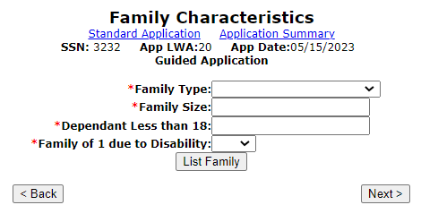
Family Characteristics Screen
For any WIOA income calculation, besides recording the income of each family member for the previous six months, the family must be recorded within the application
The “Family Characteristics Screen” is the location where the family members are recorded within the application in IWDS

Slide 59
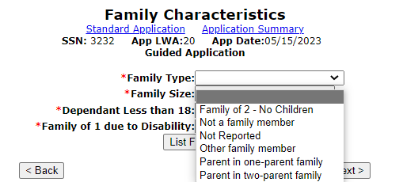
Family Characteristics Screen
It is important to understand that the “Family Type” does not have any eligibility consideration; and should be populated based on the best description of the circumstances related to the family income calculation being completed.

Slide 60
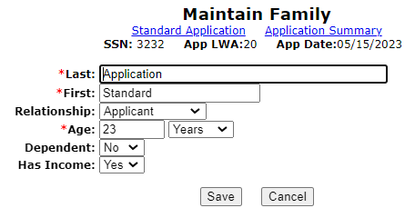
Recording Family Members
Record each family member that are being counted towards the family income calculation
In this example, the client is a mother in the family but is the applicant for the WIOA application

Slide 61
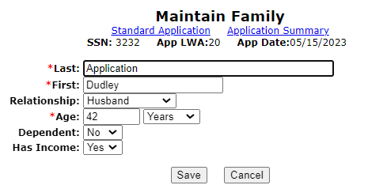
Recording Family Members
When recording the family, keep in mind that you are describing this family as it relates to the WIOA family definition:

Slide 62
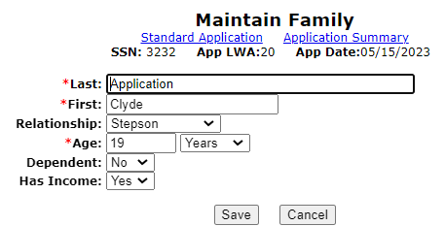
Recording Family Members
Could a nineteen-year-old stepson be considered part of the WIOA defined family in this circumstance?
Refer to the WIOA Family definition:
The term “family” means two or more persons related by blood, marriage, or decree of court, who are living in a single residence, and are included in one or more of the following categories:
(A) A married couple and dependent children
(B) A parent or guardian and dependent children
(C) A married couple

Slide 63
Recording Family Members
For the question, could a stepson be considered a part of the family for an income calculation?
Answer: Yes, in this situation, “Clyde” is still residing with his father and stepmother and would fall under the family definition as a member of the family
An important distinction to understand for adult dependents (individuals aged 18 or older, still living at home with parents/guardians). If being included as part of the family, any income that individual has had in the six months prior to the WIOA application must be included as part of the income calculation

Slide 64
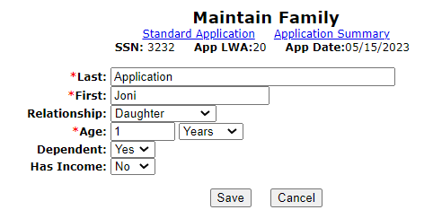
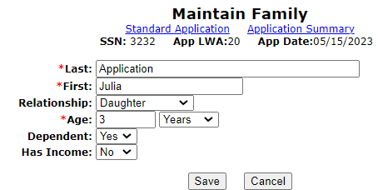
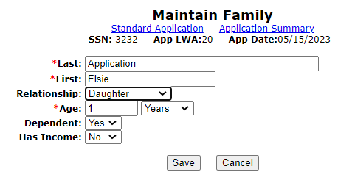
Recording Family Members
The remaining individuals in this family are the children of the applicant and her husband:

Slide 65
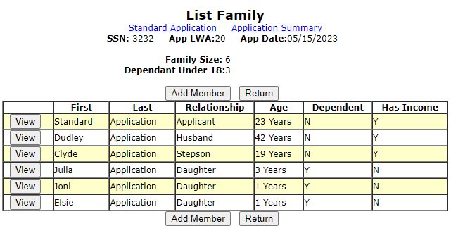
Recording Family Members
Example, family size of six; please also note this client is from LWIA 20:

Slide 66
Family Income Calculation
When referring to WIOA Notice No. 22-NOT-01 – Revised Income Guidelines for Determining Low-Income Status for WIOA, as shown on slide #48 of this presentation, at LWIA 20, the maximum income allowed for a family size of six (6) is $40,600 or less
For the example, as demonstrated under slide #57, the total family income recorded was exactly $40,600

Slide 67
Family Income Calculation
For this client’s situation related to the Low-Income Determination, there was income recorded from the Applicant, her husband, and the 19-year-old stepson
At the time of eligibility certification, the “Career Planner” would be responsible for having the income verification documentation for everyone in the WIOA defined family to support the completed income calculation that was recorded

Slide 68
Over Family Income
If a client does not meet any of the automatic Low-Income qualification factors and is over the family Low-Income level, there is a final way Low-Income could be determined.

Slide 69
Family of One due to a Disability
If an individual with a disability whose own income does not exceed the higher of:
The poverty line; or Seventy percent (70%) of the lower living standard income level, but who is a member of a family whose income does not meet this requirement

Slide 70
Family of One due to a Disability
IWDS must be documented in three places within the IWDS application to properly document family of one due to a disability.

Slide 71
Family of One due to a Disability
On the “Private Information” screen, the disability must be identified
The “Income Calculation” screen is where the client’s income must be documented
The “Family Characteristics” screen is where the criteria of “Family of One” is specified

Slide 72
Private Information Screen

Slide 73
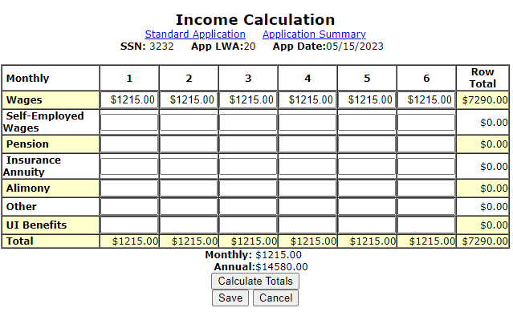
Family of One due to a Disability
The client’s income for the six months prior to application date must be documented on the “Income Calculation” screen.

Slide 74
Family of One due to a Disability
If the client does not have income, the client must write an attestation stating they have not had income in the previous 6-month period
If the client has income, it must be at or under the income for a family of one ($14,580) as described in WIOA Notice 22-NOT-01, Revised Income Guidelines for Determining Low-Income Status for WIOA

Slide 75
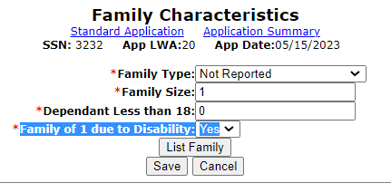
Family of One due to a Disability
On the “Family Characteristics” screen the client is characterized as “Family of One Due to a Disability”.

Slide 76
Family of One due to a Disability
Q – 17-year-old Holly is applying for the In-School Youth Program, she lives with her parents and their family income is above the Low-Income criteria guidelines. However, one of Holly’s barriers is a disability due to a hearing impairment. Her own income is less than the family of one income criteria so she will meet the Low-Income criteria of family of one due to a disability. Would a self-attestation be acceptable documentation to support her disability?

Slide 77
Family of One due to a Disability
Q – 17-year-old Holly is applying for the In-School Youth Program, she lives with her parents and their family income is above the Low-Income criteria guidelines. However, one of Holly’s barriers is a disability due to a hearing impairment. Her own income is less than the family of one income criteria so she will meet the Low-Income criteria of family of one due to a disability. Would a self-attestation be acceptable documentation to support her disability?
A – No, a self-attestation for the disability is not an acceptable documentation choice under these circumstances due to the client is utilizing family of one due to a disability to support her Low-Income criteria.

Slide 78
Additional Clarification on Question about Documentation
In instances where a Youth client has multiple barriers that support eligibility; and the Low-Income determination of the individual is not based on family of one due to a disability; the formal documentation for the disability is not required and a self-attestation for the disability could then be used
The thought is to be less intrusive regarding the individual’s documentation of the disability, since the client would have other barriers to support their eligibility beyond just the disability

Slide 79
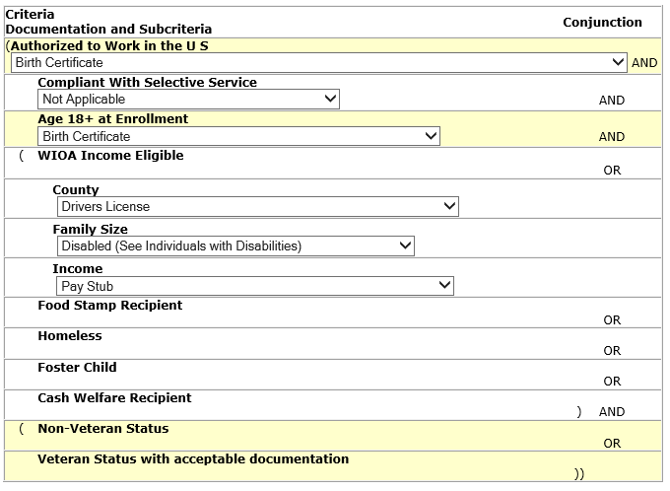
Family of One due to a Disability
Documentation must include the following:
Documentation addressing income
Documentation addressing disability

Slide 80
Question about Family of One due to a Disability
Q - If a client has a disability, should “Family of One due to a Disability” always be used to determine WIOA low-income status for the individual?

Slide 81
Answer about Family of One due to a Disability Question
Q - If a client has a disability, should “Family of One due to a Disability” always be used to determine WIOA low-income status for the individual?
A – No, “Family of One due to a Disability” should only be used in instances when a client would not meet WIOA Low Income criteria by any other way, but when the client who has a disability, and their own income is below the income threshold for a family size of one. (Currently at $14,580).

Slide 82
Low-Income Individual
Of the eight ways an individual can be determined to be Low-Income for WIOA, there are six ways that do not require capturing income information on the customer and/or the customer’s family.

Slide 83
WIOA Low-Income Criteria that does not require income calculation
Cash Welfare
Food Stamps
Homeless
Free or Reduced Priced Lunch
Foster Child
Youth Customer Living in a High Poverty Level

Slide 84
Doesn’t Meet Automatic Qualification Criteria
If a client does not meet one of the previous six automatic qualification factors that is when an income calculation should be utilized to determine Low-Income status.

Slide 85
WIOA Low-Income Eligibility
All determinations of Low-Income status for customers must be supported by proper documentation of the qualifying condition as outlined in the “WIOA Title IB General and Fund Source Eligibility Requirements and Documentation Sources”.

Slide 86
Recap
This presentation covered the following items:
The eight (8) different ways an individual could meet WIOA Low-Income criteria
Where the WIOA Low-Income criteria is recorded within an IWDS application
How the eligibility documentation must be provided to support the WIOA Low-Income eligibility indicated within the IWDS application

Slide 87
Questions
This concludes the presentation on WIOA Low-Income:
If you have questions related to this presentation, feel free to contact me at James.potts@Illinois.gov or you can phone me at (217) 416-7097.

