Slide 1
IWDS Illinois Workforce Development System
1-24-2024
Assessment and IEP/ISS

Slide 2
Objective
The objective of this PowerPoint is to discuss and demonstrate the requirements tied to WIOA new client assessment and demonstrate the tools available within Illinois Workforce Development System (IWDS) for recording assessment results.
We will cover the steps for recording the services of the Individual Employment Plan (IEP) for Adult and Dislocated Worker clients, and the activity of Individual Service Strategy (ISS) for Youth clients within IWDS.

Slide 3
WIOA Assessment Requirements
It is important to understand that under WIOA, mandated assessment requirements must be followed.
The new Office of Employment and Training Career Planning Policy Chapter 4 Section 2 was issued on March 14th, 2023 and it provides extensive guidance around assessments and Career Planning.
Section 4.2.4 of the Career Planning Policy states, “a thorough assessment is the foundation for understanding the participant’s employment goals, existing skills, career readiness, and determining all appropriate barriers to education or employment that may exist”.

Slide 4
WIOA Assessment Requirements
We are not going to dig into “all” of the details within the Career Planning Policy but cover the highlights of the assessment requirements and demonstrate the tools within IWDS for recording the assessment.
Based on feedback from the Policy Unit, the Career Planning Policy is being updated to reflect the changes in the Services Matrix updates that were deployed to IWDS in 2023.
There is still supposed to be State-wide training around the updated Career Planning Policy.

Slide 5
WIOA Youth Assessment Requirements
The Workforce Innovation and Opportunity Act (WIOA) legislation and Training and Employment Guidance Letter (TEGL) 21-16 – Third WIOA Title I Youth Formula Guidance and the State’s Career Planning Policy guidance even expands requirements around the Youth new client assessment.
Both Federal and State guidance dictates that any individual who is going to be served under the Youth title must have a complete assessment before the client is determined eligible and enrolled in WIOA Youth Services.
The results of the Youth assessment are used to support enrollment in the WIOA Youth program, and the assessment is used to create the Youth’s initial Individual Service Strategy (ISS).

Slide 6
WIOA Legislation Youth Assessment Guidance:
Section 129(b)(2)(c)(1)(A) of WIOA Legislation States:
Career Planners must provide an objective assessment of:
Academic levels
Skill levels
Service needs of each participant
Review of basic skills
Occupational Skills
Prior work experience
Employability
Interests
Aptitudes (including interests and aptitudes for nontraditional jobs)
Supportive service needs
Development needs of the participant
The assessments must also consider a youth’s strengths rather than just focusing on areas that need improvement

Slide 7
State of Illinois Youth Assessment Requirements
From the OET Career Planning Policy:
1) Interest and skills inventory;
2) Prior work experience;
3) Essential employability skills;
4) Digital literacy assessment;
5) Financial literacy assessment;
6) Basic skills deficiency;
7) Developmental needs;
8) Career goals;
9) Suitability for employment and/or training program;
10) Review of training options that align with interest and skills inventory;
11) Barriers to education or employment;
12) Determination of referrals;
13) Supportive services;
14) Progress Reporting; and
15) Follow-up.

Slide 8
Individual Service Strategy
Under the updated Career Planning Policy issued on March 14th, 2023 Chapter 4 Section 2 under paragraph 6. states, “The ISS is required to be completed after the objective assessment prior to youth being enrolled in WIOA Title IB. The ISS must document the following:
A summary of all goals and objectives established with additional information focusing on activities and tolls used for achievement;
Identify an appropriate pathway;
Documentation of the services that will be provided to the participant including, but not limited to the fourteen (14) required WIOA Title IB Youth Elements;
A summary of action steps to eliminate or minimize any barriers including referrals to partner agencies for assistance with childcare, transportation, counseling, etc.;
The direct link to one or more of the WIOA Title IB performance indicators; and
The method for tracking progress and identifying next steps including, but not limited to follow-up on open goals, objectives, and services.

Slide 9
WIOA Youth Non-Enrolling Activities
Career Planning Policy 4.2 under section 4.2.6 paragraph 4.1.a.,b.,c. states that the following activities must be entered into IWDS before a Youth program element can be recorded.
YOUTH – Comprehensive and Specialized Assessment
Development of an Individual Service Strategy (ISS)
YOUTH Career Planning (Case Management)
No specific sequence or order is required.
Youth will not be a “Registrant” (Participant) until all three pre-enrolling activities and at least one of the 14 program elements is provided.

Slide 10
WIOA Adult and Dislocated Worker
For Adult and Dislocated Worker clients, under both the WIOA Legislation and TEGL 19-16 – Guidance on Services Provided through Adult and Dislocated Worker under WIOA – provides guidance on requirements for assessments prior to enrollment in WIOA funded training services.
The OET Career Planning Policy provides very detailed guidance for Adult and Dislocated Worker clients at all stages of WIOA enrollment, including individuals who might only be initially requiring Career Services.

Slide 11
WIOA Adult and Dislocated Worker
The Career Planning Policy under subparagraph 4.2.4.1.a.1.) states that the assessment will determine a customer’s interests, skills, and needs during intake. This initial assessment provides preliminary information about the individual’s skill levels, aptitudes, abilities, and supportive service needs. It forms the basis for determining suitability as part of informed customer choice and the development of the IEP.
a) Interest and skills inventory;
b) Essential employability skills;
c) Digital literacy assessment;
d) Financial literacy assessment;
e) Basic skills deficiency;
f) Barriers to employment;
g) Determination of referrals; and
h) Supportive services.

Slide 12
WIOA Adult and Dislocated Worker
It is essential to understand, under the guidance within the Career Planning Policy addressed in the last slide, that all Adult and Dislocated Worker clients are required to have an initial assessment and an Individual Employment Plan (IEP) created, even if the client only intends to receive WIOA Career Services.
If the client needs WIOA Training Services, the assessment must be more thorough, as outlined in the next slide.

Slide 13
WIOA Adult and Dislocated Worker
The Career Planning Policy states under 4.2.4.1.a.2.), after enrollment, the assessment builds off information gathered at intake and assists with informing the IEP development. As with the assessment during intake, career planners must address informed customer choice when determining suitability for training in a particular career pathway. At a minimum, the continuation of the assessment must address the following areas:
a) Employment goals;
b) Suitability for employment and/or training program;
c) Review of training options including work-based learning and/or traditional training provided through an Individual Training Account (ITA) by a training provider that is on the Eligible Training Provider List (ETPL) if training is needed to meet employment goals;
i. The training service must align with the participant’s existing skills and career readiness using the results from the interest and skills inventory.
ii. The career planner must facilitate a process that provides the participant with an informed choice of training options.
d) Barriers to employment for the chosen career pathway (e.g., criminal history, substance abuse);
e) Determination of referrals (coordination with partner programs or community organizations that provide training and education resources);
f) Supportive services (as supportive service needs may change if attending training);
g) Progress Reporting; and
h) Follow‐up.

Slide 14
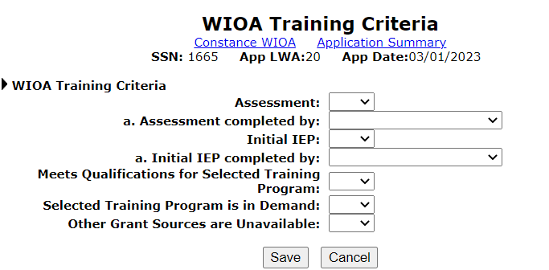
WIOA Training Criteria Screen in IWDS
The “WIOA Training Criteria” screen is required to be completed in IWDS for all Adult and Dislocated Worker Clients before the client can be enrolled in Training Services:

Slide 15
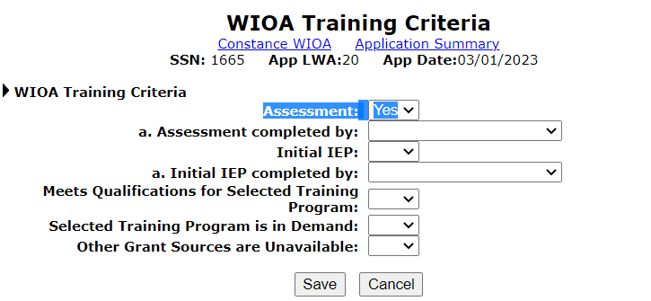
WIOA Training Criteria Screen in IWDS
On the ‘WIOA Training Criteria screen, there must be a complete assessment to support the Adult or Dislocated Worker client entering training services, so the response to the first question must be “Yes.”

Slide 16
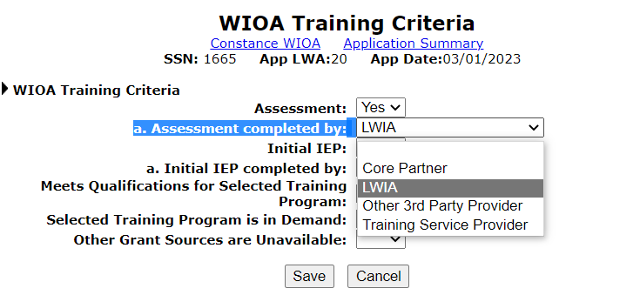
WIOA Training Criteria Screen in IWDS
Who completed the assessment? If it was the Career Planner, the correct response would be “LWIA.” Other individuals could complete the assessment, but it will typically be the Career Planner at the LWIA.

Slide 17
Guidance on Individual Employment Plan
The Career Planning Policy under section 4.2.5 provides detailed guidance about the Individual Employment Plan (IEP) and the Individual Service Strategy (ISS).
As mentioned earlier, there will be formal training around the entire Career Planning Policy. During this presentation, we will not focus on the IEP and/or ISS but more reference the requirements associated with the IEP and ISS regarding requirements within IWDS.

Slide 18
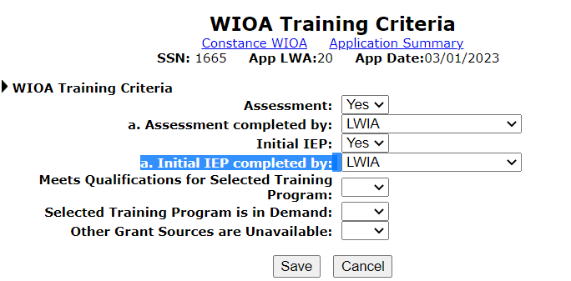
WIOA Training Criteria Screen in IWDS
There must be a complete Individual Employment Plan (IEP) that supports the client going into WIOA Funded Training Services, and who completed the IEP must also be recorded; if it was the Career Planner, then “LWIA” is the correct response:

Slide 19
Individual Employment Plan (IEP):
The Participant and the Career Planner develop an IEP to identify the Participant’s overall employment goal, the appropriate achievement objectives, and the appropriate combination of services for the participant to achieve the employment goal, including providing information on eligible providers of training services and career pathways to attain career objectives.
The IEP (like the ISS) is a living document that once developed, must be signed by the participant and be properly documented within IWDS.
Lastly, anytime the IEP has changes made, both the Participant and the Career Planner must be aware of the changes and why they are needed and agree to the changes.

Slide 20
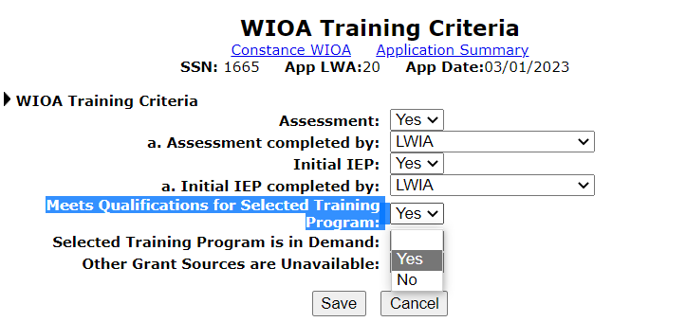
WIOA Training Criteria Screen in IWDS
“Meets Qualification for Selected Training Program” should not be glossed over. WIOA Participants might have an overall goal/objective related to training that might not be achievable for the individual. Goals and objectives must be realistic and attainable:

Slide 21
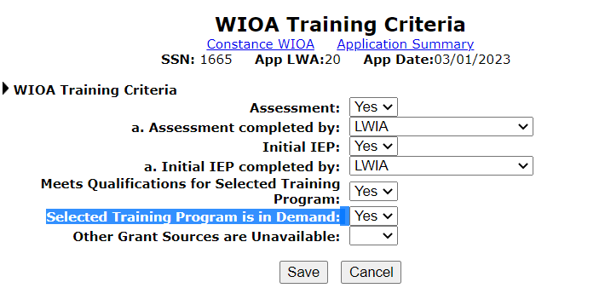
WIOA Training Criteria Screen in IWDS
The training must be on the WIOA approved “in-demand” training programs, but like the question of “Meets Qualification for Selected Training Program”, the client does need to have the ability to get accepted and be successful in the training program before it should be indicated in the plan.

Slide 22
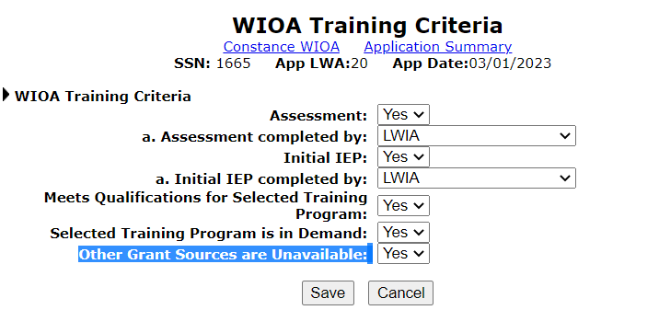
WIOA Training Criteria Screen in IWDS
The last question of “Other Grant Sources are Unavailable” on the “WIOA Training Criteria” is a two-part question; first, have we examined the available alternative funding options (Federal, State Educational Assistance); but also, can the client afford to participate in training?

Slide 23
Other Grant Sources Unavailable
A completed “Training Budget Worksheet, which shows the client’s monthly income and monthly expenses, is the only acceptable documentation to support the criteria of “Other Grant Sources Unavailable”.

Slide 24
Income and Expenses
The only documentation to support the criteria of “Other Grant Sources are Unavailable” is completed is the “Income and Expenses” worksheet, also known as the “Training Budget Worksheet”.
We will examine this document later under the details about the assessment.

Slide 25
Parts of an Assessment:
Formal Assessment involves using some alternative tools that are available; the information gleaned from the formal assessment tools could then be combined with information learned from other informal assessment steps, such as the one-on-one interview and observations:
Aptitude and Ability Tests
Interest Inventories
Career Development Assessments
Personality or Management Style

Slide 26
Formal Assessment Tools
There are many “Formal” Assessment Tools available, including but not limited to:
TABE 11-12 and CASAS GOALS assessment tests;
English as a Second Language (ESL) assessment tests;
Illinois Career Information System;
Interest Determination, Exploration and Assessment System (IDEAS);
Values: Work Importance Locator;
Competency Model Clearinghouse;
Minnesota State CAREERwise;
Illinois Job Link;
Resources within Illinois workNet (IwN) (see next few slides);

Slide 27
Within Illinois workNet (IwN)
There are some “formal” assessment tools within IwN under “Skills & Interests” that could be utilized:

Slide 28
IwN Skills & Interests
Some of the tools within IwN include “Career Cluster Inventory”, “Interest Profiler”, and “Work Importance Locator”:

Slide 29
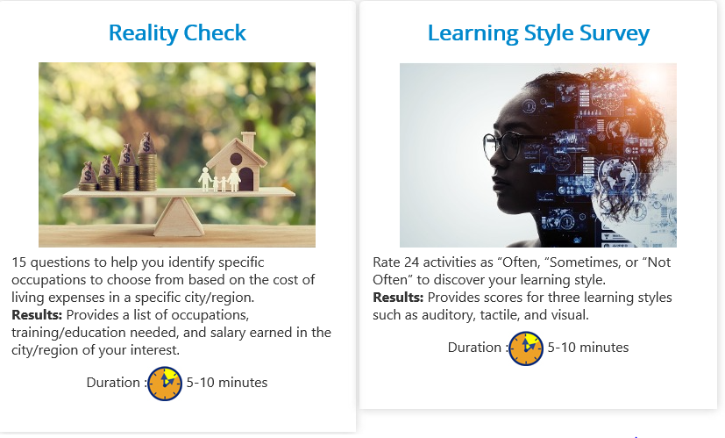
IwN Skills & Interests
Other tools within IwN under Skills & Interests include “Reality Check” and “Learning Style Survey”:

Slide 30
Informal Assessment
Besides the formal assessment, a large part of the assessment is the interaction between the Career Planner and the client which is considered the “informal” portion of the assessment.
Informal Assessment includes the one-on-one interaction between the Participant and the Career Planner, where the Career Planner and client are looking at various things including but not limited to identifying strengths, transferable skills, interests, work values, and personal priorities related to employment.
The assessment is part of a process leading the self-awareness and relies on active participation by the participant.

Slide 31
Parts of an Informal Assessment
Observation
Education/Experience/Transferable Skills
Interview Examining Many Aspects
Values Assessments

Slide 32
Documenting the Assessment
The Career Planner will be gathering many types of information. Always remember, the job isn’t done until the paperwork is done.
The information from the formal assessment tools and the information gathered from the informal assessment is used when putting together a complete picture of the assessment.

Slide 33
Documenting the Assessment
Under the Career Planning Policy, section 4.2.6 – Service Documentation (Case Management), specifically paragraph 5., where it states “Documentation of any completed assessment must follow policy, be recorded in the career planning system (IWDS)”;
Under paragraph 5.a., it expands guidance stating the “Narrative tools on the Assessment Summary in IWDS must be utilized to record information gleaned from the Career Planner related to the different assessment categories. The narrative should incorporate what the assessment results mean, not just documentation of the tests outcomes.”

Slide 34
From the Application Menu – Select Assessment Summary

Slide 35
Location to Document Narratives

Slide 36
Assessment Topics Available
Documenting the Assessment is broken down into different categories:
Aptitudes
Behavior
Employment
Family
General
Interests
Skills
Barriers

Slide 37
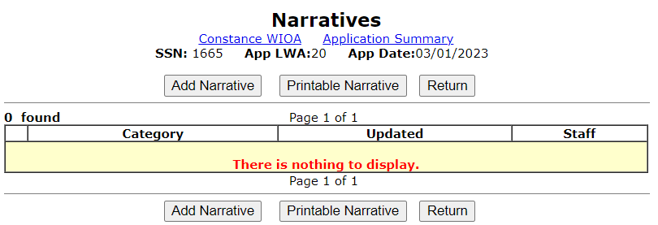
Adding Narratives
As mentioned previously, per the Career Planning Policy, all WIOA Clients are required to have the assessment summary narrative recorded:

Slide 38
Select Assessment Type

Slide 39
Aptitude
“Aptitude” means the quality of being apt or appropriate; a natural tendency or inclination; a natural ability or talent; quickness to learn or understand.
This would include recording suitability for employment and/or training programs.

Slide 40
Example of ‘Aptitude’ Assessment

Slide 41
Barriers
“Barriers” are anything that prevents passage or approach; obstruction; anything that holds apart, separates, or hinders.
Common barriers could include but are not limited to lack of transportation, lack of suitable dependent care, and lack of work clothing.
This could include any barriers to employment and if a determination of a referral is made, those details could be included describing attempts to assist with the barriers.

Slide 42
Example of ‘Barrier’ Assessment

Slide 43
Behavior
“Behavior” is the way a person behaves or acts; conducts; or manners.
What are your observations of the customer’s behavior while you are meeting with them?
Is your client cooperative? Is your client engaged? Withdrawn? Alert? Distracted?
Is your client making or avoiding eye contact?

Slide 44
Example of ‘Behavior’ Assessment

Slide 45
Employment
"Employment" – Should gather work history to assess for employability, termination patterns, and to gauge customer interests for future employment.
This includes employment goals and essential employability skills.

Slide 46
Example of ‘Employment’ Assessment

Slide 47
Family
"Family" – Probing questions can be used to gather the background information.
This can be a difficult block with some people during the first meeting.
Some questions could be:
“Who is in your family?”
“What are their names, ages, and relationships?”
Ask questions about the family’s support.

Slide 48
Example of ‘Family’ Assessment

Slide 49
General Information
General – there isn’t anything specified for this block; however, remember that while doing an assessment, we are tasked with gathering information on the participant’s needs, strengths, support system, education, job skills, interests, and career goals. In other words, the “general” narrative can be used to fit in anything you haven’t found a category for in the other sections.
This would be a good place to document that you reviewed the training options on the Eligible Training Provider List (ETPL) that align with the interest and skills inventory through informed customer choice if training is needed to meet the participant's goals.

Slide 50
Example of ‘General’ Assessment

Slide 51
Interests
"Interests" - In this category, we want to capture the breadth and depth of a customer’s interests to get a well-rounded picture of the customer.
To get a well-rounded picture of the customer, different open-ended probing questions should be used.
For instance, “What do you like to do in your free time for fun?”
“Let’s talk about your interests regarding your future?”
This would include any interest surveys, inventories, or assessments the participant took.

Slide 52
Example of ‘Interests’ Assessment

Slide 53
Skills
"Skills" – This area could be used to elicit the customer’s skills and how they were acquired.
You can assess “hard” skills by asking about past jobs, unpaid work experiences, hobbies, or work performed at home.
This would include any skills surveys, inventories, or assessments the participant took, including basic skills deficiency, digital literacy, and financial literacy.

Slide 54
Example of ‘Skills’ Assessment

Slide 55
Completed Assessment Narratives:

Slide 56
Tests
Tests – This screen contains a list of assessment test results that have been loaded in and are associated with the client.
Please refer to the Basic Skills Deficiency Policy, as there are details related to requirements that are relevant for clients who might have their assessment tests waived due to specific circumstances.

Slide 57
Employment Goals
Within the Career Planning Policy under section 4.2.6 paragraph 5.b., it provides guidance that the “Employment Goals” portion of the Assessment Summary provides an area to record items such as the participant’s wage goal, ability to work different shifts, distance willing to travel, and other information from conversations between the participant and the Career Planner.
The next few slides will demonstrate recording this portion of the assessment for a client.

Slide 58
Employment Goals

Slide 59
Employment Goals Screen

Slide 60
Details about Employment Goals Screen
The Employment Goals segment is designed to record target wage level per period (hour, day, week, month, or year).
Employment Goals segment also records the target kinds of work (permanent or temporary).
Employment Goals segment also records the target types of work (full or part-time).
Employment Goals segment also records the target shifts (days, afternoons, evenings, rotating or split).
Employment Goals segment also records acceptable commuting distance from a specific zip code and a willingness to relocate.

Slide 61
Identifying Target Wage and Per:

Slide 62
Select Kind, Type of; Shifts willing to Work:

Slide 63
Miles Willing to Travel for Work

Slide 64
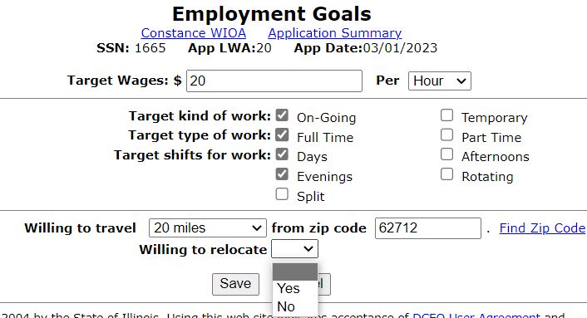
Willing to Relocate?
Is the client willing to relocate for new employment?

Slide 65
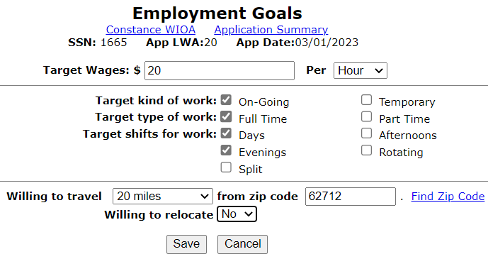
Updated Employment Goals Screen
Complete Employment Goals screen:

Slide 66
Income & Expenses Worksheet

Slide 67
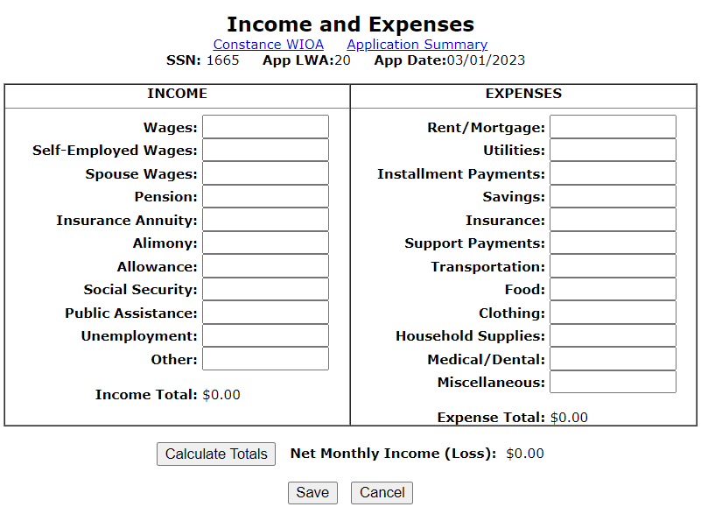
Income & Expenses
If you recall, earlier in the presentation under the “WIOA Training Criteria” screen, there was a question about “Other Grant Sources are Unavailable”; the only acceptable documentation for this criteria is the completed “Income and Expense” sheet which is also known as “Training Budge Worksheet”.

Slide 68
Income & Expenses
The Income and Expenses screen is designed to assist the customer and Career Planner in evaluating the customer’s ability to support themselves and their family while in the WIOA funded training program.
This is used to hopefully prevent the client from needing to drop out of the WIOA funded training because they simply need to work.
The Income and Expense is required for any Adult or Dislocated Worker client that is going into “Training Services”; and recommended for Youth going into “Training”;
The only acceptable documentation to support the criteria of “Other Grant Sources are Unavailable” is the completed Income and Expense sheet.

Slide 69
Income & Expenses Worksheet
The Income and Expenses worksheet is designed to assist the customer and career planner in evaluating the customer’s ability to support themselves and their family if they enter a training program.
The goal is to try to ensure we are examining income/expenses throughout the training to lessen the chances the individual might have to drop out of training due to finances.

Slide 70
Income & Expenses Worksheet
Considerations should be items such as, if the client is on UI, will the UI last throughout the client’s planned training? If not, how will the client make ends meet without the UI?
If the client is working, will they be able to continue working the same amount while also participating in their training program?

Slide 71
Completed Income & Expenses Worksheet
Career Planners evaluate if this is a realistic budget, and is it reasonable that the client should be able to support themselves while completing WIOA funded training?
In this instance, the income is higher than expenses which shows the client is making $1200 per month. Will they continue to make that income while in training?

Slide 72
If Expenses are Over Income?
If expenses are higher than income, there needs to be a plan to address the difference in income, to ensure the client’s ability to complete the training program.
For this client, her income (from sources other than employment wages) matches her expenses; therefore, she should not be expected to have financial concerns that need to be addressed.
However, say her income was related to her employment, you need to inquire about the client’s ability to work the same number of hours while in training.

Slide 73
Ownership of the Assessment and Plan
Part of making an employment plan/service strategy is ensuring that the participant takes some ownership in researching potential careers.
You could and should assist in guiding the client towards programs that are mutually beneficial for the client and the overall WIOA program.

Slide 74
Completed Assessment Summary Screen

Slide 75
Case Notes
Within the Career Planning Policy under section 4.2.7 Case Notes provides detailed guidance about Case Notes.
Including under 4.2.7. paragraph 5.a.,b.,c.,d.,e.,&f., where it provides specific guidance about case notes under headings of “Introduction”; Determination of Training Need”; “Training Begin Date (if applicable)”; “Training End Date (if applicable)”; “Service Closure/Exit”; and “Follow-up”.
On Wednesday, 4-27-2022 – Robin Kralman with the Southern Region Monitoring Team conducted virtual Case Note Training; this was a State-wide Training that was needed and was very detailed.

Slide 76
Case Notes Training
The April 27th, 2022, Case Note presentation recording can be found: https://youtu.be/YgqKxADVwxI
One of the key items that I would like to share was a case note format that Robin shared during some case notes barriers and then solutions

Slide 77
Case Note Format Ideas
Barriers
Solutions
Lack of training on how to properly formulate a case note to include required components
Lack of training on entering case notes in chronological order to validate the decision-making process of the participant’s enrollment into services
Copying and pasting the same case notes each month
Action needed and/or services planned or provided
Progress/Plan towards Goals and Objectives
Reason for the contact

Slide 78
Example Case Note Format
Note Category: WIOA Case Note Supporting Same Day Service
Note Subject: Fall 2021 grades received/ Spring 2022 Voucher issued
Case Note: (R) Met with Carl today to issue his Spring 2022 voucher and receive his Fall 2021 grades. Carl brought in his grades for Fall 2021 and received 3A’s and 1B. He also brought in his Spring 2022 schedule. (A) A review of his curriculum verifies that all registered classes for Spring 2022 are required for his HVAC program. A tuition voucher for Spring 2022 was issued for 13 credits. A Supportive Service voucher was provided for a multimeter. MSG was entered in IWDS for the successful completion of 12 credits for Fall 2021. (P) A review of Carl’s progress in training is satisfactory as he currently has a 3.9 GPA. He continues to be on track to complete his training goal of obtaining an Associate’s Degree in HVAC at Kaskaskia College by the projected End Date of May 15, 2023.
Reason for the contact
Action needed and/or services planned or provided
Progress/Plan towards Goals and Objectives

Slide 79
Details about Types of Contact in Case Notes
Another topic from the case note presentation that I liked was recommending that the case note author be specific in what type of contact it is when communicating with your participants.
Meaning, making it clear at the beginning of the case note the particular type of communication/contact was made with the client.

Slide 80
Acceptable Types of Contact Include:
Phone call
Email
Social Media
Text message
In-person contact
Virtual Meetings/Contacts

Slide 81
Adding Case Notes from Assessment Screen

Slide 82
Add Case Notes:

Slide 83
WIOA Eligibility Determination
The application was dropped off on 3/1/2023, but due to the client’s schedule, the assessment could not be completed on that date. So, the application is being updated to an application date of 3/6/2023, as that was the date of the Youth Assessment.
This client should meet both WIOA Adult with the Priority of WIOA Low-Income priority as well as WIOA Basic Skills Deficient; and this client does also meet WIOA Out-of-School Youth criteria due to being at or below the age of 24, not attending school, and has the barrier of “Aged Out of Foster Care”.

Slide 84
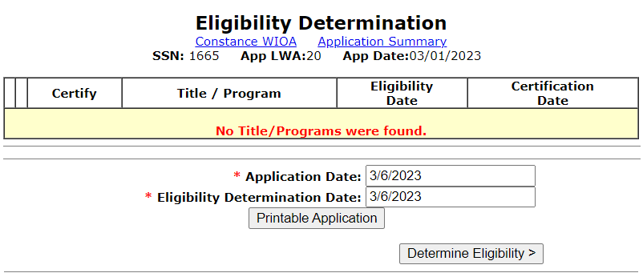
WIOA Eligibility Determination
As mentioned in the previous slide, updating the application date to 3/6/2023:

Slide 85
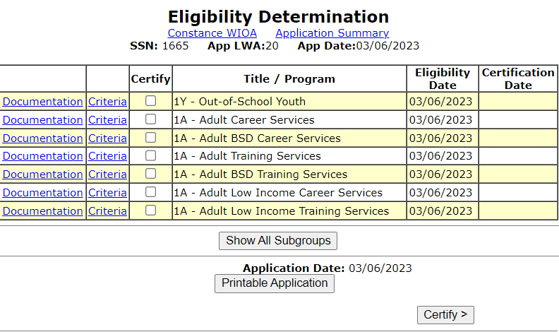
WIOA Eligibility Determination
As shown in the adjacent screen print, the client has been determined eligible for multiple WIOA Adult Priorities as well as WIOA Out-of-School Youth:

Slide 86
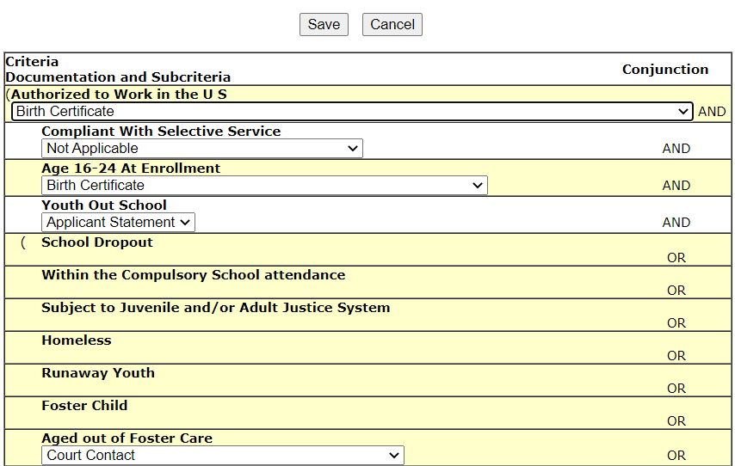
WIOA Youth Eligibility Certification
At this time, this client is most suitable for the WIOA Youth title, so that is the WIOA program we will first demonstrate:
The adjacent screen demonstrates the documentation needed to certify this client under OSY.

Slide 87
WIOA Youth Eligibility Certification

Slide 88
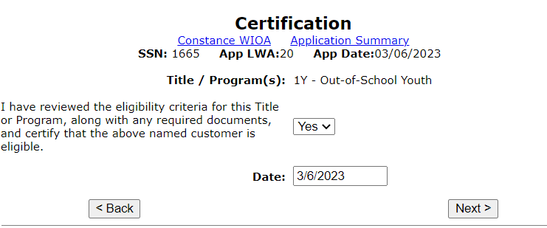
WIOA Youth Eligibility Certification
Must change the certification statement from “No” to “Yes” and then record the certification date, which in the case of this client of 3/6/2023:

Slide 89
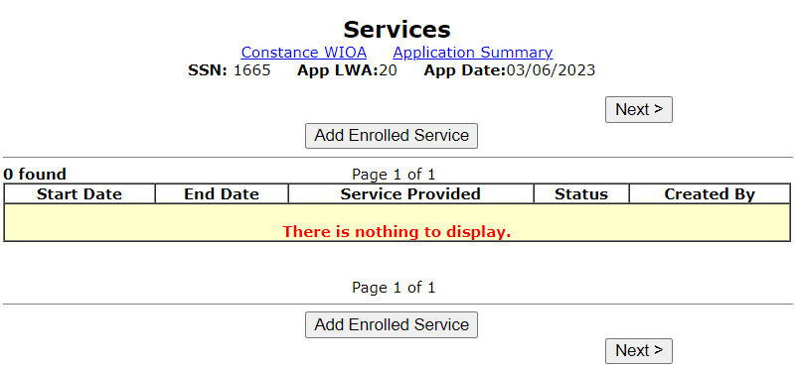
WIOA Youth Eligibility Certification
Once the IWDS record has been certified as eligible, the record transitions to “Applicant” status. An Applicant is a record that has had eligibility certified but has not been enrolled in an enrolling activity:

Slide 90
Non-enrolling Youth Activities
After an application has been certified under the Youth title (either ISY or OSY), internal IWDS logic will require each new Youth to first have three non-enrolling Youth Activities recorded:
YOUTH Comprehensive and Specialized Assessments;
Development of an Individual Service Strategy (ISS);
YOUTH Career Planning (Case Management)

Slide 91
Non-enrolling Youth Activities
Those three non-enrolling Youth activities should be recorded on the date the Youth has had their Youth eligibility certified.
The example client “Constance WIOA” in this PowerPoint was certified under the Youth title on 3/6/2023, so that is the date that all three non-enrolling Youth activities should be recorded.
Note: IWDS logic will allow those three non-enrolling services to be recorded on dates after the original certification, but when that is done, no enrolling Youth activity can be recorded on any date until the latest end date of those three non-enrolling Youth activities.
Lastly, there is internal logic within IWDS that still requires that the first enrolling Youth activity must occur within 45 days of the original Youth certification.

Slide 92
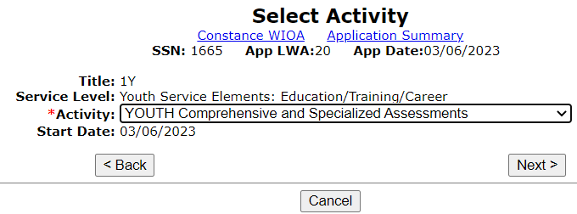
Non-enrolling Youth Activities
Below demonstrates the first non-enrolling Youth activity that should be recorded:

Slide 93
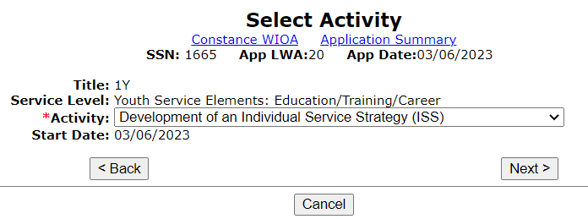
Non-enrolling Youth Activities
Youth non-enrolling activity of Development of an ISS should be the second non-enrolling Youth activity recorded:

Slide 94
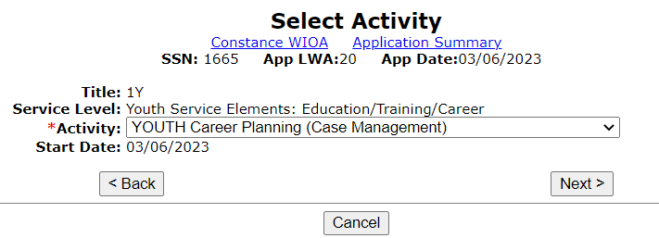
Non-enrolling Youth Activities
YOUTH Career Planning (Case Management) should be the third non-enrolling Youth activity that is recorded:

Slide 95
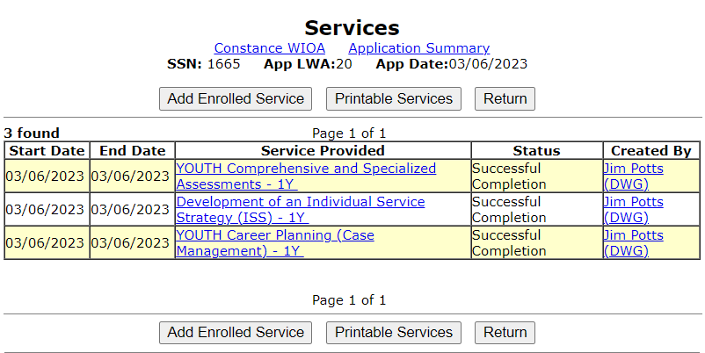
Non-enrolling Youth Activities
Once all three non-enrolling Youth activities have been recorded, the client is still at the “Applicant” status in IWDS, and will only transition to “Registrant” status after an enrolling Youth activity has been recorded:

Slide 96
Enrolling Youth Activities
WIOA Title IB Youth client services/activities are tied to 14 different youth program elements:
Tutoring, study skills training, instruction, and dropout prevention;
Alternative secondary school services or dropout recovery services;
Paid and unpaid work experience;
Occupational skills training;
Education offered concurrently with workforce preparation and training for a specific occupation;
Leadership development opportunities;
Supportive services;
Adult mentoring;
Follow-Up Services;
Comprehensive guidance and counseling;
Financial literacy education;
Entrepreneurial skills training;
Services that provide labor market information;
Postsecondary preparation and transition activities.

Slide 97
Transition from Youth to Adult
This concludes the portion about the Youth titles; as was demonstrated the three non-enrolling Youth activities must be recorded after certification.
Once those three non-enrolling Youth activities are recorded, then enrolling Youth activities must be recorded within 45 days of the certification date of the WIOA Youth application.
All enrolling Youth activities must be tied to one or more of the fourteen (14) Youth Elements.

Slide 98
Transition to Adult/Dislocated Worker
Now that we have covered the Youth requirements in the previous slides, let us now transition to the Adult (which works the same as Dislocated Worker) after certification.
For an Adult and/or Dislocated Worker (DW), the requirements are different than for a Youth. The activity/service of “Development of an Individual Employment Plan (IEP)” as well as “Career Planning (Case Management)” are both enrolling services under the Adult and/or DW titles.
For the following slides we will just be demonstrating an Adult but understand a DW client would have the same requirements around assessment and the original services that should be recorded.

Slide 99
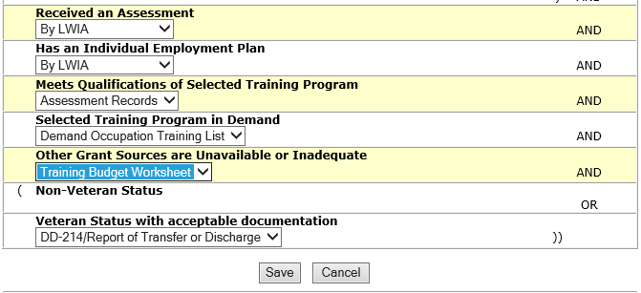
For Certification to Adult Training Level:
Let us examine the documentation needed for certification up to the Adult Training services level:

Slide 100
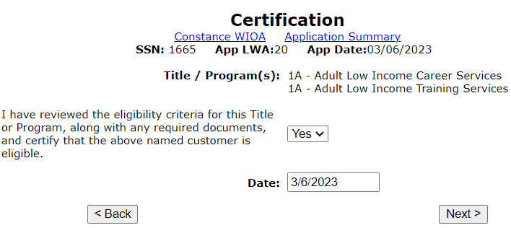
Adult Low-Income Career and Training
On 3/6/2023, she is being certified as both 1A Adult Low-Income Career and Adult Low Income Training Services:

Slide 101
Examine What is Stated at Certification
Often it seems Career Planners staff might go through steps with certifying an Adult and/or Dislocated Worker clients up to the training service level in IWDS.
However, it must be understood that the assessment and the IEP must support the enrollment and be completed in-depth, with a mutually agreed upon overall goal (which for Adults and Dislocated Workers must be tied to full-time, self-sustaining employment); realistic and attainable objectives that are used to reach the overall goal; and then a breakout of the services needed to obtain the objectives and overall goal.

Slide 102
Assessment Requirements
The new OET Career Planning Policy section 4.2.4 – requires an assessment for all Adults and Dislocated Worker clients, even if the plan is to only receive Career Services alone.
If the Adult and/or Dislocated Worker is going to receive both Career and Training Services, then a full-blown assessment must be completed.
Then results of the assessment are the basis for developing the Individual Employment Plan (IEP). The Career Planning Policy States: The IEP, which is an individualized career service, is required to be one of the first services provided to a WIOA Title IB Adult or Dislocated Worker participant since it describes the ongoing strategy for the participant to achieve their goals.”

Slide 103
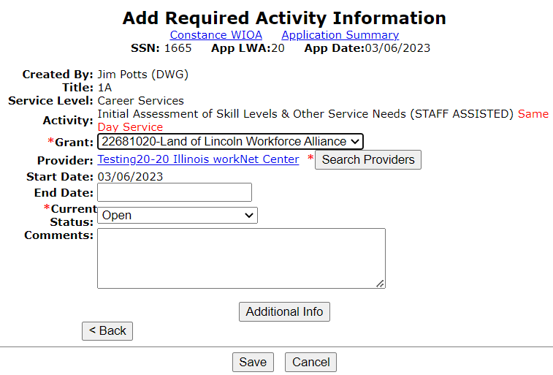
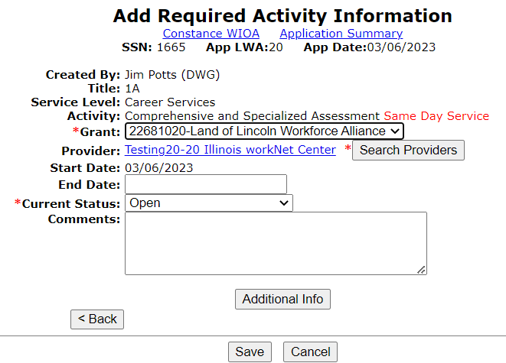
Different Types of Assessment Services
Under the new WIOA Service Matrix for an Adult and/or Dislocated Worker, there are a couple of similar assessment services, those are:

Slide 104
Different Types of Assessment Services
A recommendation would be, for an Adult and/or Dislocated Worker client, that the plan at the initial assessment is that the client will only need WIOA Career Services to obtain full-time, self-sustaining employment, then the service of “Initial Assessment of Skill Levels & Other Services Needs” would be appropriate to document as the service.

Slide 105
Different Type of Assessment Services
Where an Adult and/or Dislocated Worker client will need WIOA Training Services to regain full-time, self-sustaining employment, then a much more in-depth assessment will be needed to then the service of “Comprehensive and Specialized Assessment” would be the appropriate service to record.

Slide 106
Internal IWDS Logic Related to IEP
It is important to understand that IWDS internal logic requires the service of “Development of an IEP” for any Adult or Dislocated Worker who will receive WIOA funded training.
The new OET Career Planning Policy section 4.2.5 – Individual Employment Plan (IEP) and Individual Service Strategy (ISS); under paragraph 4., provides direction that, “The IEP, which is an individualized career service, is required to be one of the first services provided to a WIOA Title IB Adult or Dislocated Worker participant since it describes the ongoing strategy for the participant to achieve their goals.”
Within IWDS, the actual service is titled “Development of an IEP”.

Slide 107
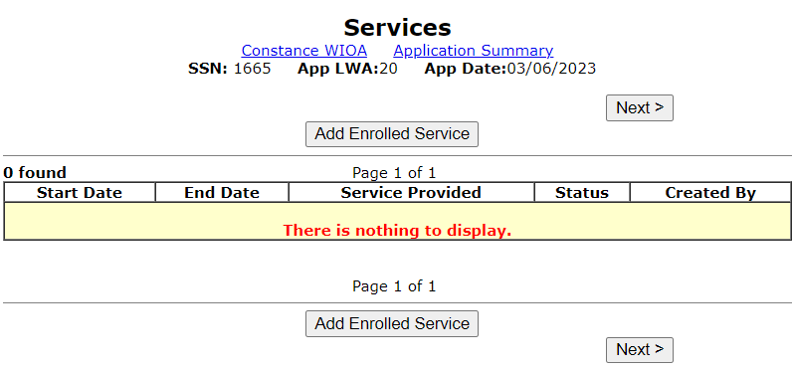
Enrollment in Services
For this example, the first service we will record will be the “Development of an IEP”; we need to move forward by clicking on either “Add Enrolled Service”:

Slide 108
Development of an IEP
Like many services, the “Development of an IEP” is a same day service, meaning it must be closed on the date it was opened.
In some services, weekly hours are required even on the same day service of “Development of an IEP”; the time can be estimated on the time it had taken to conduct the assessment and IEP.
When a same day service is “Saved”, it will require the same day service case note.

Slide 109
Same Day Service Case Note
Case notes need to be descriptive and explain relevant details of the service.
It must be understood, that case notes are really the only tool that can explain exactly what is occurring with the client.
A good case note can answer questions for any supervisor, state or federal monitor, and can be used to support any new staff member who might have responsibilities with assisting the client if the primary Career Planner is not available.

Slide 110
WIOA Services Screen
This “mock” client is now a WIOA Registrant based on enrollment of the service of “Development of an IEP”.
Any time there is a change to the IEP, an additional episode of the original “Development of an IEP” should be added with an updated same day service case note that would match the date of the latest version of the clients mutually agreed upon IEP.
Now let us record the service of the assessment that was completed.

Slide 111
Comprehensive and Specialized Assessment
As a reminder, based on guidance in the Career Planning Policy, the assessment must be recorded under the Assessment Summary screen of the application. (See previous slides 33 – 73 demonstrating recording assessment summary section.)
In this situation the client has been certified up to the Training Service level and a full blown assessment has been completed and the service of “Comprehensive and Specialized Assessment” is being recorded.
This service technically had occurred prior to the IEP, so we could have recorded it first.

Slide 112
Same Day Service Case Note
As mentioned previously, for any Adult and/or Dislocated Worker must have an assessment and the results from the assessment are the basis for the initial Individual Employment Plan (IEP) for the client.
For the same day service case note, since the entire assessment has been recorded on the “Assessment Summary” screen of this record, it would be acceptable to record a note like I have demonstrated on the adjacent screen print.

Slide 113
WIOA Services Screen
This “mock” client is now a WIOA Registrant based on enrollment of the service of “Development of an IEP”.
At anytime there is a change to the IEP, an additional episode of the original “Development of an IEP” should be added with an updated same day service case note that would match the date of the latest version of the clients mutually agreed upon IEP.
One last initial service that should be recorded on each Adult and/or Dislocated Worker is Career Planning (Case Management).

Slide 114
Next Service Every Client Should Have
Within the OET Career Planning Policy under section 4.2.6 Service Documentation (Case Management) paragraph 1., “regular contact is defined as two-way communication that occurs every thirty (30) days.
On the next slide, we will cover the same day Career Planning (Case Management) service more in-depth.

Slide 115
Service of Career Planning (Case Management)
Within WIOA services, under the Youth, Adult or Dislocated Worker is the service/activity of “Career Planning (Case Management” and this service should be recorded on the initial date of certification and each subsequent time two-way communication is conducted between the Participant and the Career Planner, via an “Additional Episode” of the original service should be recorded.
The only exception to this would be if the client has met their overall goal under WIOA, and all objectives that are laid out, and all services have been closed with no other services planned.

Slide 116
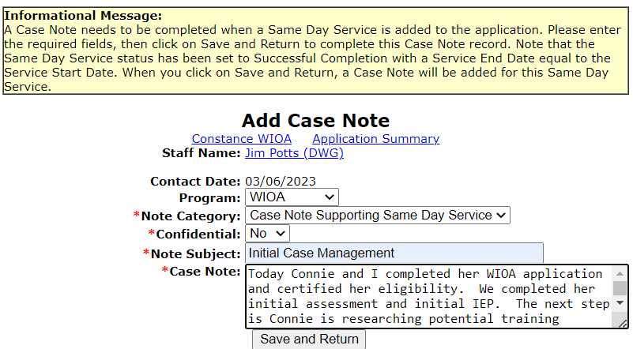
Same Day Service Case Note
Case notes for Career Planning (Case Management) should tell the story of the interaction.

Slide 117
Current WIOA Services Screen
The adjacent screen print is an example of the completed services screen after initial eligibility certification and recording the services of “Development of an IEP”, “Comprehensive and Specialized Assessment” and “Career Planning (Case Management)”.
These three services should be created on ALL new Adult and Dislocated Worker clients after certification of eligibility.

Slide 118
Recording an Additional Episode
For this example Adult client, she had been researching potential training options since our initial meeting on 3/6/2023, she returned for her follow-up appointment on 3/10/2023, and the following few slides demonstrate the “Add Additional Episode” of the Career Planning (Case Management) service.
As a reminder, each time a WIOA Adult and/or Dislocated Worker Registrant interacts with the Career Planner where an actual service has occurred, an additional episode of Career Planning (Case Management) should be added.
The exception to the statement above would be if the objectives and overall goal of the client’s IEP have been met, the client would transition to Follow-up and no longer have the Career Planning (Case Management) recorded.

Slide 119
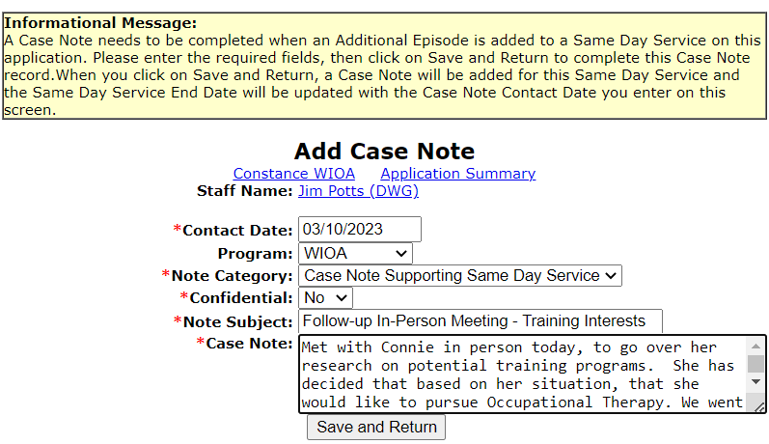
Recording an Additional Episode
After clicking on “Add Additional Episode” for the original “Service/Activity” that is considered a Same-Day-Service as was demonstrated on the previous slide, then the “Add Case Note” will come up.
Once the case note has been recorded and “Save and Return” is hit, the end date of the original Career Planning (Case Management) will be updated to reflect the 3/10/2023 date.

Slide 120
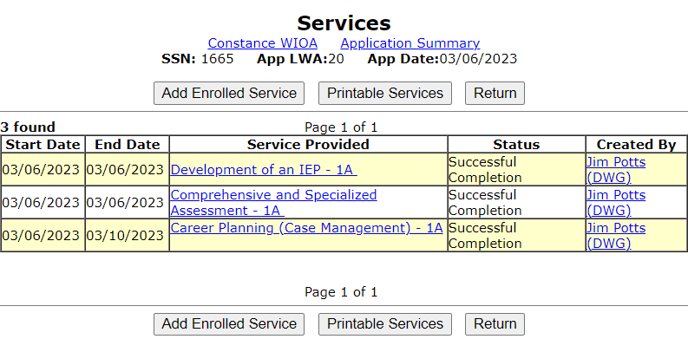
Updated Example WIOA Services Screen
As shown below, the end date to the Career Planning (Case Management) – 1A now reflects 3/10/2023.

Slide 121
WIOA Client Requirements
To ensure everyone is aware, from the Career Planning Policy it states under section 4.2.5 Individual Employment Plan (IEP) and Individual Service Strategy (ISS) guidance that;
“All active participants must have an IEP/ISS with at least one (1) open goal with at least one (1) open objective.”
Meaning, if a client does not have at least one (1) open goal with at least one (1) open objective, the client should be exited.

Slide 122
Conclusion
This concludes the presentation on Assessments, Individual Service Strategy (Youth) & Individual Employment Plan (Adult & Dislocated Worker); along with the tools within IWDS to record the assessments.
We also covered the importance of good descriptive case notes.
We demonstrated enrollment in same day services and demonstrated adding additional episodes when the subsequent activity occurs.
We discussed how enrollment in the WIOA Youth Program requires enrollment in an activity tied to one or more of the fourteen (14) Youth Elements.

Slide 123
Questions?
If you have any questions related to the content of this presentation, feel free to reach out to James (Jim) Potts by phone at (217) 299-4532 or by email at james.potts@illinois.gov

